Slide 1
BGCGW celebrated Boys & Girls Clubs Week with a host of special events. The weeklong celebration called attention the important role Boys & Girls Clubs play in the Washington area.

Slide 2
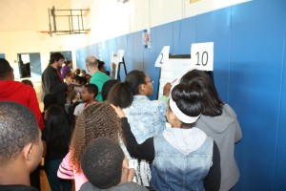
Boys & Girls Clubs of Greater Washington- Germantown Branch celebrated BGC Week with a scavenger hunt promoting character and leadership.

Slide 3
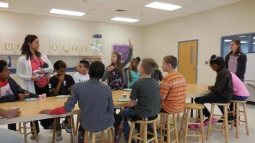
The Keystone Club Manassas Boys & Girls Club’s Iron Chef event revolved around healthy lifestyles. It educated kids about the different food groups, how much of each food group they should be eating daily, and what kind of healthy snacks to prepare in between meals. The presentation also included info about 9-5-2-1-0. (9 hours of sleep needed, 5 servings of fruits and vegetables each day, limit to 2 hours of screen time a day, 1 hour of exercise a day, & 0 sugary drinks.) 40 Club Kids ages 9-12 were in attendance that day!

Slide 4
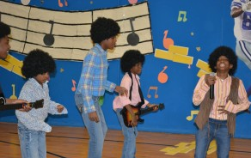
Dunbar Alexandria-Olympic Boys & Girls Club celebrated the arts and literacy. The event was filled with music, dancing and acting. Club members rehearsed lines and read lyrics. We hope the talent show encouraged our members to become writers, producers and directors!

Slide 5
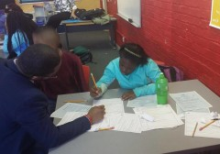
George M. Ferris Jr. Clubhouse 6 hosted an iResume and Mock Interview workshop. Club members created their first resume and conducted mock interviews with Howard scholars and other professionals.

Slide 6
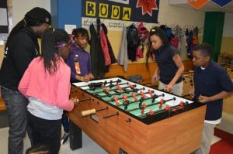
The Boys & Girls Clubs of Greater Washington- Jelleff Rec. Center held the BGCGW Triple Play Tournament. Club Kids split up into teams to battle against each other in ping pong, foosball and billiards. The winner? ARGENTINA!

Slide 7
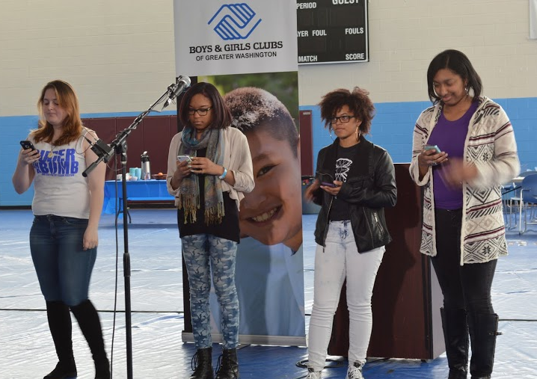
To wrap up the week, FBR Branch hosted #OurLivesMatter2. On Saturday, March 28, more than 200 middle and high school students participated in the second open forum. #OurLivesMatter2 was designed to assist youth of color with developing cultural awareness that equips them for the ongoing civic and community engagement movement taking place here and around the country

