Slide 1
Rugby World Cup 2015 Pauline Freestone, Rugby World Cup Project Officer

Slide 2
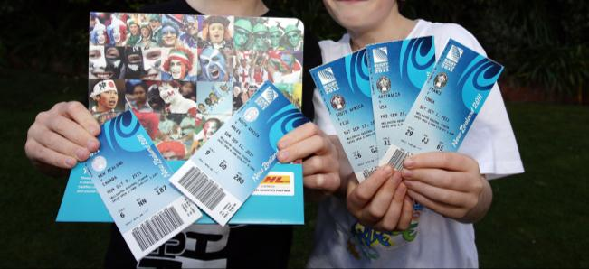
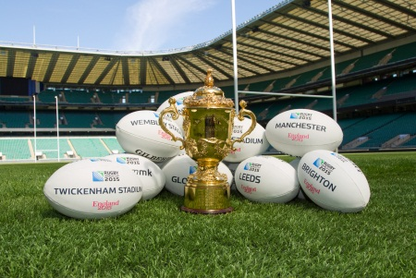
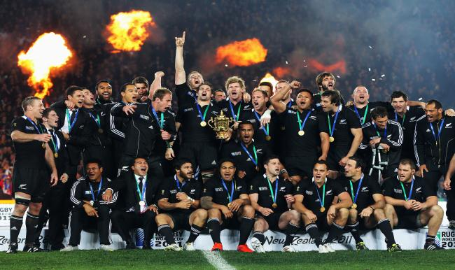
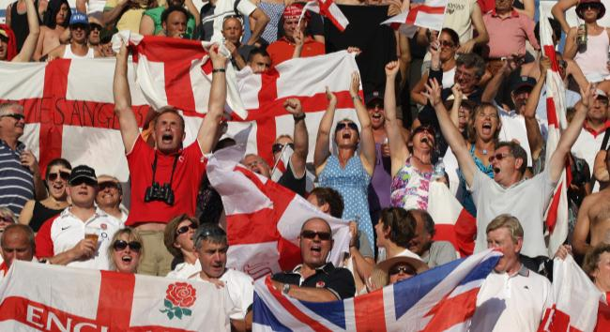
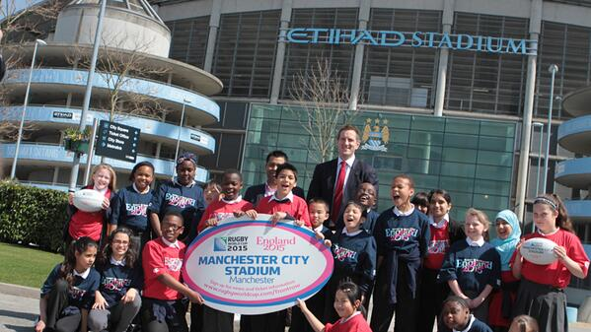
The tournament in Brighton
Saturday 19 September 2015 – South Africa v Japan, Brighton Community Stadium 16.45pm
Sunday 20 September 2015 – Samoa v USA, Brighton Community Stadium 12 noon

Slide 3
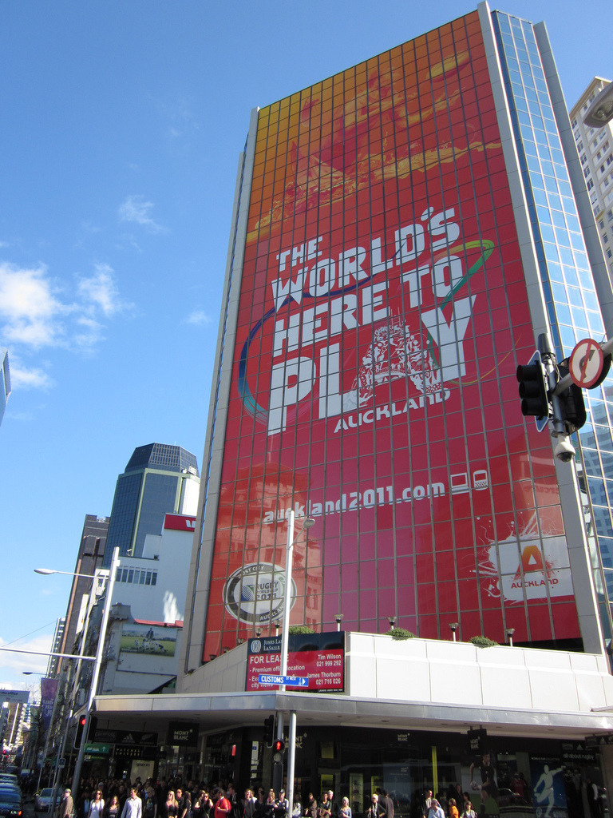
England 2015 Aims of City Delivery
Exceptional fan experience
Build excitement
National tournament, local flavour
Inward investment – tourism/events
Legacy for Rugby

Slide 4
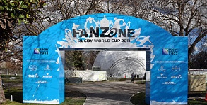
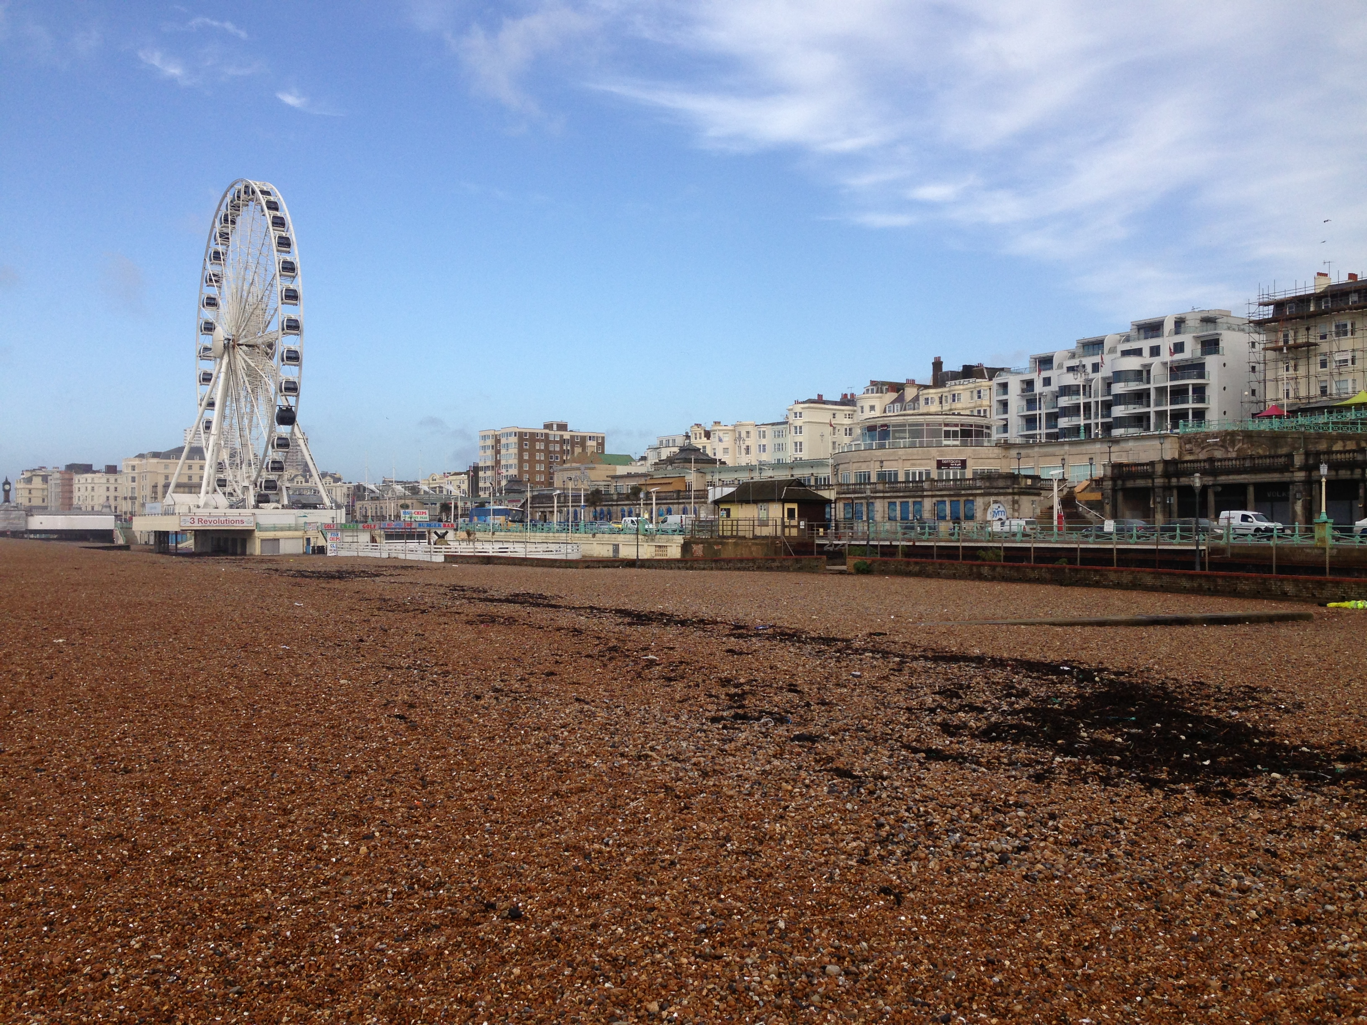
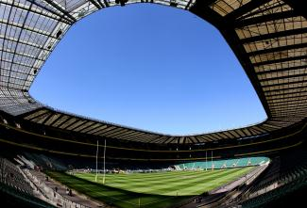
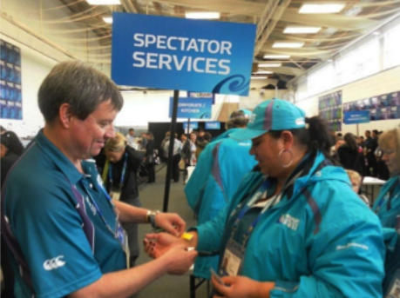
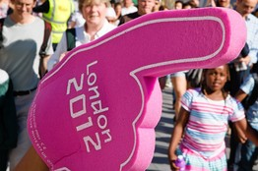
Fanzone
Brighton Beach at Madeira Drive,
free to enter
Capacity 10,000
Big screen and catering
Sponsor Activations
RFU Activation

Slide 5
Fanzone
Friday 18 September 4 - 11pm
7pm Tournament Opening Ceremony
8pm England v Fiji
Saturday 19 September 11am – 11pm
12 Noon Tonga v Georgia
2.30pm Ireland v Canada
4.45pm South Africa v Japan
8pm France v Italy
Sunday 20 September 11am – 11pm
12 Noon Samoa v USA
4.45pm Australia v Fiji
8pm France v Romania

Slide 6
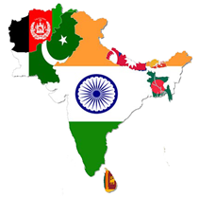
City Dressing
Mix of ER2015 dressing and bespoke creative installations
Brighton Station
Walking Route
Fanzone

Slide 7
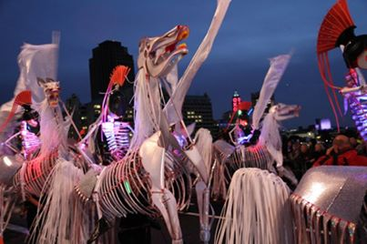
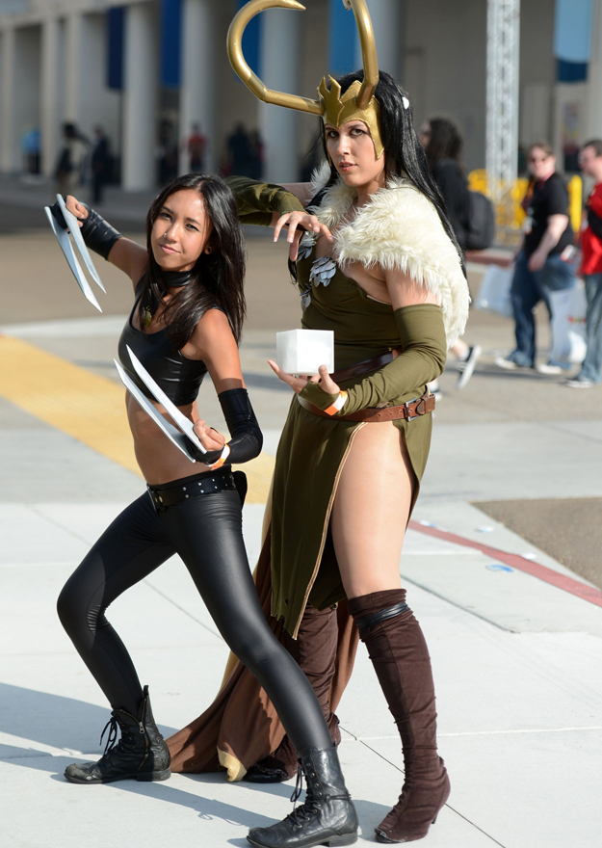
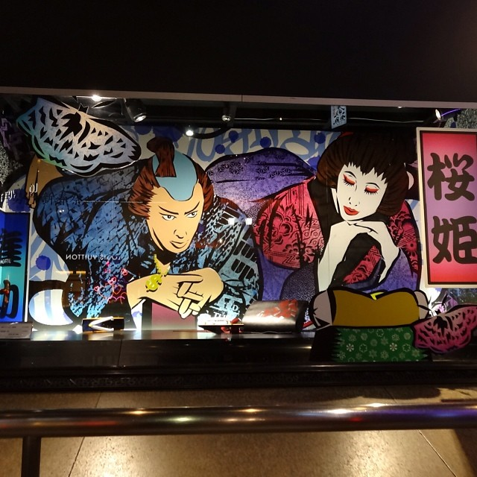
Get Involved! Festival of Rugby
TakePart – 20 June, Preston Park
The Costume Games
The Cosplay Carnival
Superheroes Music
Artists in Residence
Create your own Festival of Rugby Event

Slide 8
Team Bases University of Brighton - Samoa Brighton College - Japan Community/schools activity Welcome ceremonies

Slide 9
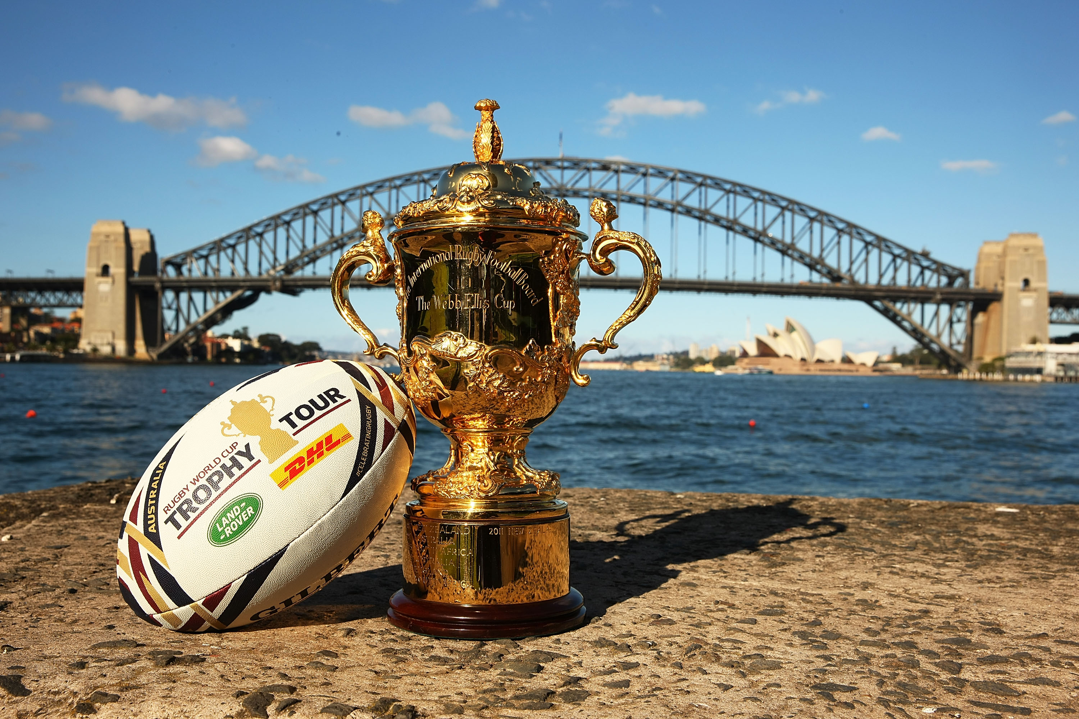
Trophy Tour
100 day continuous Tour
31 August & 1 September
Devil’s Dyke
Community Stadium
Brighton Museum
Beach Rugby
Team Bases - University of Brighton & Brighton College
Rugby Wheels
Iconic photo shoots
ER2015 Activations

Slide 10
Agenda
Questions

