Slide 1
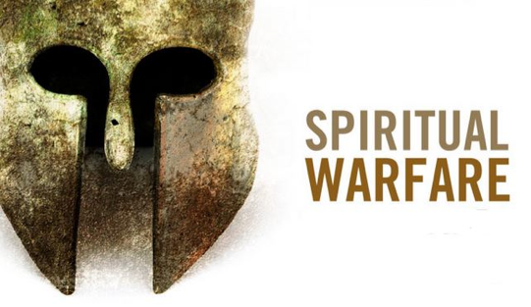
July 13th, 2014

Slide 3
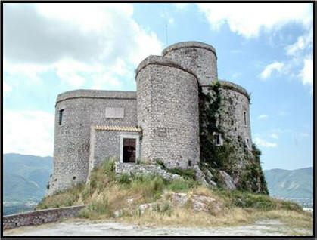
STRONGHOLD REVIEW
“ For though we walk in the flesh, we are not waging war according to the flesh. For the weapons of our warfare are not of the flesh but have divine power to destroy strongholds. We destroy arguments and every lofty opinion raised against the knowledge of God, and take every thought captive to obey Christ,” 2 Corinthians 10:3-5
Strongholds are built on LIES I believe
If I allow strongholds to remain in my life, then I am allowing destructive temptations!

Slide 4
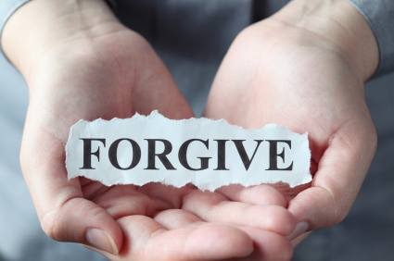
FORGIVENESS
Jesus said that his disciples will forgive as they have been forgiven (Matt. 18:21-35; 2 Cor. 2:10,11)
“ And in anger his master delivered him to the jailers, until he should pay all his debt. So also my heavenly Father will do to every one of you, if you do not forgive your brother from your heart.” – Matthew 18:33-35
Forgiveness is NOT forgetting what happened.
Forgiveness is NOT a feeling, but a choice of my will to the obedience of God.
Forgiveness DOES NOT set the person free of their consequence, but it sets me free.

Slide 5
Please no Cheating!
God created all heavenly angels for the purpose of worshiping Him?
Because Satan considered himself equal to God, he was cast from heaven?
The enemy cannot give Believers intruding thoughts?
4. Demons no longer fear God and his omnipotent power?
5. Fallen angels have specific work to accomplish on earth?

Slide 6
6. In reality, all people are involved in spiritual warfare?
7. In the book of Mark, a demon threatened to torment Jesus?
8. Christ told his disciples to celebrate because of their authority over evil spirits?
9. The thoughts in my mind will go away after time?
10. My flesh always desires to seek after God?
11. Our battles are only against the world system and the enemy?

Slide 7
12. My sins will pass down 1 – 2 generations?
13. Resisting the enemy is God’s responsibility?
14. The Biblical representation of a stronghold is a __________________?
BONUS: I will not always say what I believe, but I will always __________ what I believe.

Slide 8
ANSWERS:
God created all heavenly angels for the purpose of worshiping Him? True – Neh. 9:6
Because Satan considered himself equal to God, he was cast from heaven? True –Isa. 14:12-16
The enemy cannot give Believers intruding thoughts? False – 2 Cor. 10:3-5
4. Demons no longer fear God and his omnipotent power? F - Jam 2:19
5. Fallen angels have specific work to accomplish on earth? T – Rev.16:14

Slide 9
ANSWERS:
6. In reality, all people are involved in spiritual warfare? True - Eph 6:12
7. In the book of Mark, a demon threatened to torment Jesus? False Mk. 5:7
8. Christ told his disciples to celebrate because of their authority over evil spirits? False Lk. 10:20
9. The thoughts in my mind will go away after time? False – Col. 3:2
10. My flesh always desires to seek after God? False – Gal. 5:17
11. Our battles are only against the world system and the enemy? False – Jam. 3:15

Slide 10
ANSWERS:
12. My sins will pass down 1 – 2 generations? False – Ex. 20:5
13. Resisting the enemy is God’s responsibility? False – Jam. 4:7
14. The Biblical representation of a stronghold is a __________________? Answer: Castle
BONUS: I can always say the right thing, but I will always __________ what I believe. Answer: Live Out

Slide 11
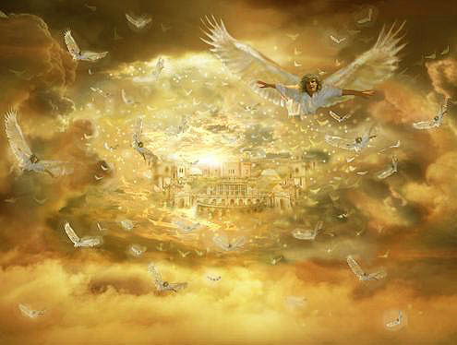
Spiritual Warfare Beginning
Ezekiel 28:12 – 18
Lucifer is a Beautiful Creation by God
Hebrew Musical Instruments in Him
Had special opportunities
Until “iniquity” was found in him
Isaiah 14:12-14
Lucifer means “morning star or bright shinning one”
Said to himself the 5 – “I wills”
Wanted to be like God (El Elyon)

Slide 12
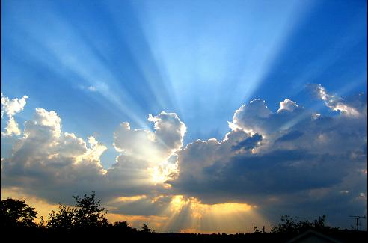
God Most High
El – Sovereign Name of God
Elyon – Supremacy over all in Heaven and Earth Realms
El Elyon – Name of God who is the Highest of the High, who is in supreme control of all.

Slide 13
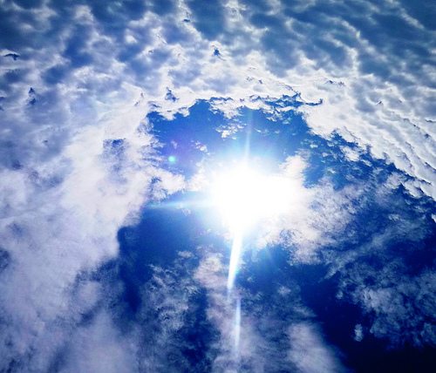
El Elyon
“When Satan and his demons, God’s prime enemies, address Him, they usually use the term El Elyon, which means Most High God. They do not use this name to curse God or to impugn His character. Rather, they call Him Most High God because that title reflects the attributes of God they lust after most.”
- Elmer Towns My Father’s Names pp54

Slide 14
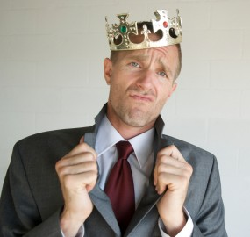
Pride Is The WORST SIN
Proverbs 6:16,17
“these six things the Lord hates, Yes, seven are an abomination to Him: A proud look, A lying tongue, Hands that shed innocent blood,”

Slide 15
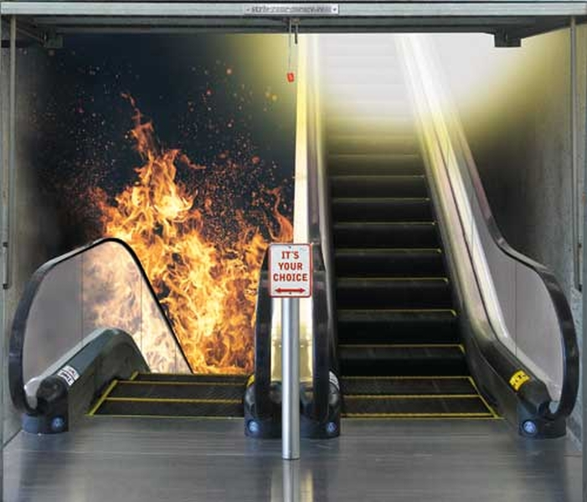
Evil Life style Starts with Pride
Proverbs 8:13
The fear of the Lord is to hate evil; Pride and arrogance and the evil way And the perverse mouth I hate.

Slide 16
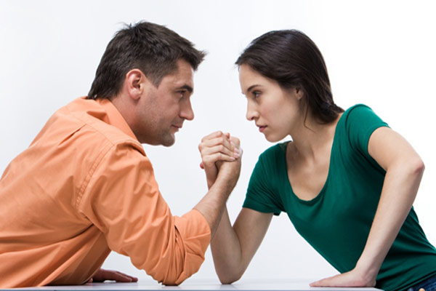
CONTENTION
Proverbs 13:10
“By pride comes nothing but strife, But with the well-advised is wisdom.”

Slide 17
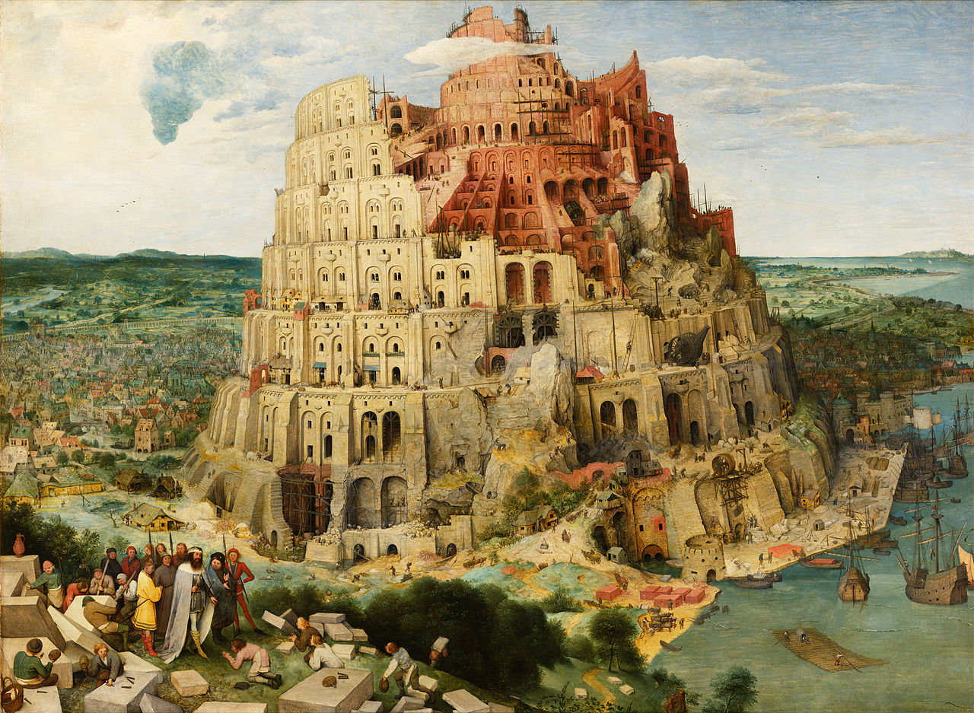
Pride DESTROYS!!!
Proverbs 11:2
“When pride comes, then comes shame ; But with the humble is wisdom.”

Slide 18
ROOT OF PRIDE
Sinful Fruits:
Anger
Unforgiveness
Addictions
Depression
Etc.
PRIDE

Slide 19
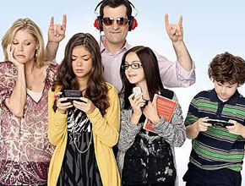
Family of Pride
Proverbs 13:5
“The Lord will destroy the house of the proud, But He will establish the boundary of the widow.”

Slide 20
How Bad is Pride?
Proverbs 16:5
“Everyone proud in heart is an abomination to the Lord; Though they join forces, none will go unpunished.”

Slide 21
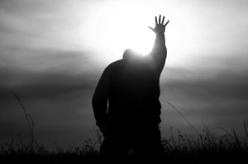
Why Is Pride So Bad?
James 4:6
“But He gives more grace. Therefore He says: “God resists the proud, But gives grace to the humble.”

Slide 22
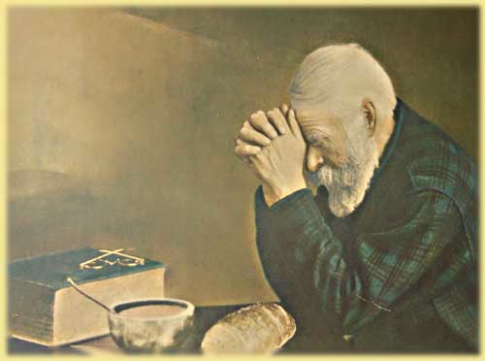
Contentment…
1 Timothy 6:6,7
“Now godliness with contentment is great gain. For we brought nothing into this world, and it is certain we can carry nothing out.”

Slide 23
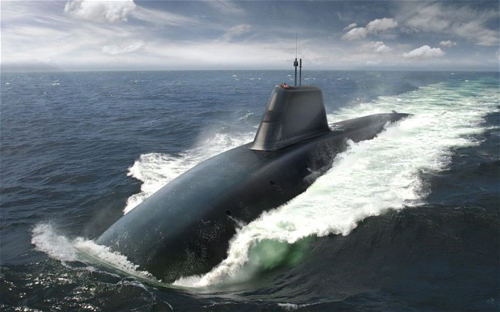
SUBMIT TO GOD…
James 4:7
“Therefore submit to God. Resist the devil and he will flee from you.”
Victory Over Temptation
Humble Yourself Before God (Jam. 4:6)
Submit Yourself to God (Jam. 4:7)
Resist the devil (Jam. 4:7)

Slide 24
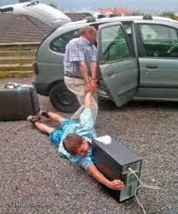
Enticed
James 1:13-15
“Let no one say when he is tempted, “I am tempted by God”; for God cannot be tempted by evil, nor does He Himself tempt anyone. But each one is tempted when he is drawn away by his own desires and enticed. Then, when desire has conceived, it gives birth to sin; and sin, when it is full-grown, brings forth death.”

Slide 25
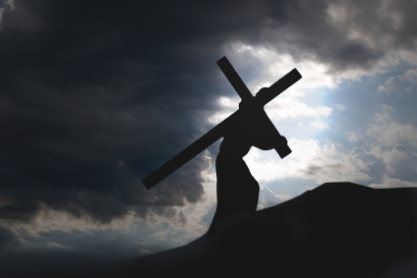
DAILY REMINDER #1
Luke 9:23
“Then He said to them all, “If anyone desires to come after Me, let him deny himself, and take up his cross daily, and follow Me.”
Deny myself = Letting Go
Take up my cross = Will of God
Follow Me = Obey the leading of the Holy Spirit

Slide 26
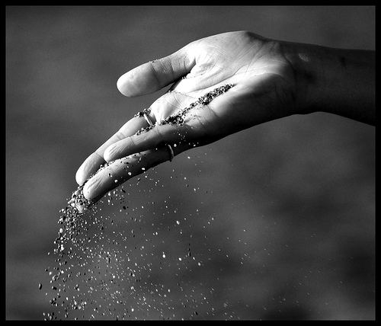
DAILY REMINDER # 2
Galatians 2:20
“I have been crucified with Christ; it is no longer I who live, but Christ lives in me; and the life which I now live in the flesh I live by faith in the Son of God, who loved me and gave Himself for me.”
A follower of Jesus has NO RIGHTS
I am commanded to Give Thanks (1 Thess. 5:18)

