Slide 1
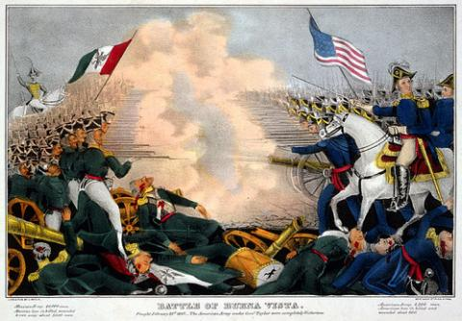
The Birth of the Mexican American

Slide 2
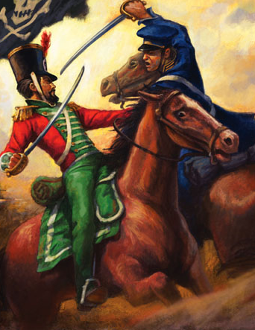
Unit Goal
After investigating and analyzing perspectives on Mexican American War through primary documents, art, corridos and cuentos students will write a argumentative essay which evaluates the impact of the annexation of Mexico’s northern territories by the United States on contemporary Mexican American culture, identity, and politics.

Slide 3
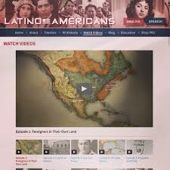
“Foreigners in their own Land”
After completing CORNELL NOTES on video, “Foreigners in their Own Lands” students will be able to write a summary that identifies significant historical contexts and issues which resulted from the Mexican American War.

Slide 4
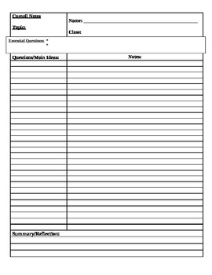
Topic: Mexican American War
Text: “Foreigners in their Own Land”
How did the “natives” become “foreigners”?

Slide 5
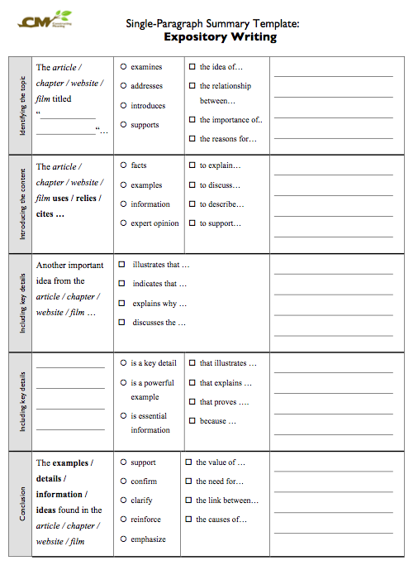
Summary Template to identify main idea and key details.

Slide 6
OBJECTIVE
After analyzing POINT OF VIEW in John Gasts’s “American Progress” and reading an excerpt of John O’Sullivan’s essay “The Great Nation of Futurity,” students will be able to identity central argument and purpose of metanarrative of Manifest Destiny by completing ANALYTICAL SUMMARIES and SOAPS Analysis.

Slide 7
ESSENTIAL QUESTIONS
Turn OBJECTIVE LANGUAGE INTO ESSENTIAL QUESTIONS

Slide 8
Metanarrative
In literal terms, a metanarrative means a "big story".
It represents, in short, an explanation for everything that happens in a society.
In Sociology, the concept of a metanarrative is sometimes referred-to as a "high level theory" or, more-usually, a perspective / ideology.
Sociological perspectives such as Functionalism, Marxism, Interactionism and Feminism are all examples of what post-modernists call metanarratives, precisely because they attempt to account for all aspects of a society in terms of the perspective and the various theories it proposes (called "mid-range" or "mid-level theories" in technical terms.
http://www.sociology.org.uk/ws1k5.htm

Slide 9
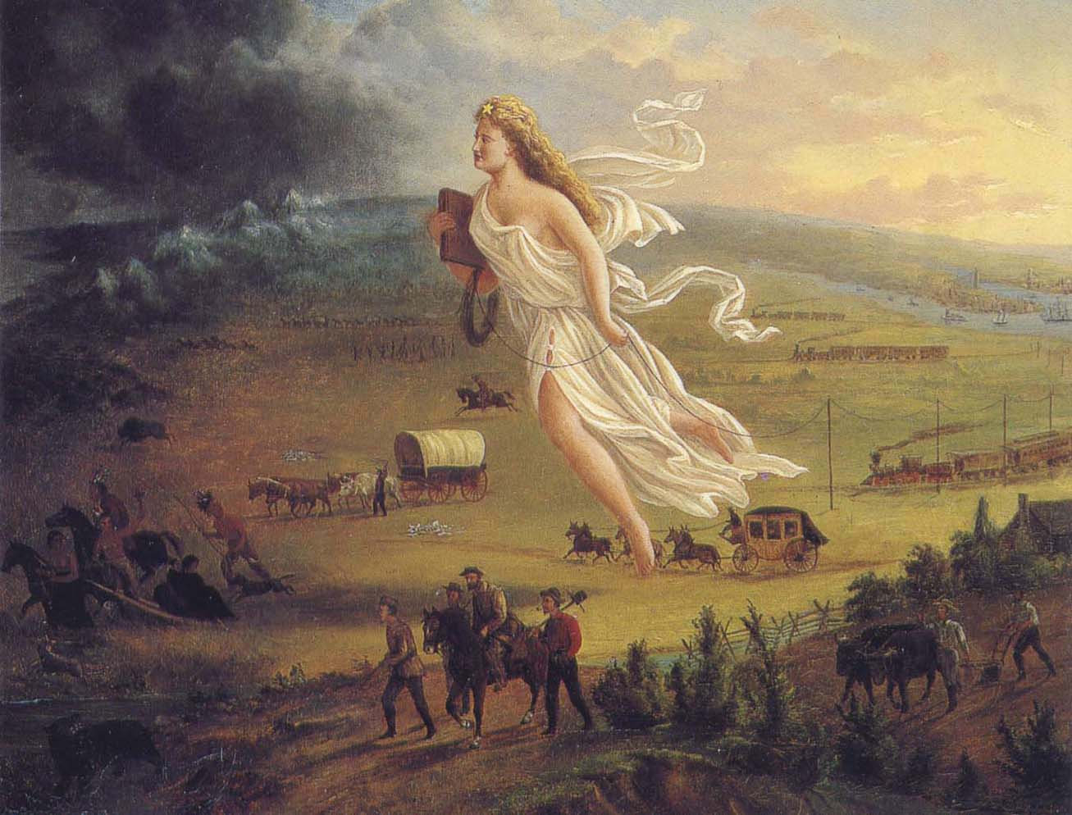
“American Progress” by John Gast

Slide 10
After you watch preview video, use circle map info to write background paragraph.
Use the following paragraph frame:
_______can be described as ______. It is the idea that ________________
________ and ________. While ________, __________became ___________in ________.
Additionally, ________________. The idea inspired ____________to ______________ by _______________.
As you watch video, fill in circle map with important information about TOPIC
Manifest Destiny
Notes:
Have students use circle map to write a paragraph on Jonathan Edwards.

Slide 11
Manifest Destiny
Manifest Destiny is a term for the attitude prevalent during the 19th century period of American expansion that the United States not only could, but was destined to, stretch from coast to coast.
This attitude helped fuel western settlement, Native American removal and war with Mexico.
The phrase was first employed by John L. O’Sullivan in an article on the annexation of Texas published in the July-August 1845 edition of the United States Magazine and Democratic Review, which he edited.

Slide 12
“American Progress” by John Gast

Slide 13
Summary Template to identify main idea and key details.

