Slide 1
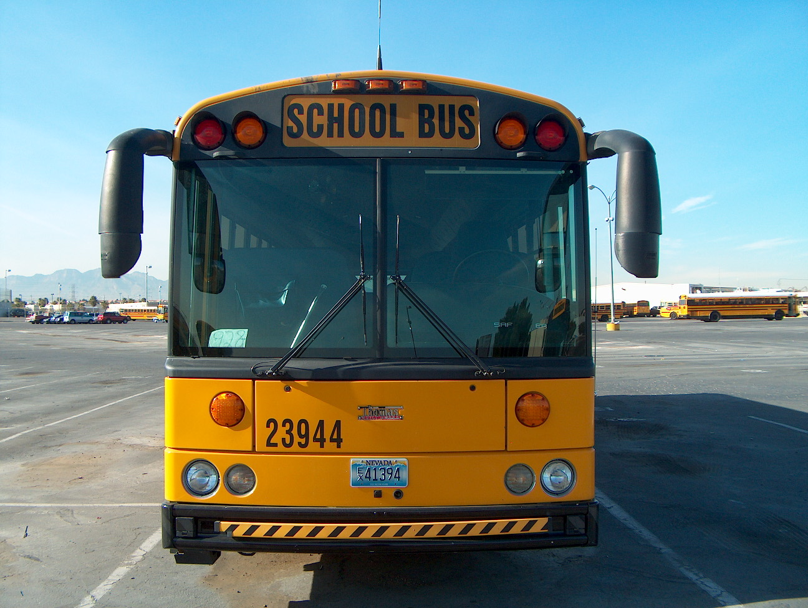
CCSD PRE-TRIP INSPECTION
ALL TRAINEES ARE REQUIRED TO KNOW THE PRE-TRIP INSPECTION BEFORE BEING RELEASED FROM TRAINING. YOU WILL HAVE TO LEARN THE NAMES AS WELL AS THE DEFECTS OF ALL THE REQUIRED COMPONENTS. IT IS ULTIMATELY YOUR RESPONSIBILITY TO APPPLY YOURSELF AND LEARN THE CCSD PRE-TRIP PROCEDURES

Slide 2
PROCEDURE #1 The Approach
Leaning to one side
Major fluid leaks such as oil, fuel, coolant etc.
Any damage not recognized from the previous day.
Smell for any unusual odors.

Slide 3
THE ENGINE COMPARTMENT
Air Compressor, Alternator, Water Pump, Power Steering Pump, Hoses & Wires, Oil, Coolant, Transmission Fluid, Power Steering Fluid

Slide 4
PROCEDURE # 1 The Engine Compartment
CCSD POLICY
NEVER OPEN THE ENGINE COMPARTMENT WITH THE ENGINE RUNNING!!!

Slide 5
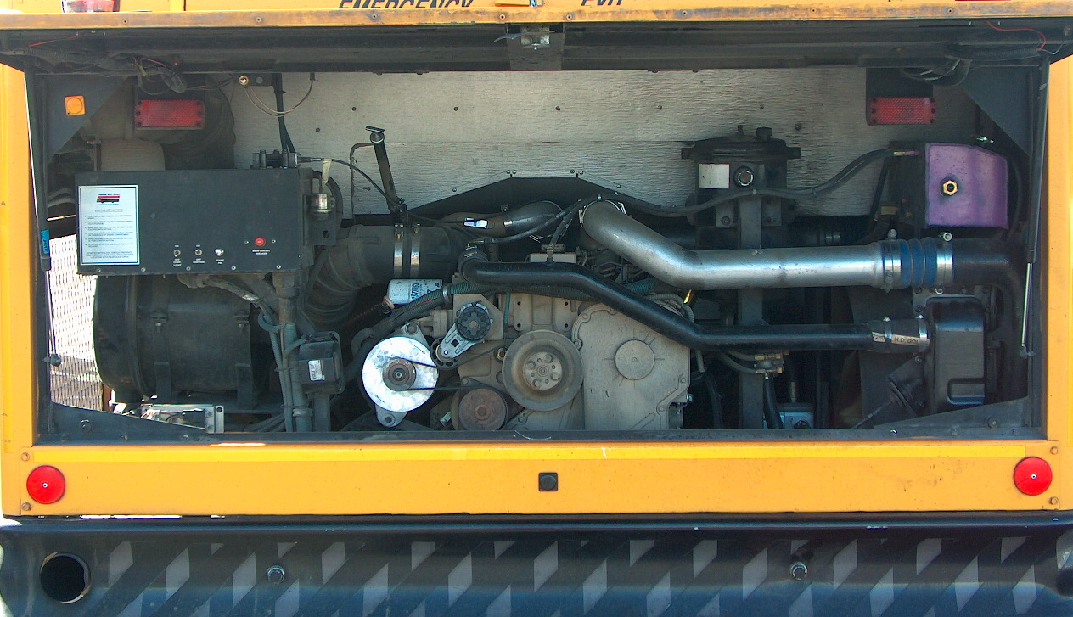
HOSES / WIRES
Hoses
Wires

Slide 6
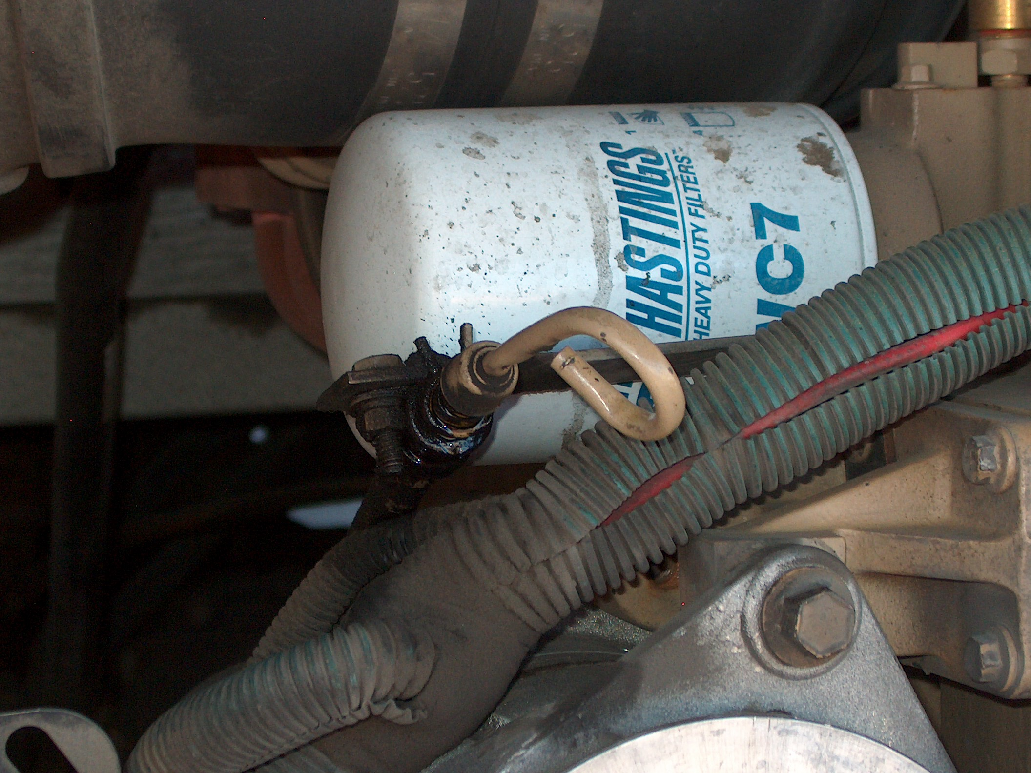
OIL DIPSTICK
Indicates where the dipstick is located.
See that the oil level is within safe operating range, above the refill mark.

Slide 7
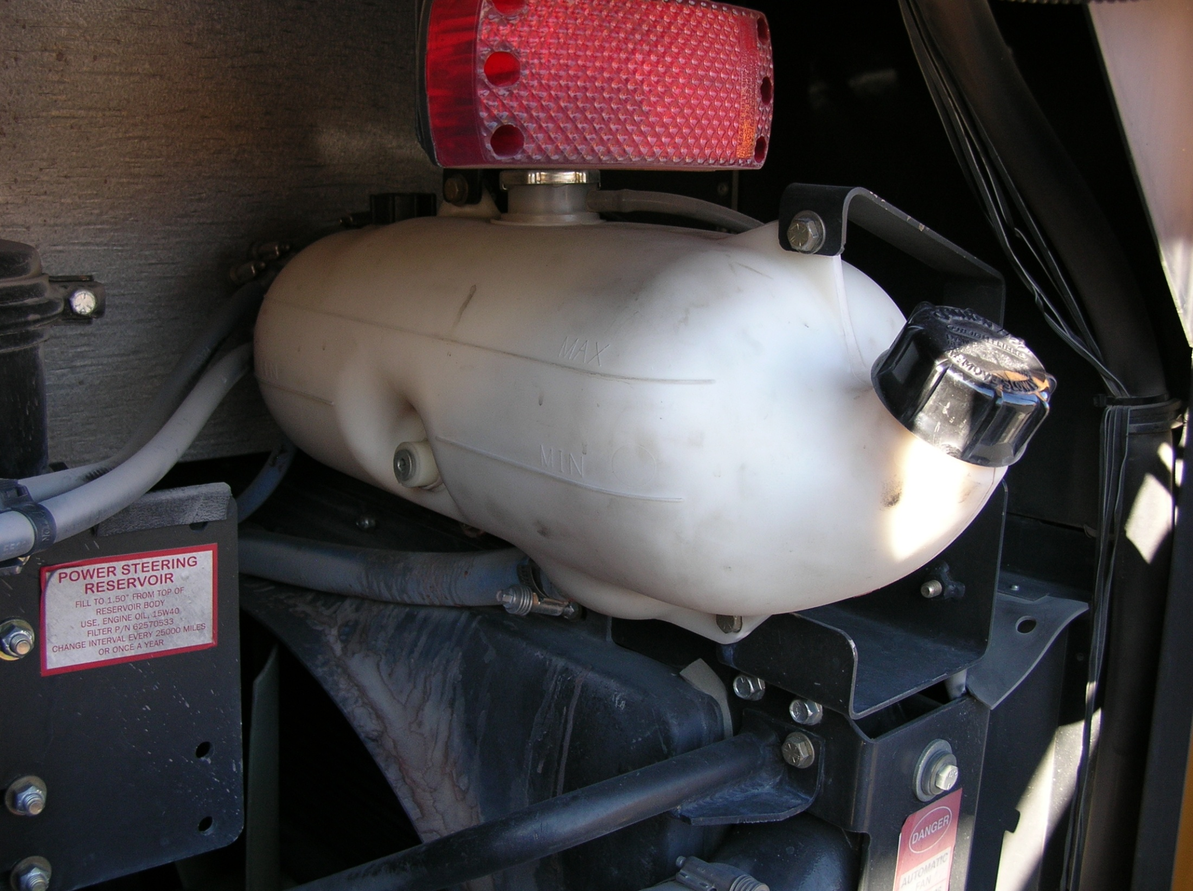
COOLANT
Inspects reservoir sight glass, or if bus has plastic cylinder, shake tank from side to side to see coolant level.
CCSD Policy: never remove the radiator cap. Take the bus to the garage.

Slide 8
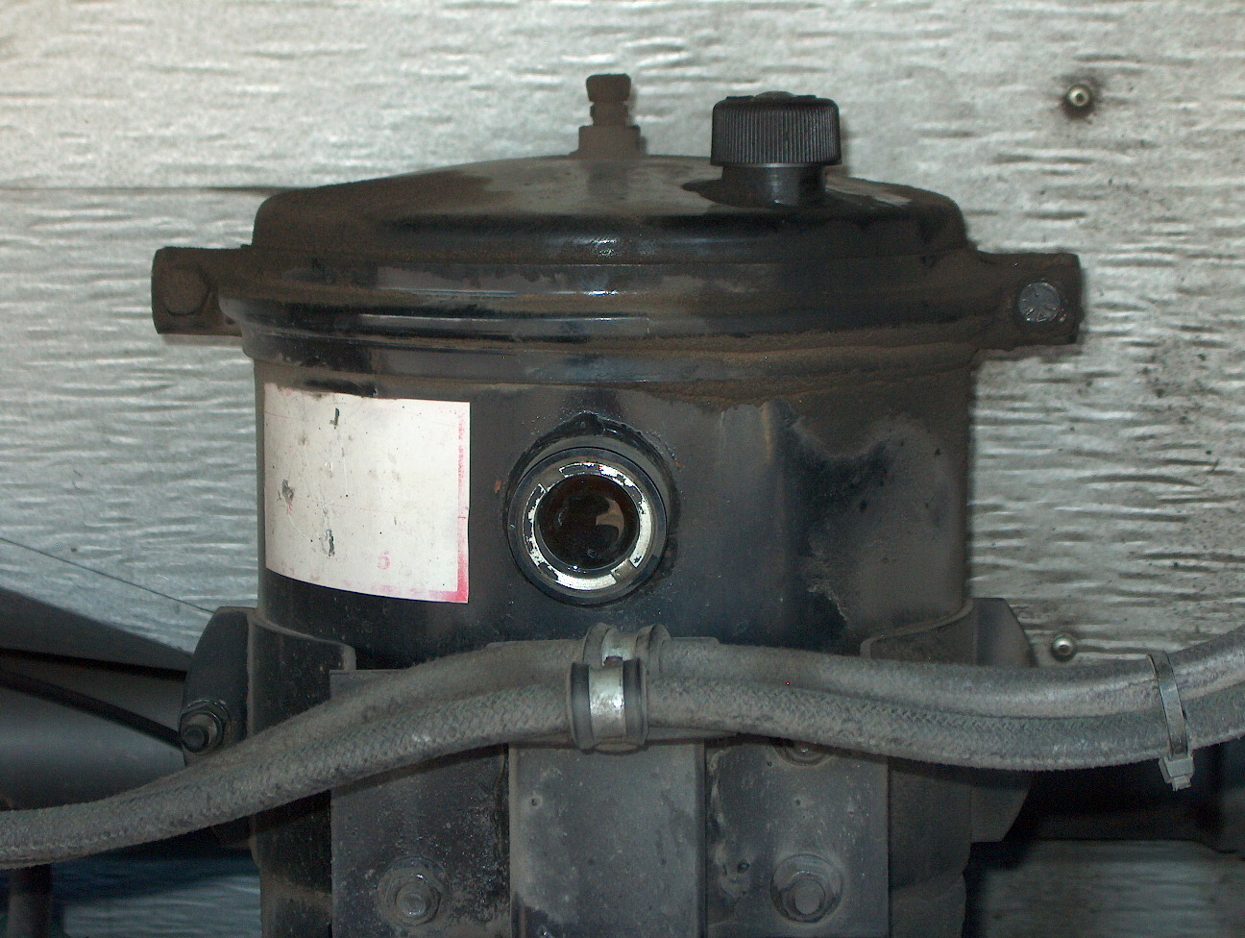
Power Steering Fluid
Indicate where power steering fluid dipstick is located.
Check for adequate power steering fluid level.
Level must be above the refill mark.

Slide 9
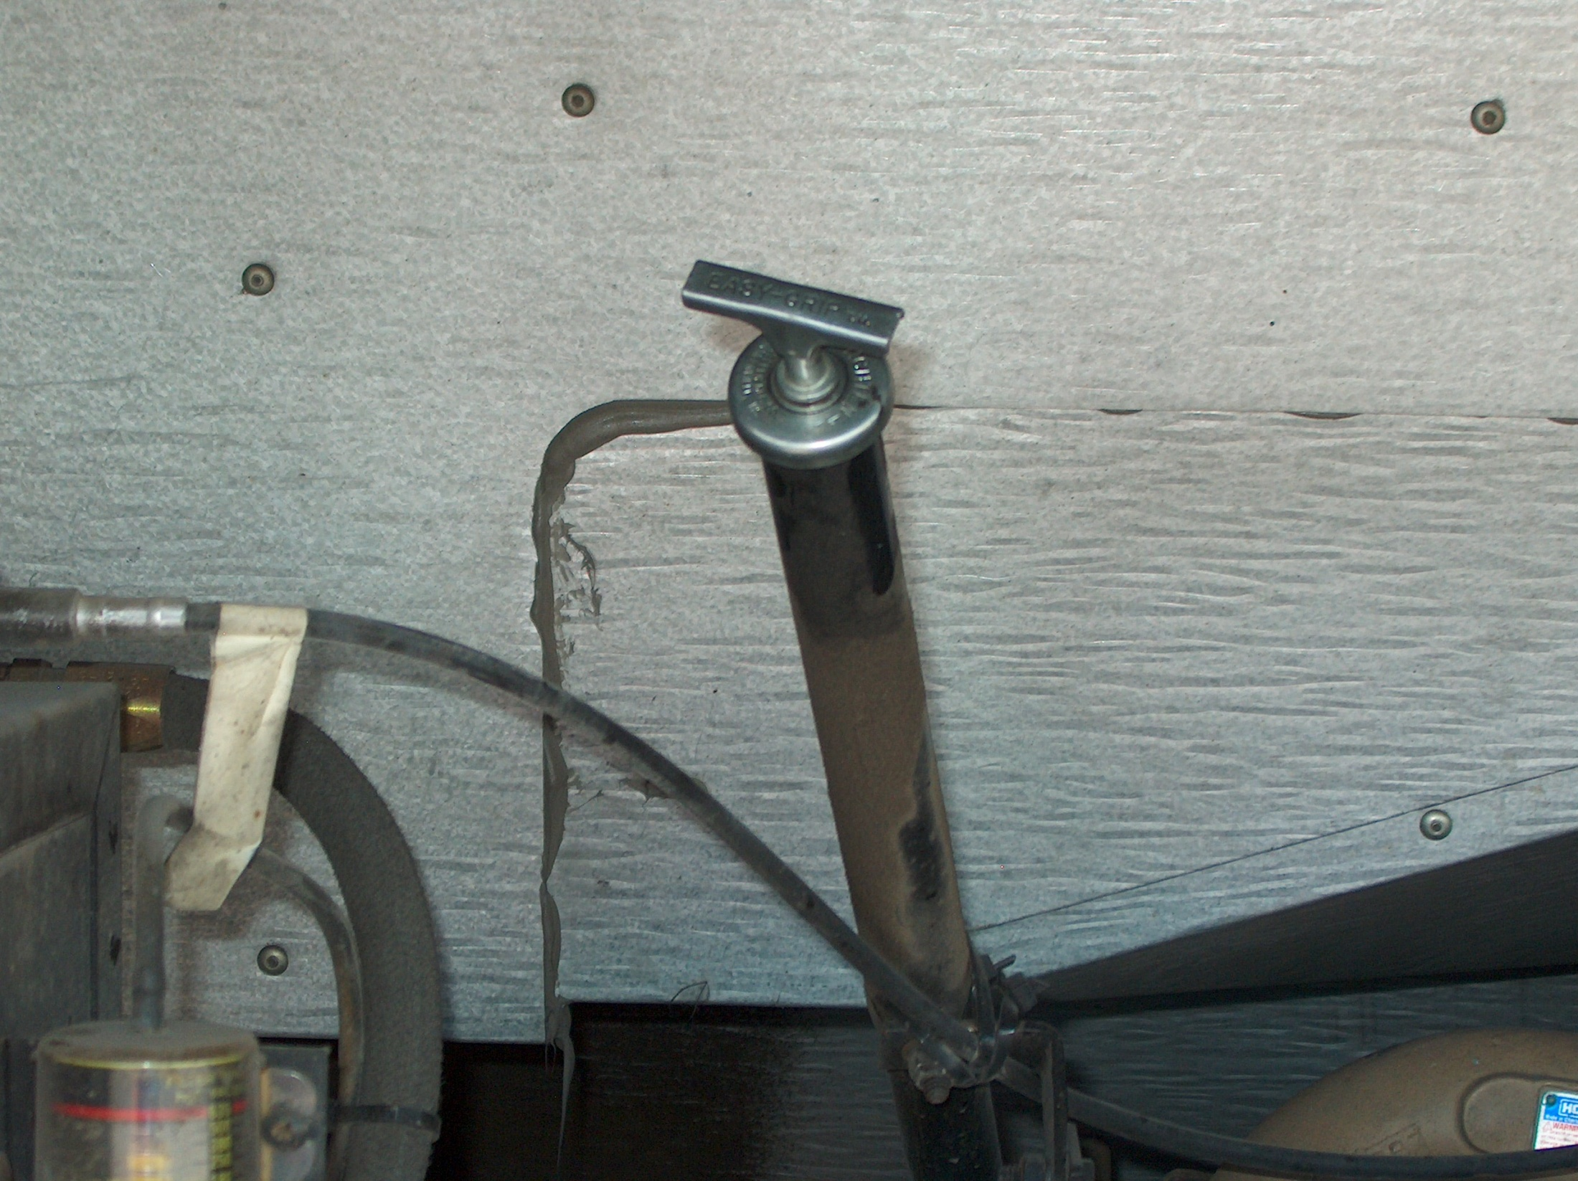
Transmission Fluid
Pull dipstick to verify there is fluid on it.
(note) The normal way to check the transmission level would be with the bus running and engine warm. For your safety all we need to know is if there is fluid on the dipstick.

Slide 10
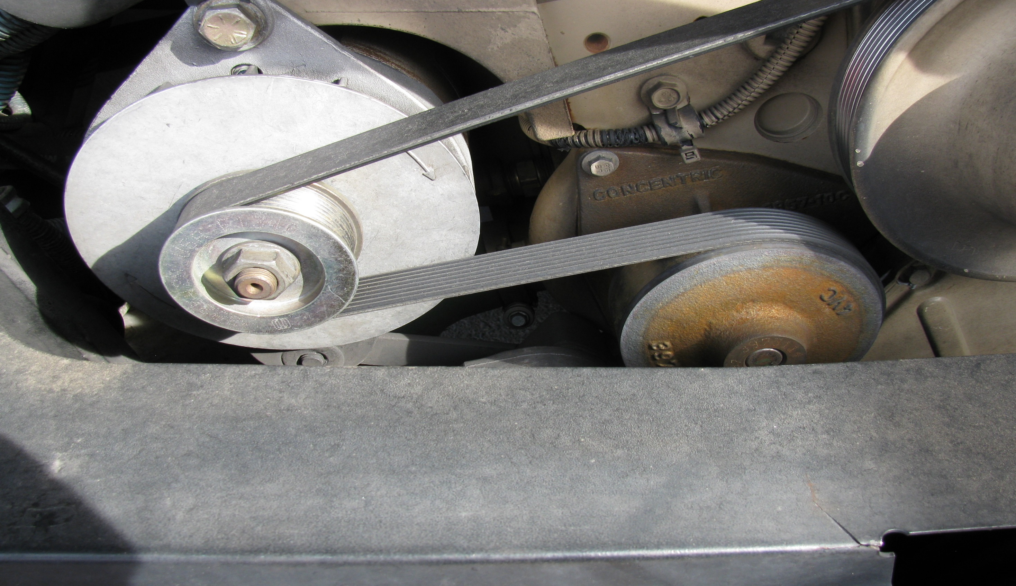
ALTERNATOR
WATER PUMP
BELT DRIVEN

Slide 11
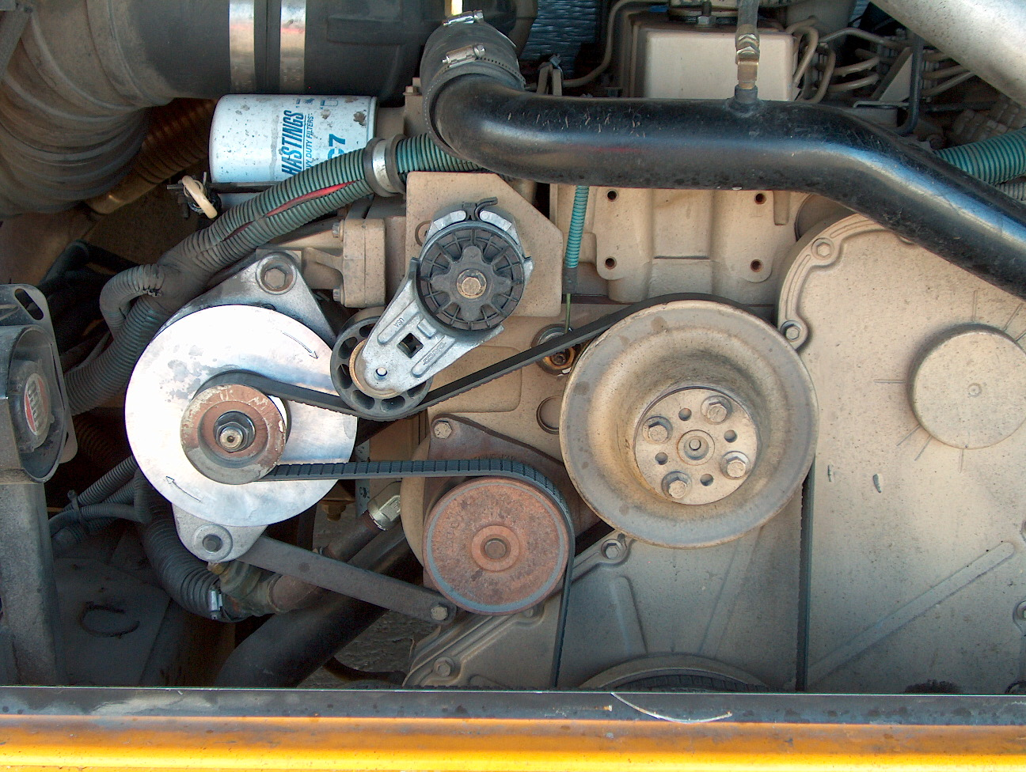
Serpentine Belt
Check the following belts for snugness (up to, but no more than ¾ inch of play at the center of the belt), cracks, or frays.

Slide 12
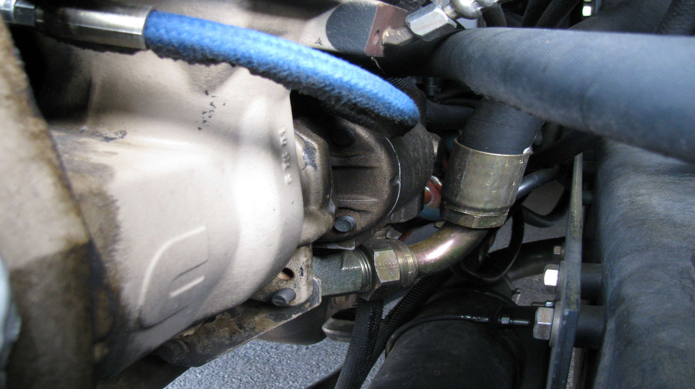
AIR COMPRESSOR
POWER STEERING PUMP
Component(s) Not belt DRIVEN

Slide 13
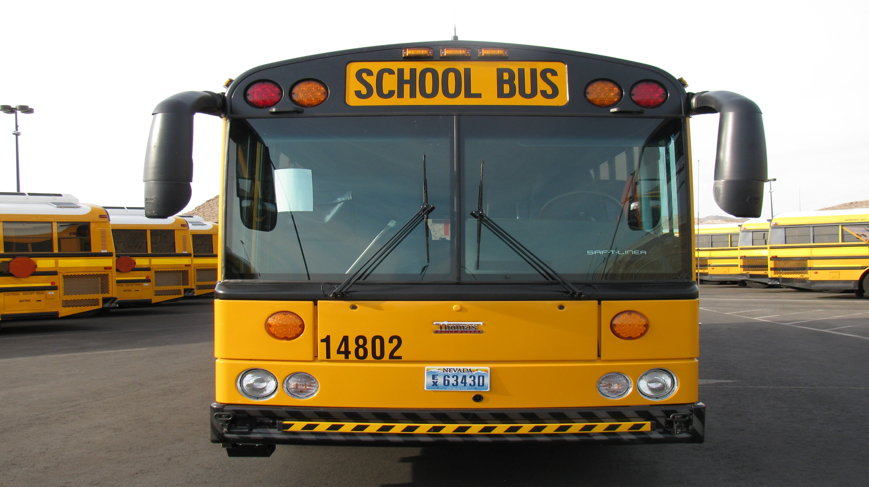
Procedure #2
Front and Under View
Check that all external lights, and reflective equipment are clean and functional.
Light and reflector checks include:
Clearance lights
Student lights (Yellows and Reds)
Turn signal / 4 way Flasher
Head lights (High and Low Beams)

Slide 14
Windshield
Should be clean with no illegal stickers, no obstructions or damage to the glass.
Crossing Arm
Checks that it is securely mounted to the bumper and not damaged.

Slide 15
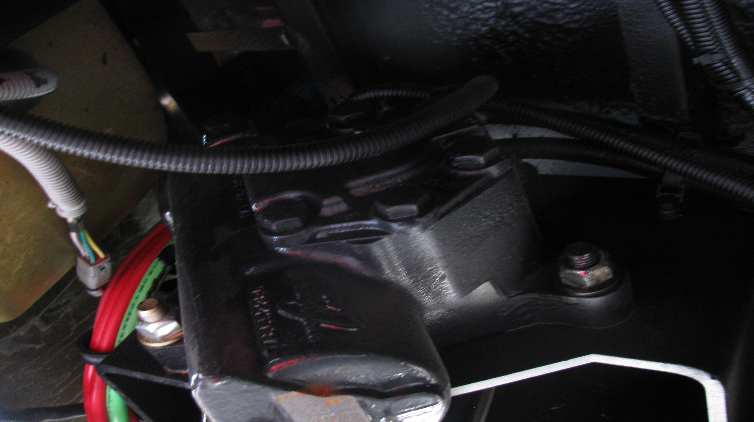
Steering Gear Box
Hoses
Check that the steering box is securely mounted and not leaking.
Looks for any nuts, bolts, or cotter keys.
Checks for power steering fluid leaks, and damage to power steering hoses.

Slide 16
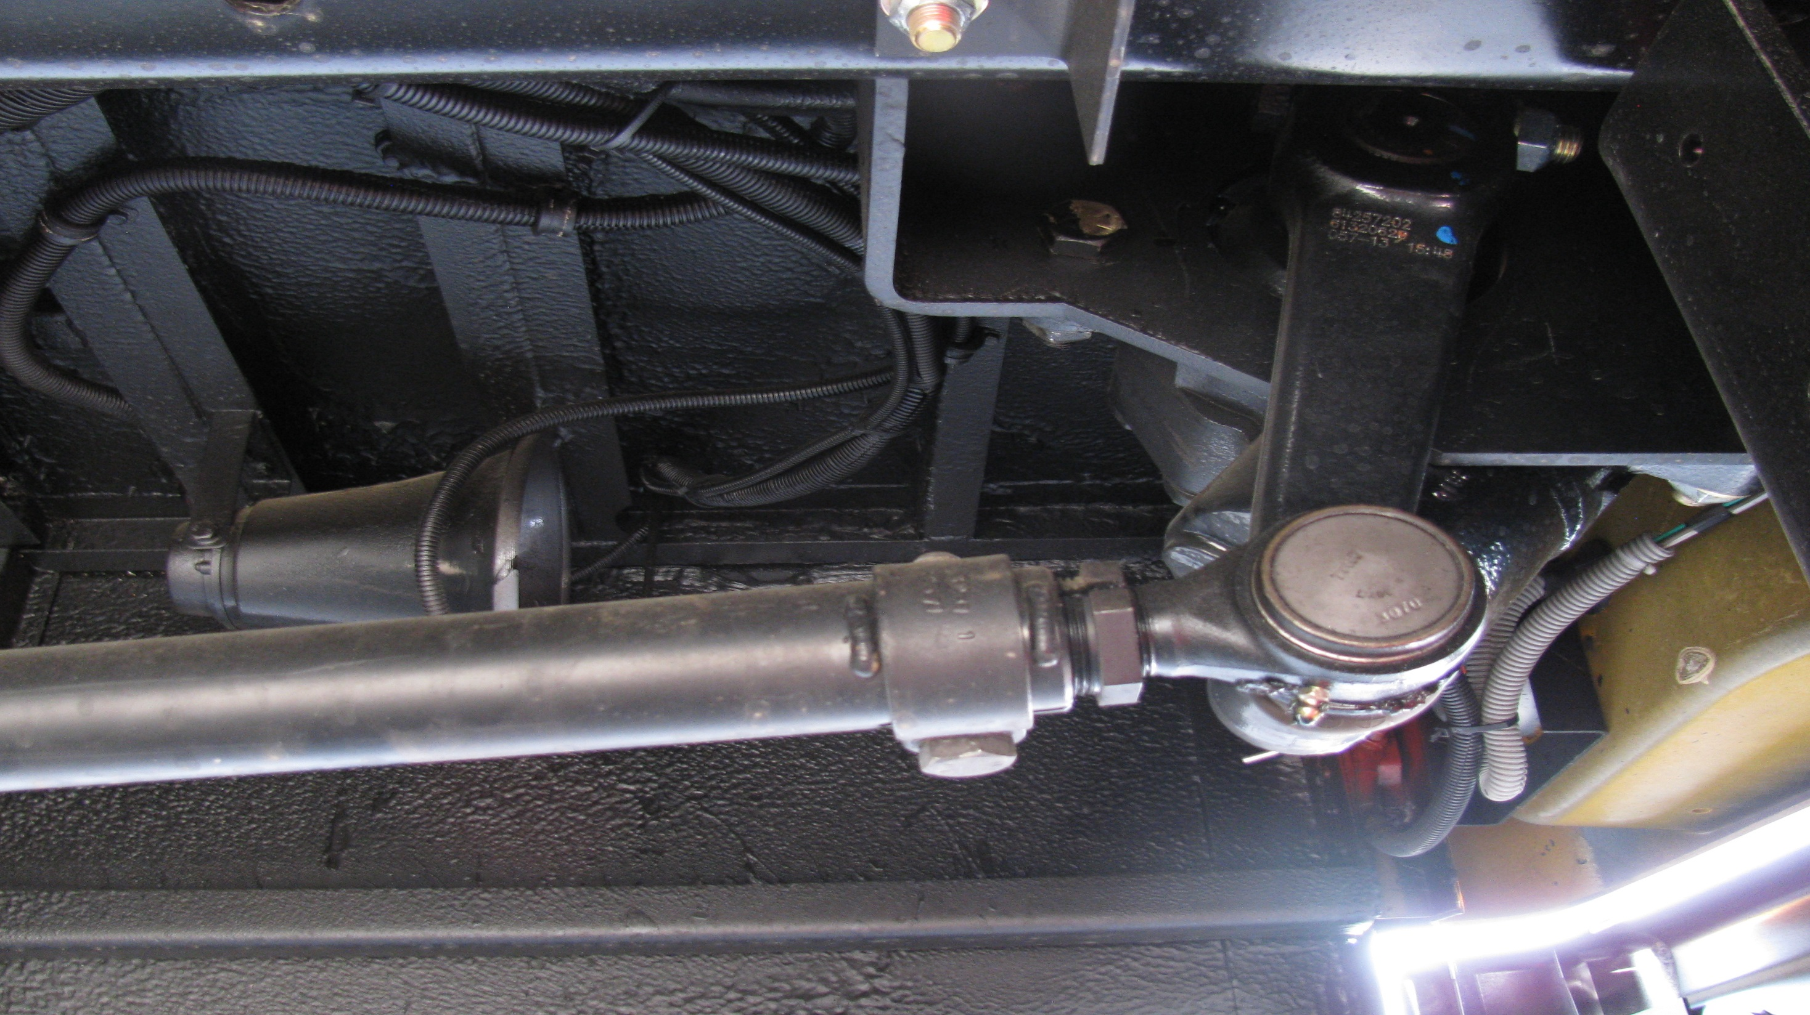
Steering Linkage
Pitman Arm
Checks that connecting links, arms, and rods, from the steering box to the wheel, are not worn or cracked.
Checks that the joints and sockets are not worn and loose.
Checks for loose or missing nuts, bolts, or cotter keys.
Drag Link

Slide 17
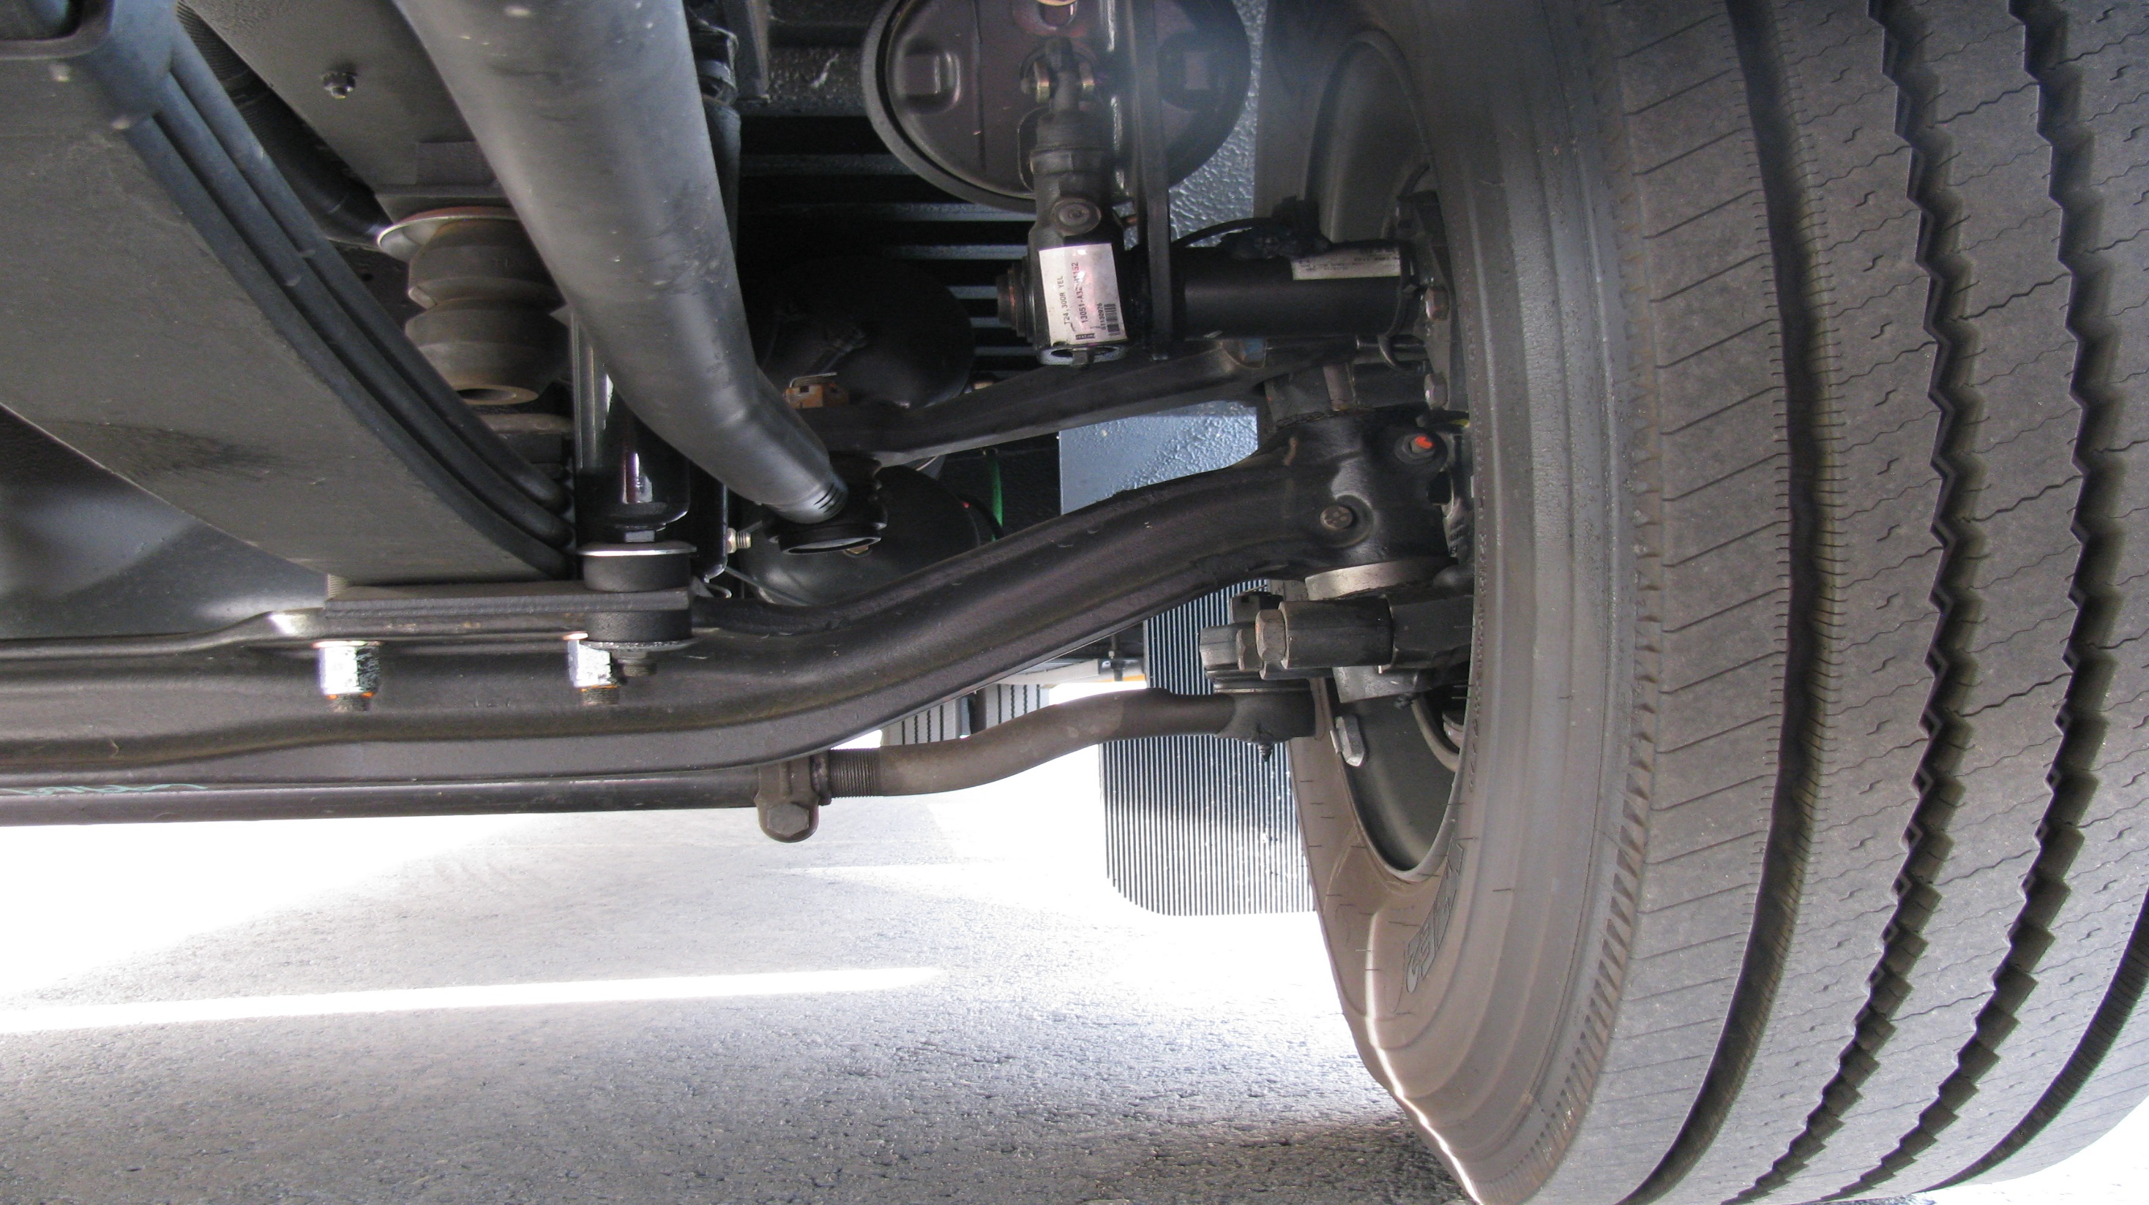
Upper Arm
Lower Arm
Tie Rod
Checks that connecting links, arms, and rods, from the steering box to the wheel, are not worn or cracked.
Checks that the joints and sockets are not worn and loose.
Checks for loose or missing nuts, bolts, or cotter keys.

Slide 18
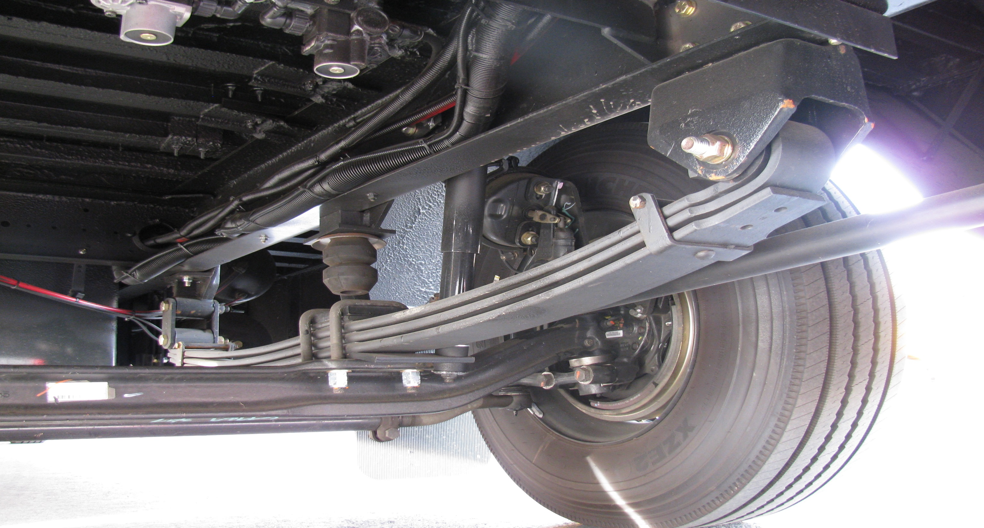
Mounts/Hangers
Suspension
U-bolts
Looks for cracked or broken spring mounts. (hangers).
Missing or damaged bushings.
Broken, loose or missing bolts, u-bolts, or other axle mounting parts. (mounts should be checked at each point where they are secured to the vehicle frame and axles)

Slide 19
See that the shock absorbers are secure and that there are no leaks
Shocks
Springs
Looks for missing, shifted, cracked, or broken leaf springs.

Slide 20
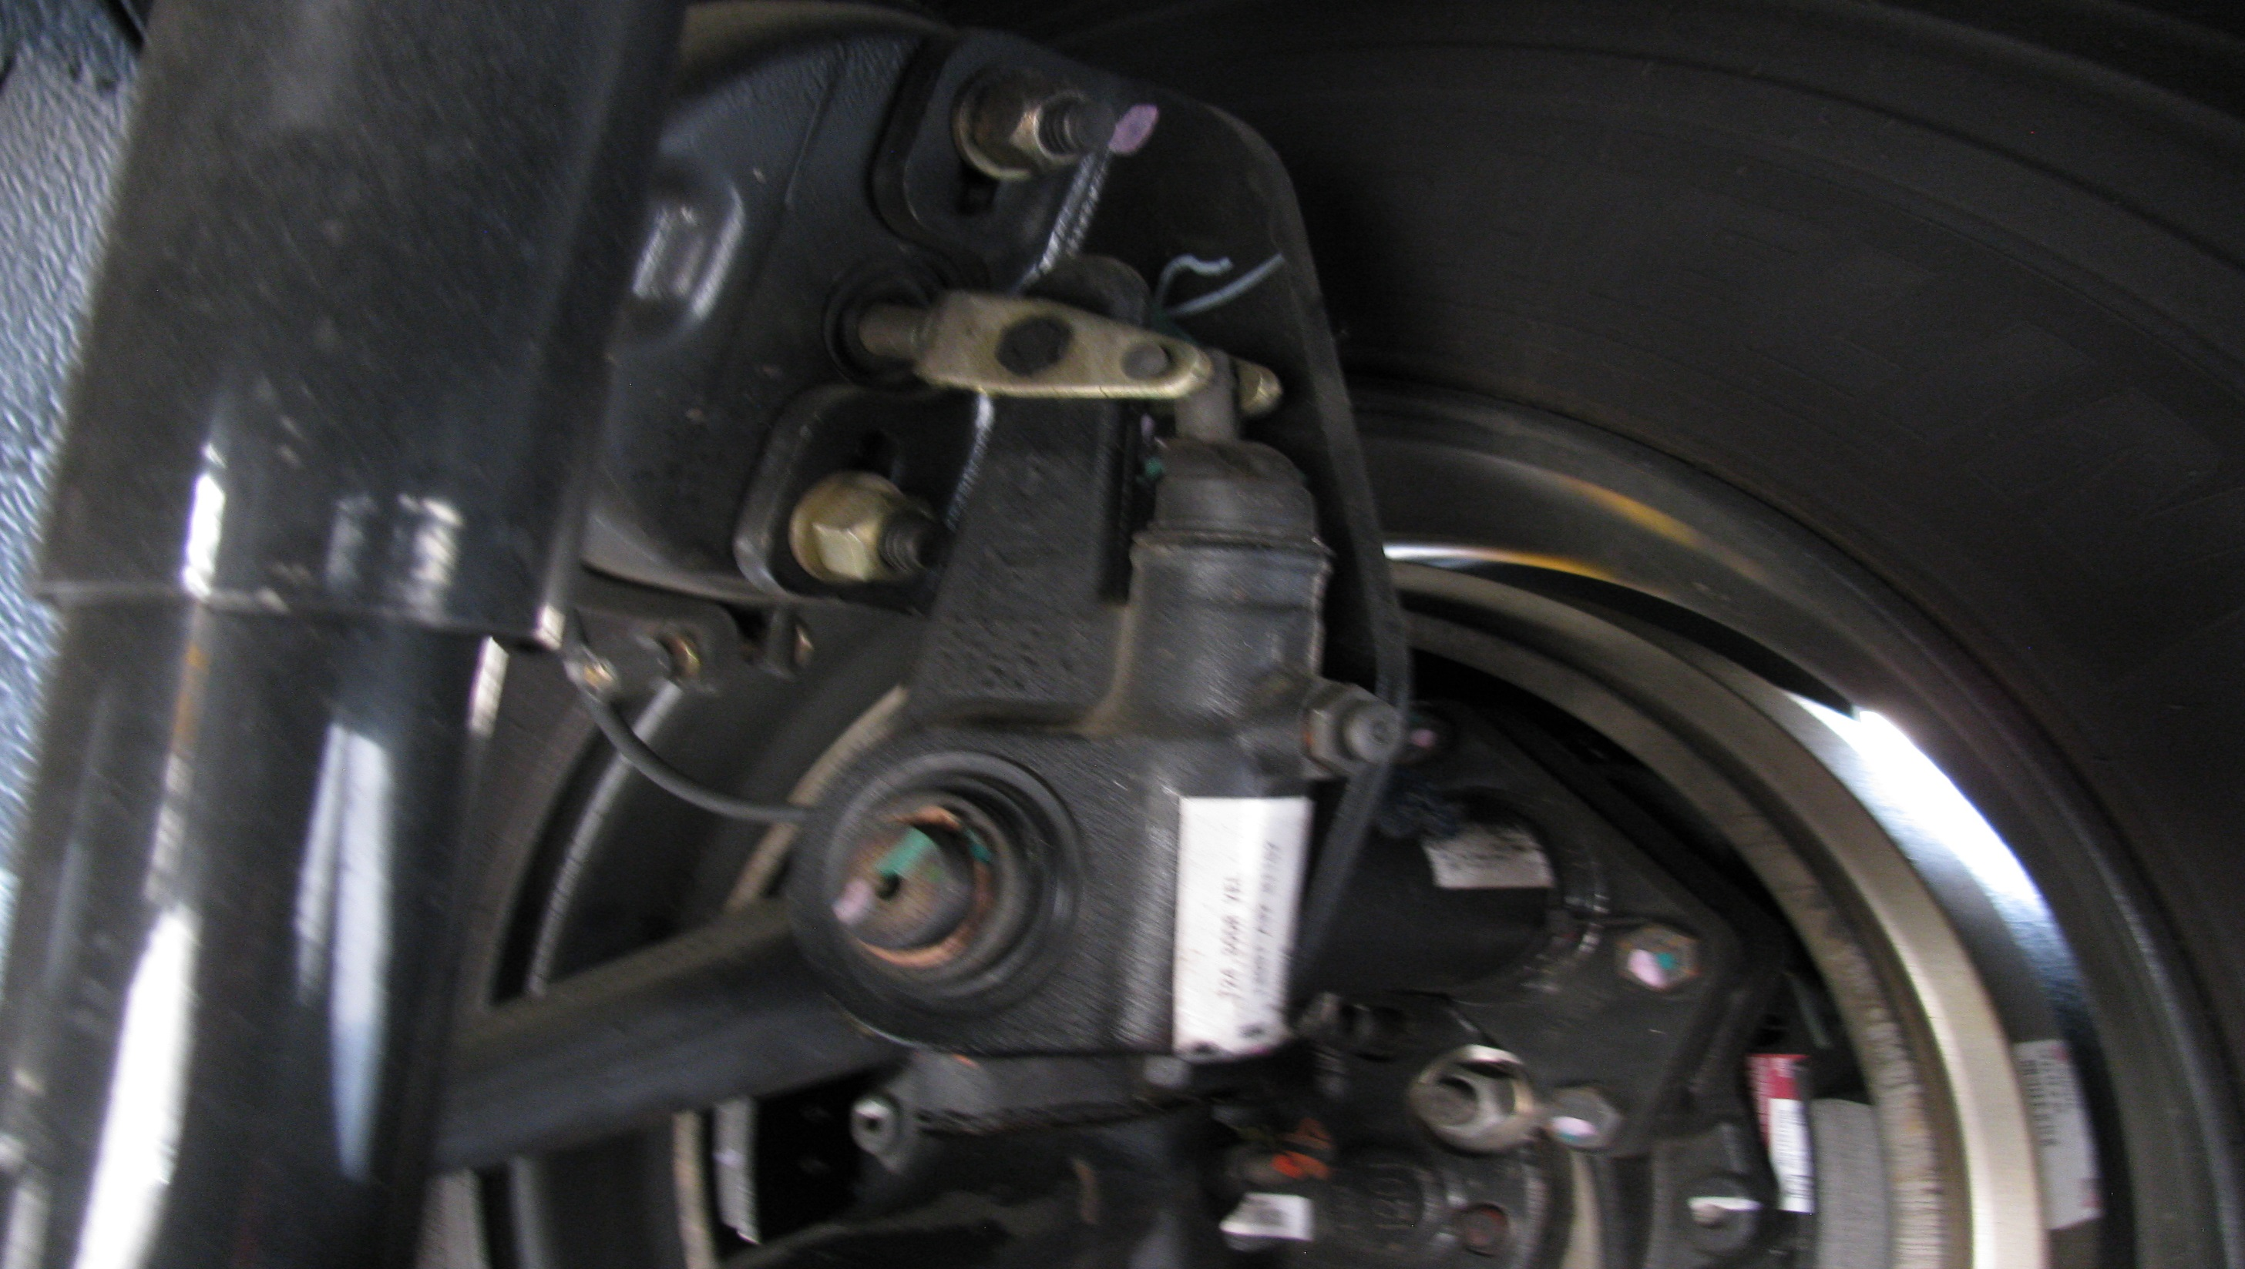
Brakes
Push Rod
Slack Adjuster
Checks for broken, loose, or missing parts.
When Pulled by hand brake push rod should not move more than one inch (with brakes released)

Slide 21
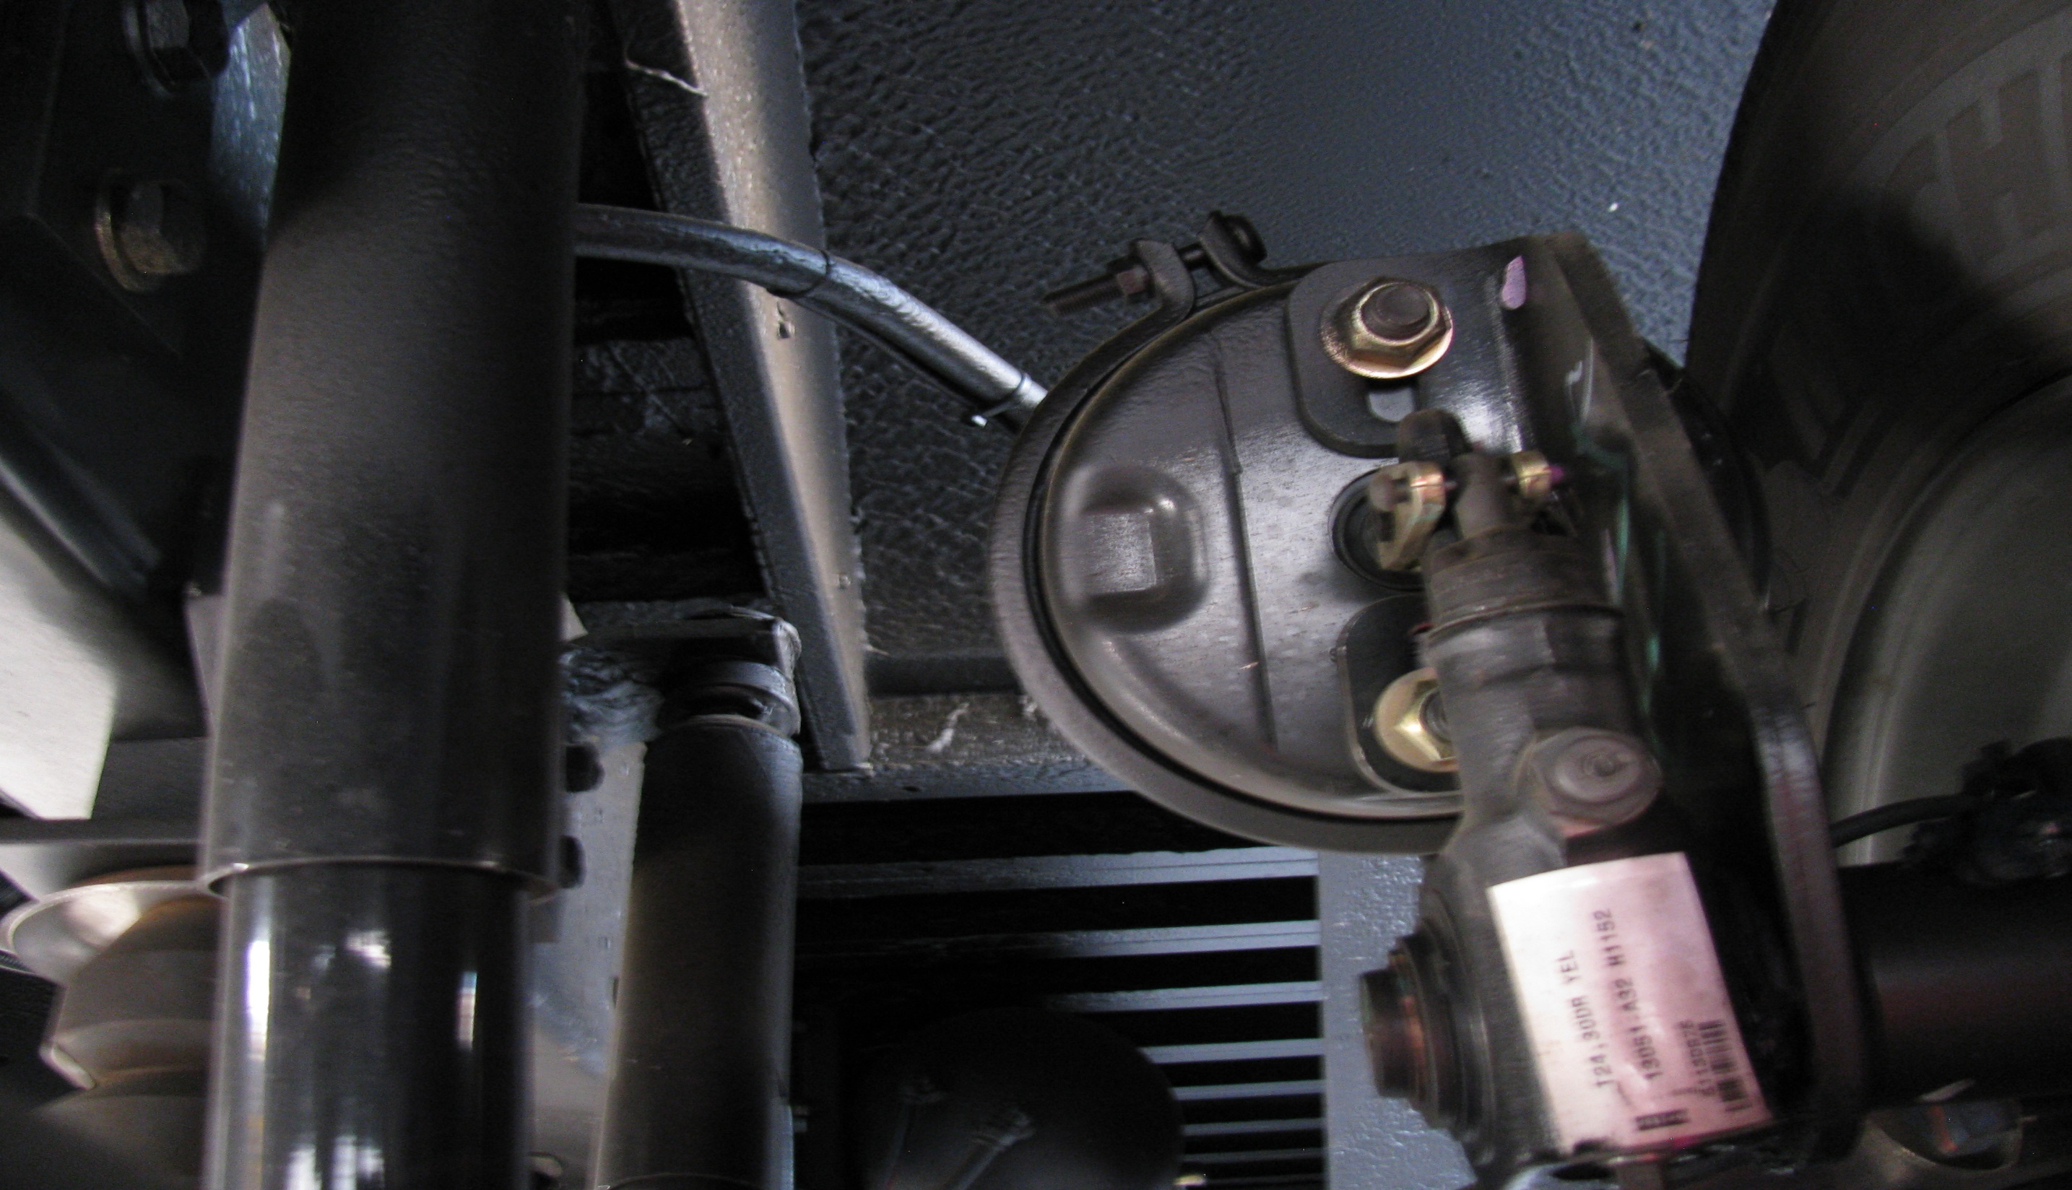
Brake hose/lines
Brake Chamber
See that the chambers are not leaking, cracked, or dented and mounted securely.
Looks for cracked, worn, or leaking hoses, lines and couplings.

Slide 22
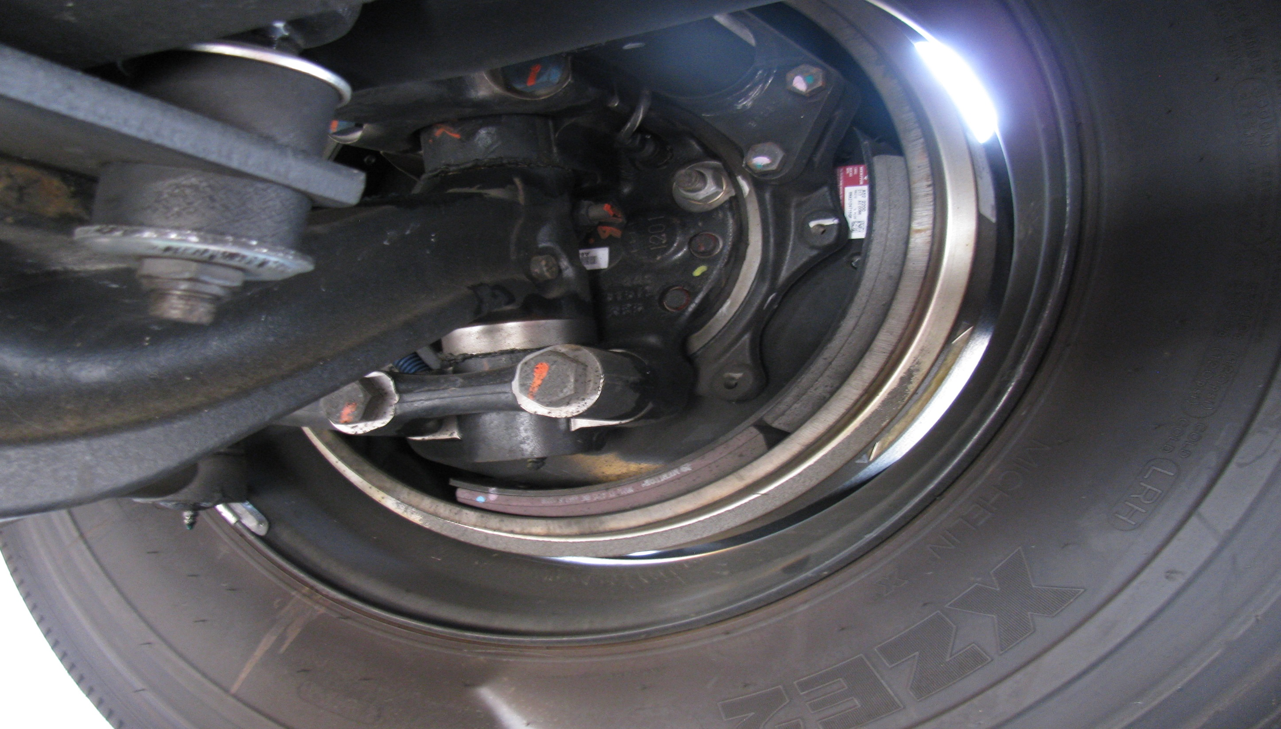
Checks for cracks, dents, holes, or loose or missing bolts.
Check for debris or oil/grease.
Brake linings (where visible) should not be worn dangerously thin
Brake Drums and Linings

Slide 23
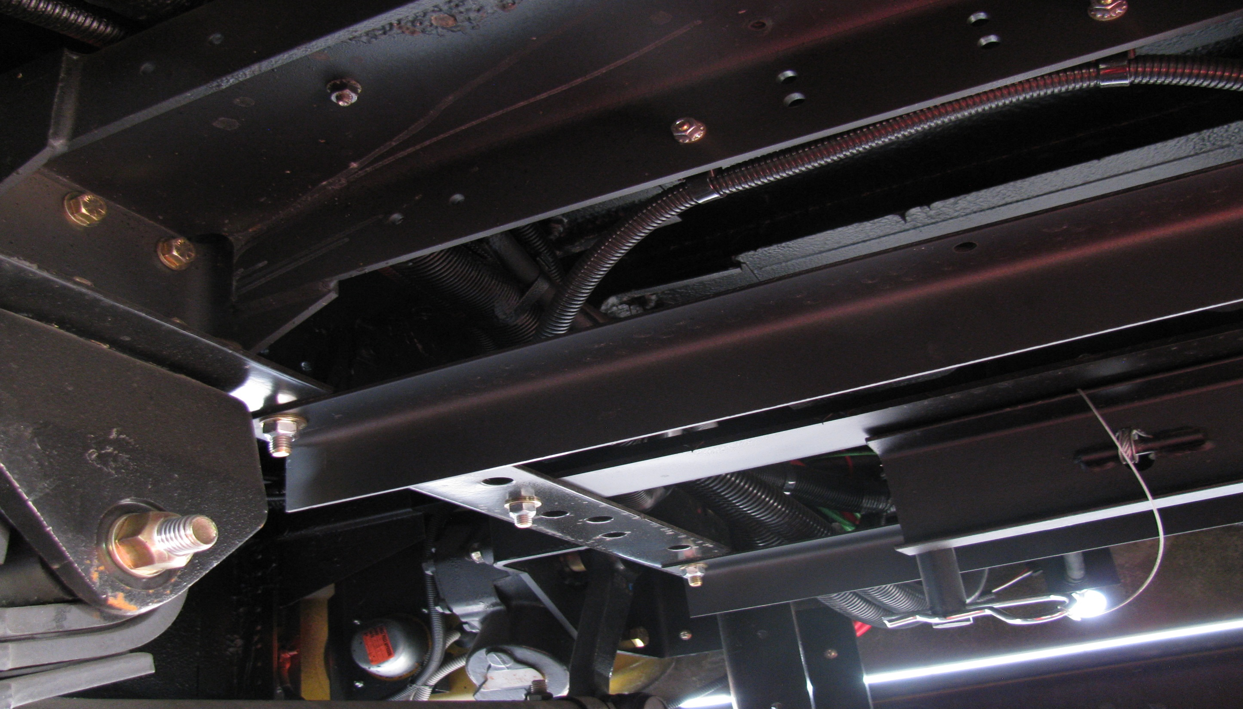
Frame and Cross Members
Looks for cracks, broken welds, holes or other damage to the longitudinal frame members, cross members box and floor.

Slide 24
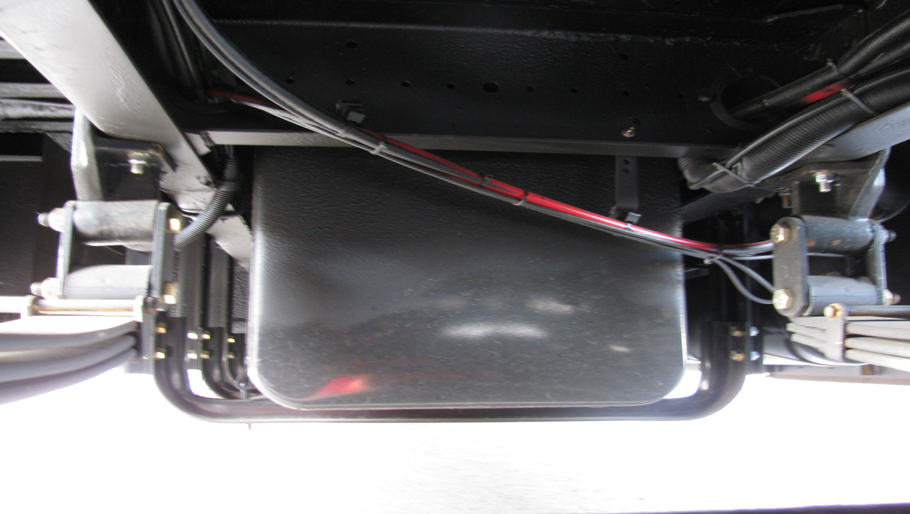
Fuel Tank/Lines
Checks that the tank(s) are secure, caps are tight and that there are no leaks from the tank(s) or lines.

Slide 25
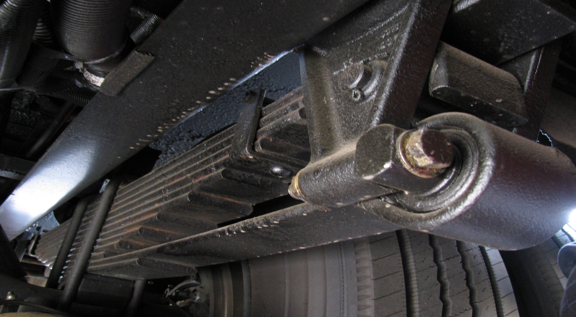
Auxiliary Spring
Not damaged and mounted securely.

Slide 26
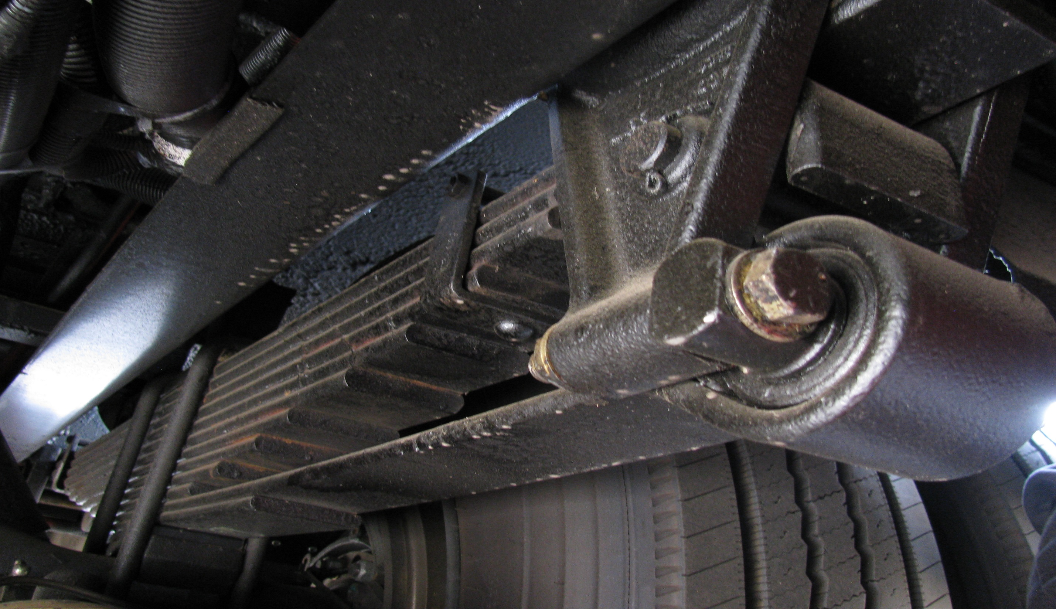
I would check all suspension and braking parts the same as I did in the front. (Must point to and name each part)

Slide 27
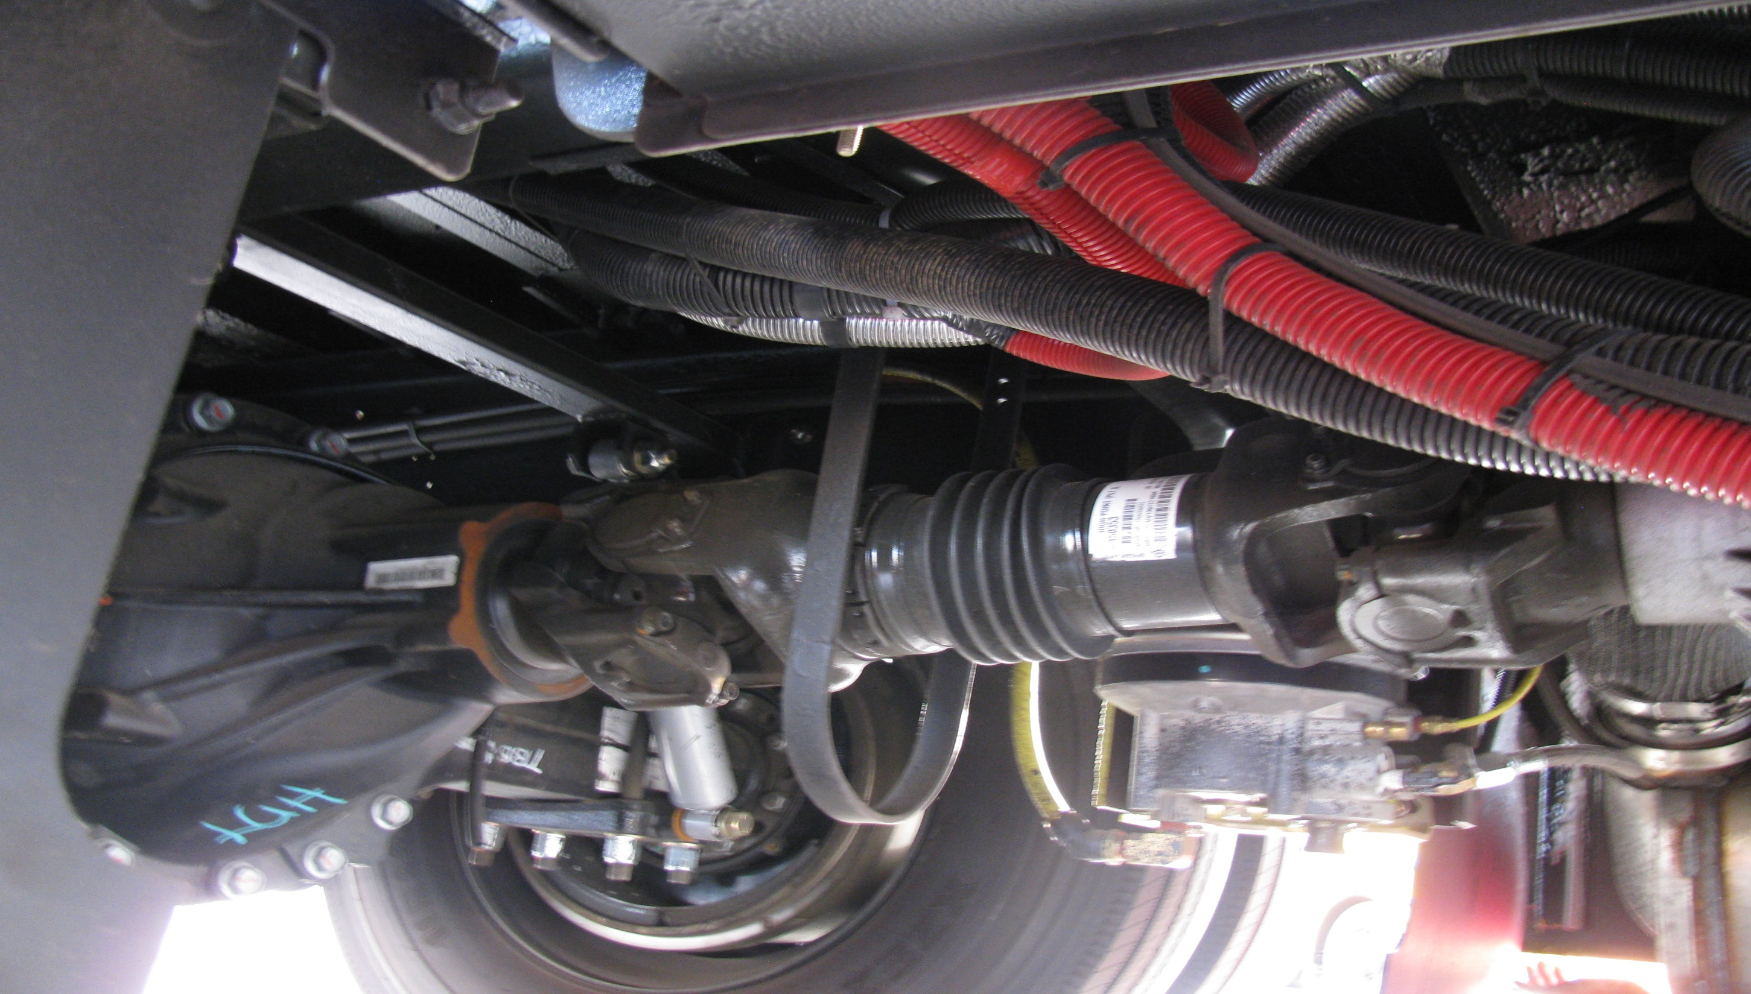
Drive Shaft
Is not bent or cracked.
Couplings should be secure and free of foreign objects.

Slide 28
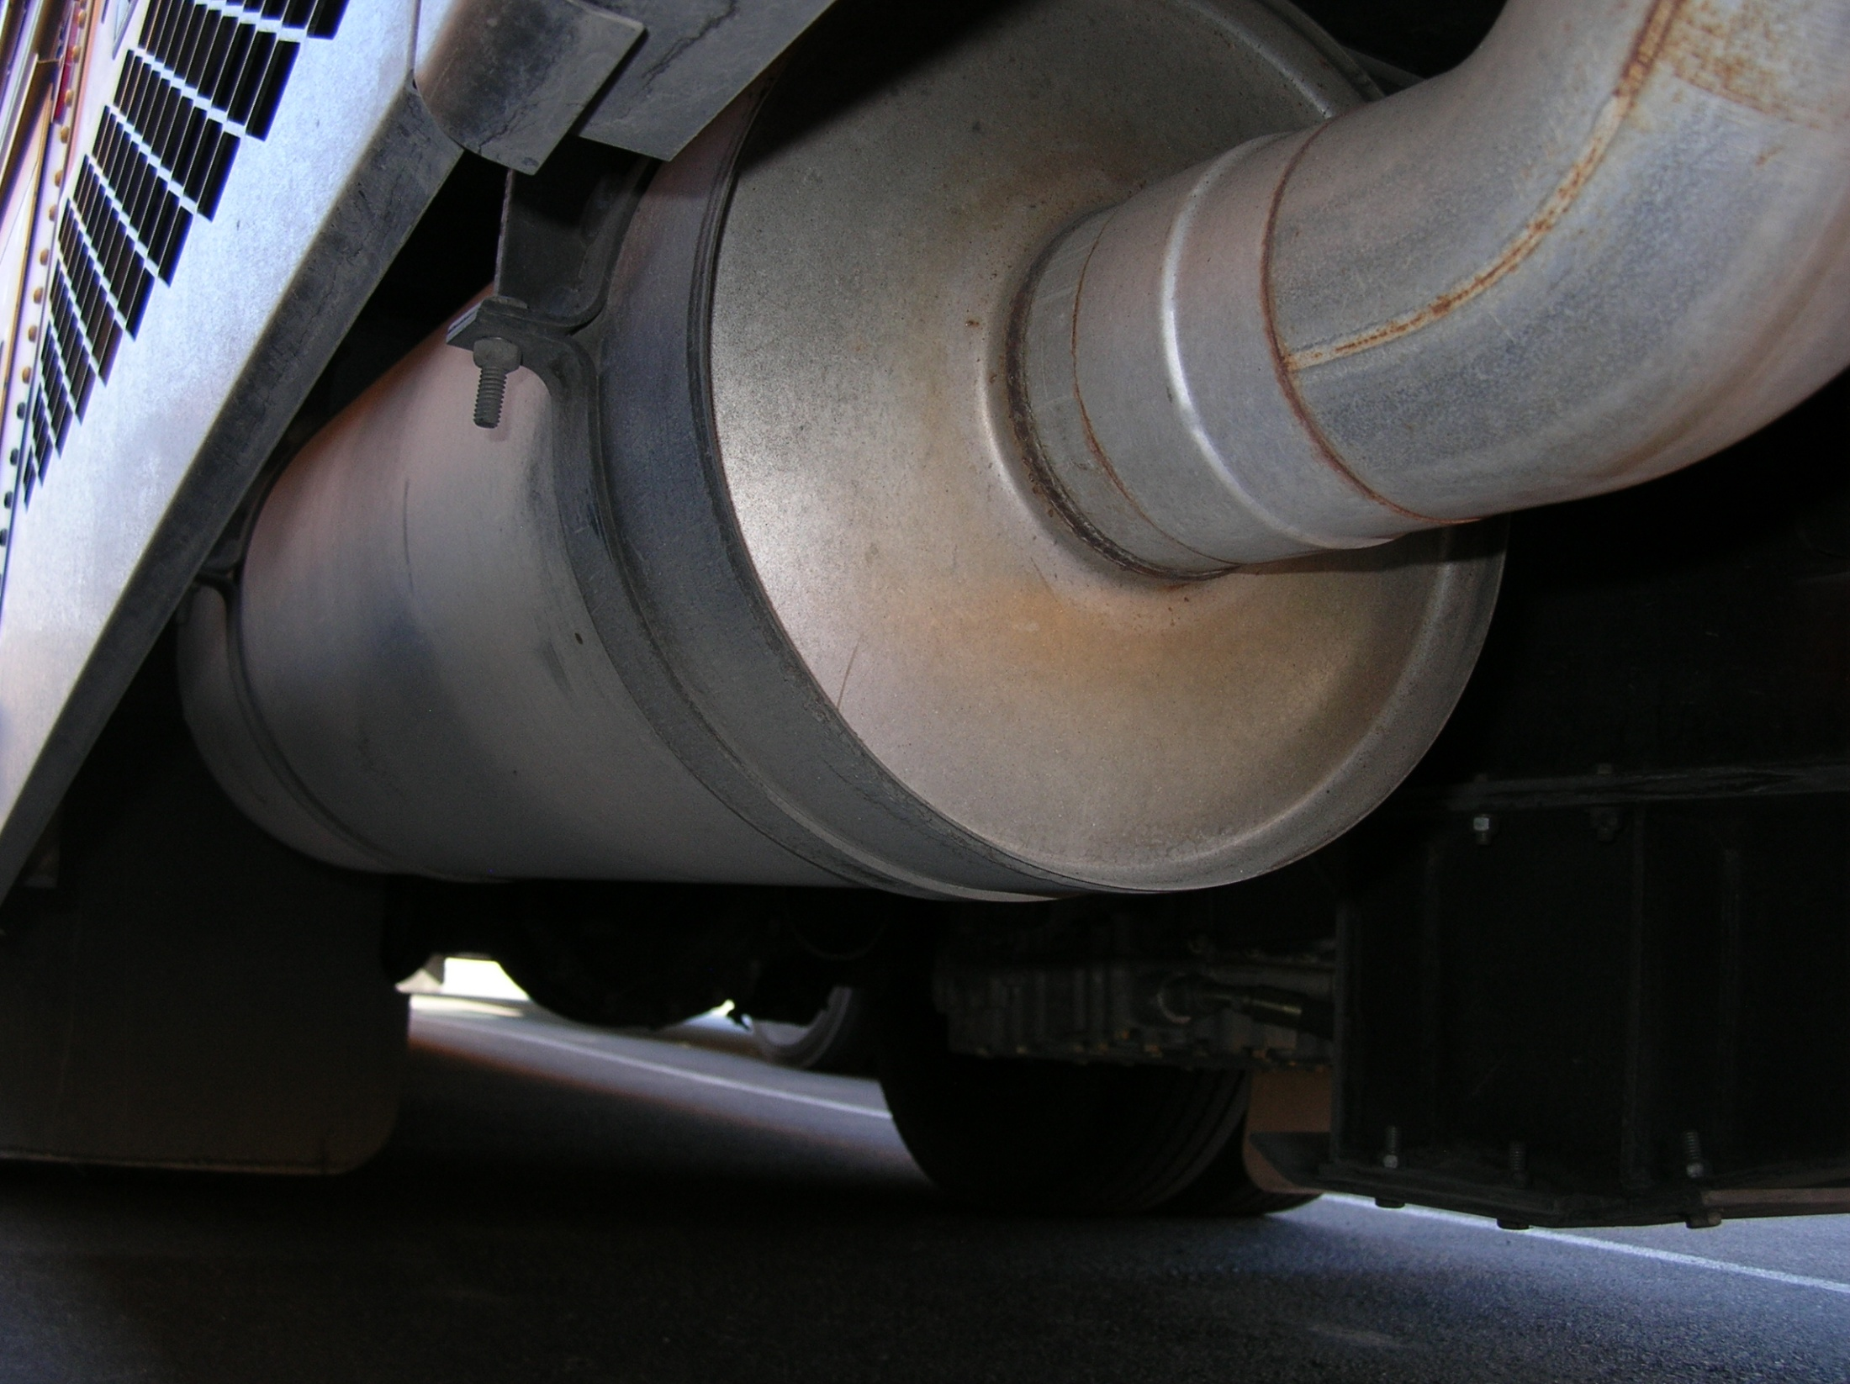
EXHAUST SYSTEM
Connected tightly and mounted securely.
Checks system for damage (cracks, holes, severe dents) and signs of leaking (rust or carbon soot).
No excessive noise when engine is running.

Slide 29
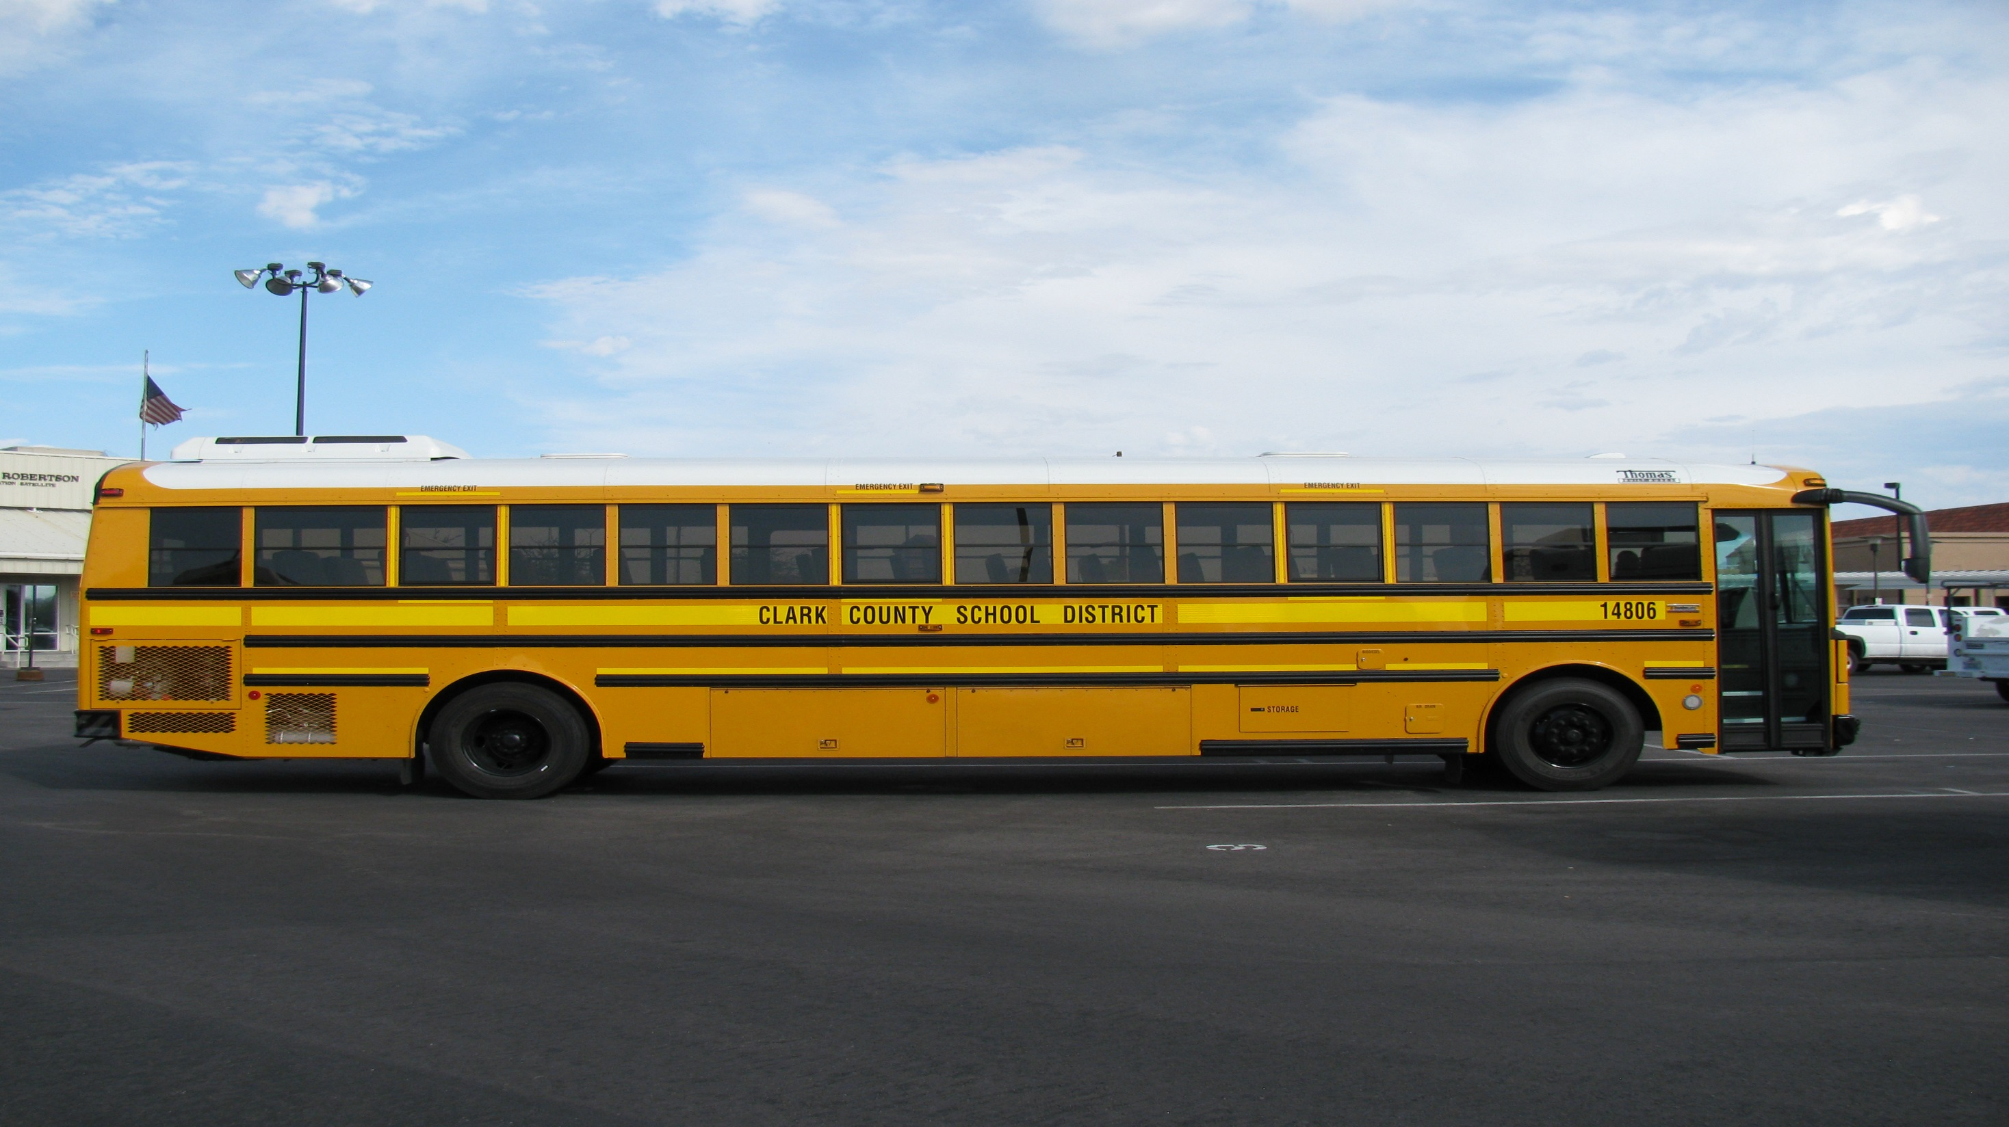
Procedure #3
Walk Around

Slide 30
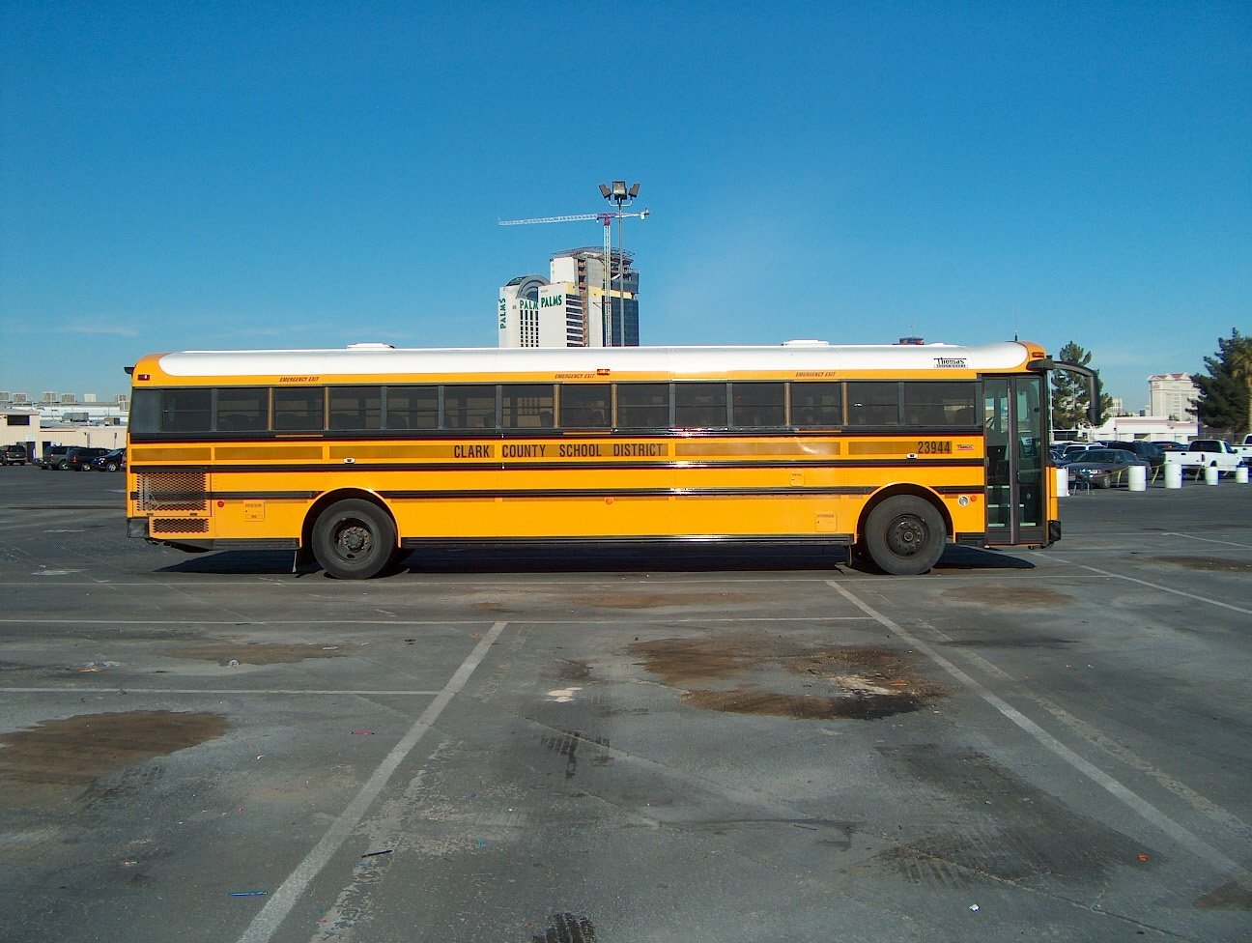
Right Side
ALL LIGHTS / REFLECTORS: Check that all external lights and reflective equipment are clean, not broken, proper color and functional. Lights include: clearance lights, turn signals, 4-way flashers, and reflective tape around bus and all emergency exits.
Door: Not damaged and opens and closes properly from the outside. Hinges should be secure with seals intact.
WINDOWS: Not cracked or broken and the 1st 3 on both sides should be clear or any stickers, signs or obstructions.
LETTERING: Make sure all lettering is legible and not peeling or missing. Emergency exits are clearly labeled from the outside.

Slide 31
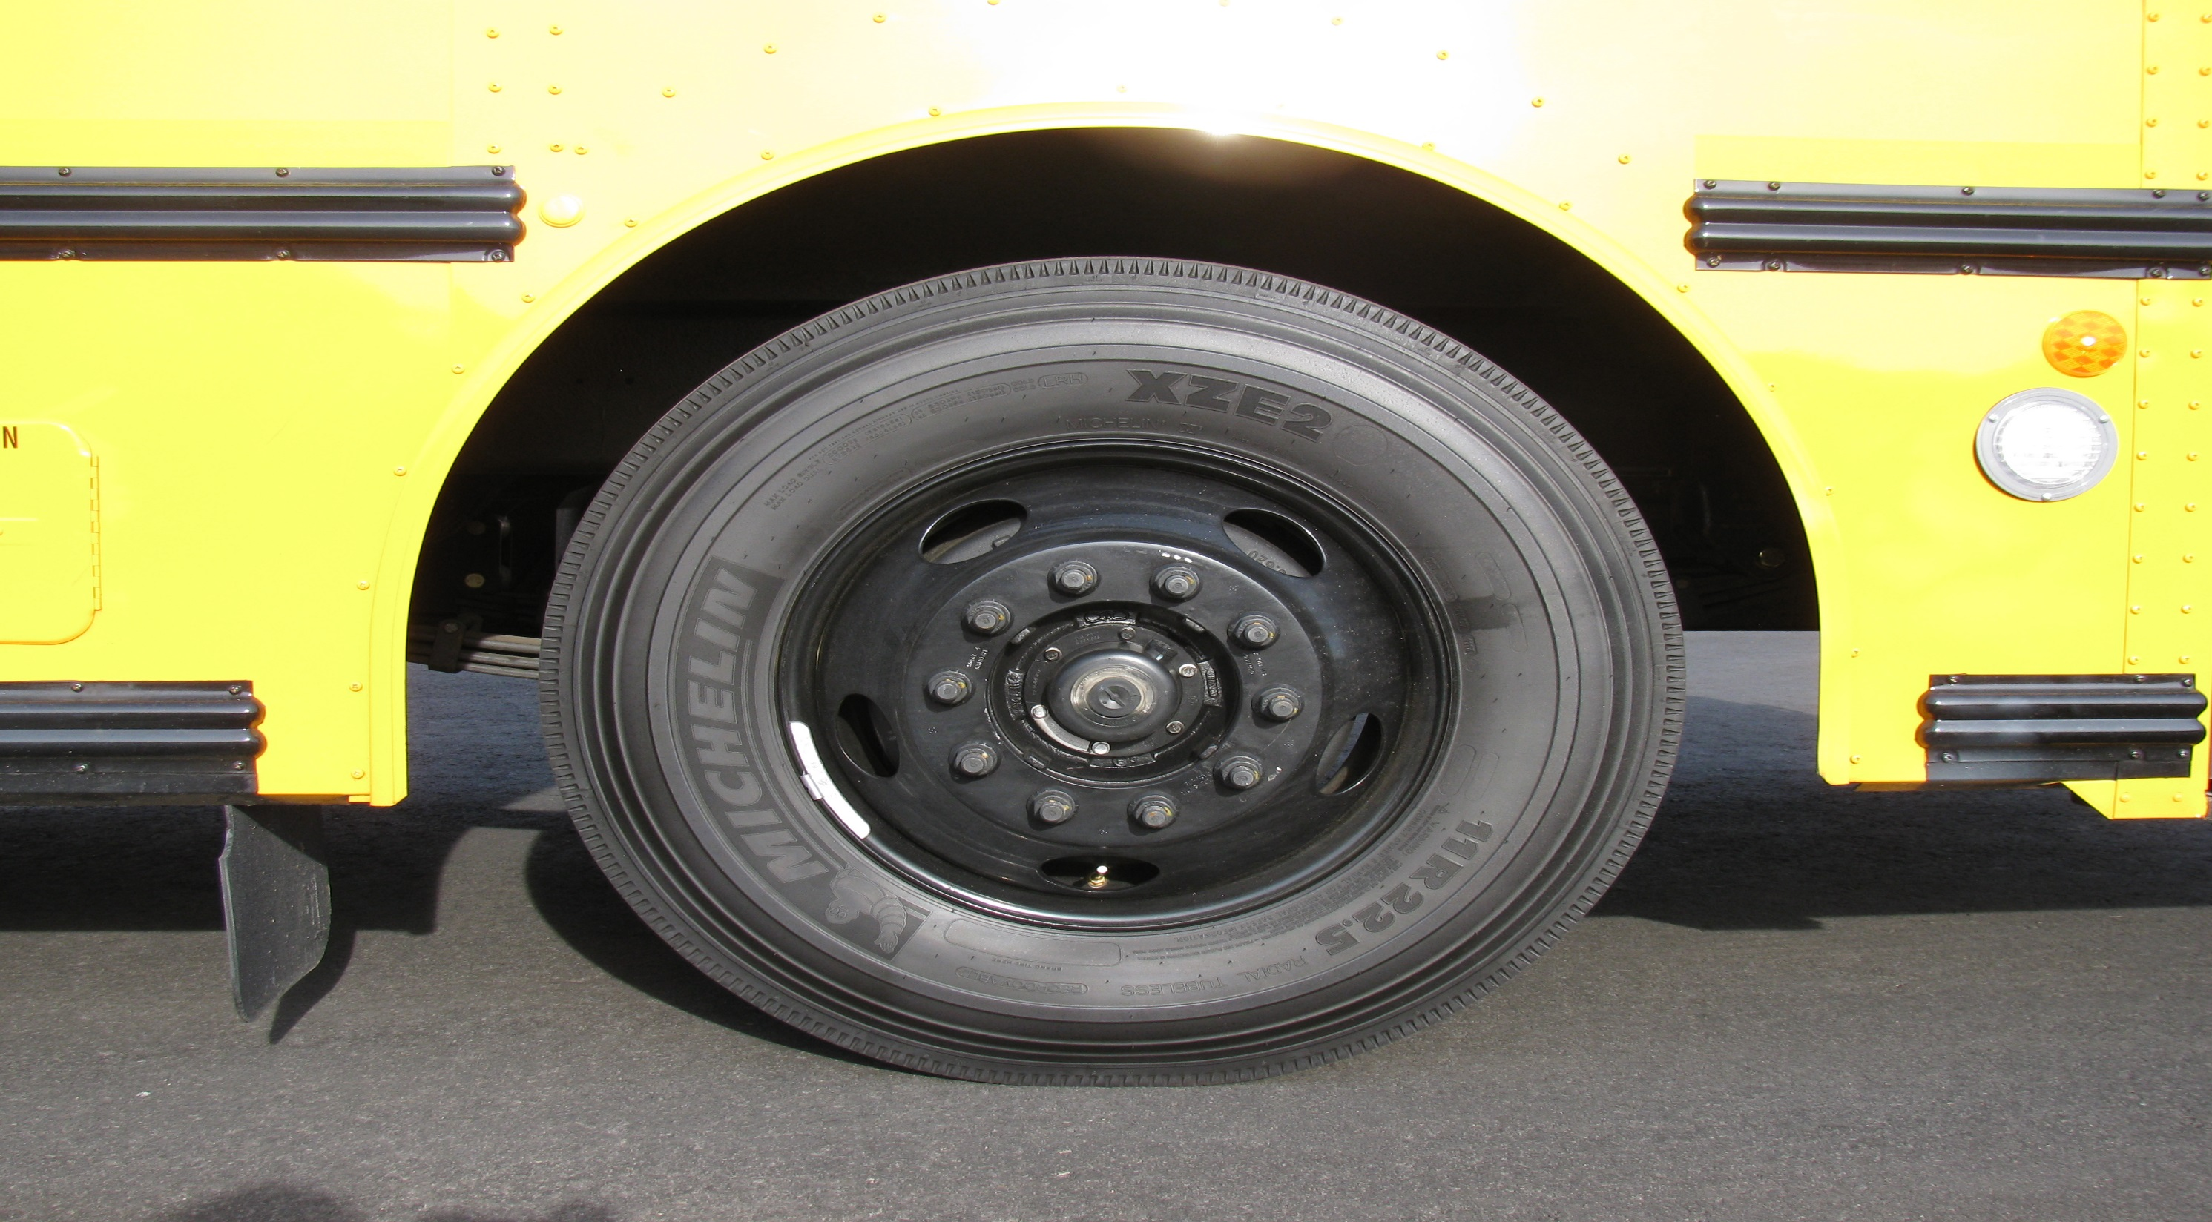
Tire
Tread Depth: Checks for minimum tread depth (4/32) on steering axel tires (2/32) on all other tires
Tire Condition: Checks that tread is evenly worn and looks for cuts or other damage to tread or sidewalls. Also makes sure that valve caps and stems are not missing, broken, or damaged.
Tire Inflation: Checks for proper inflation by using a tire gauge or by striking tires with a mallet or other similar device.

Slide 32
Checks for damaged or bent rims.
Rims cannot have welding repairs
Checks that all lug nuts are present, free of cracks and distortion
shows no signs of looseness such as rust trails or shiny threads.
Make sure all bolt holes are not cracked or distorted.

Slide 33
HUB/AXEL OIL SEAL: Sees that hub oil/grease and axel seals are not leaking and if a sight glass is present, that the oil level is adequate.
Splash Guards: Check that splash guards or mud flaps are not damaged and are mounted securely.

Slide 34
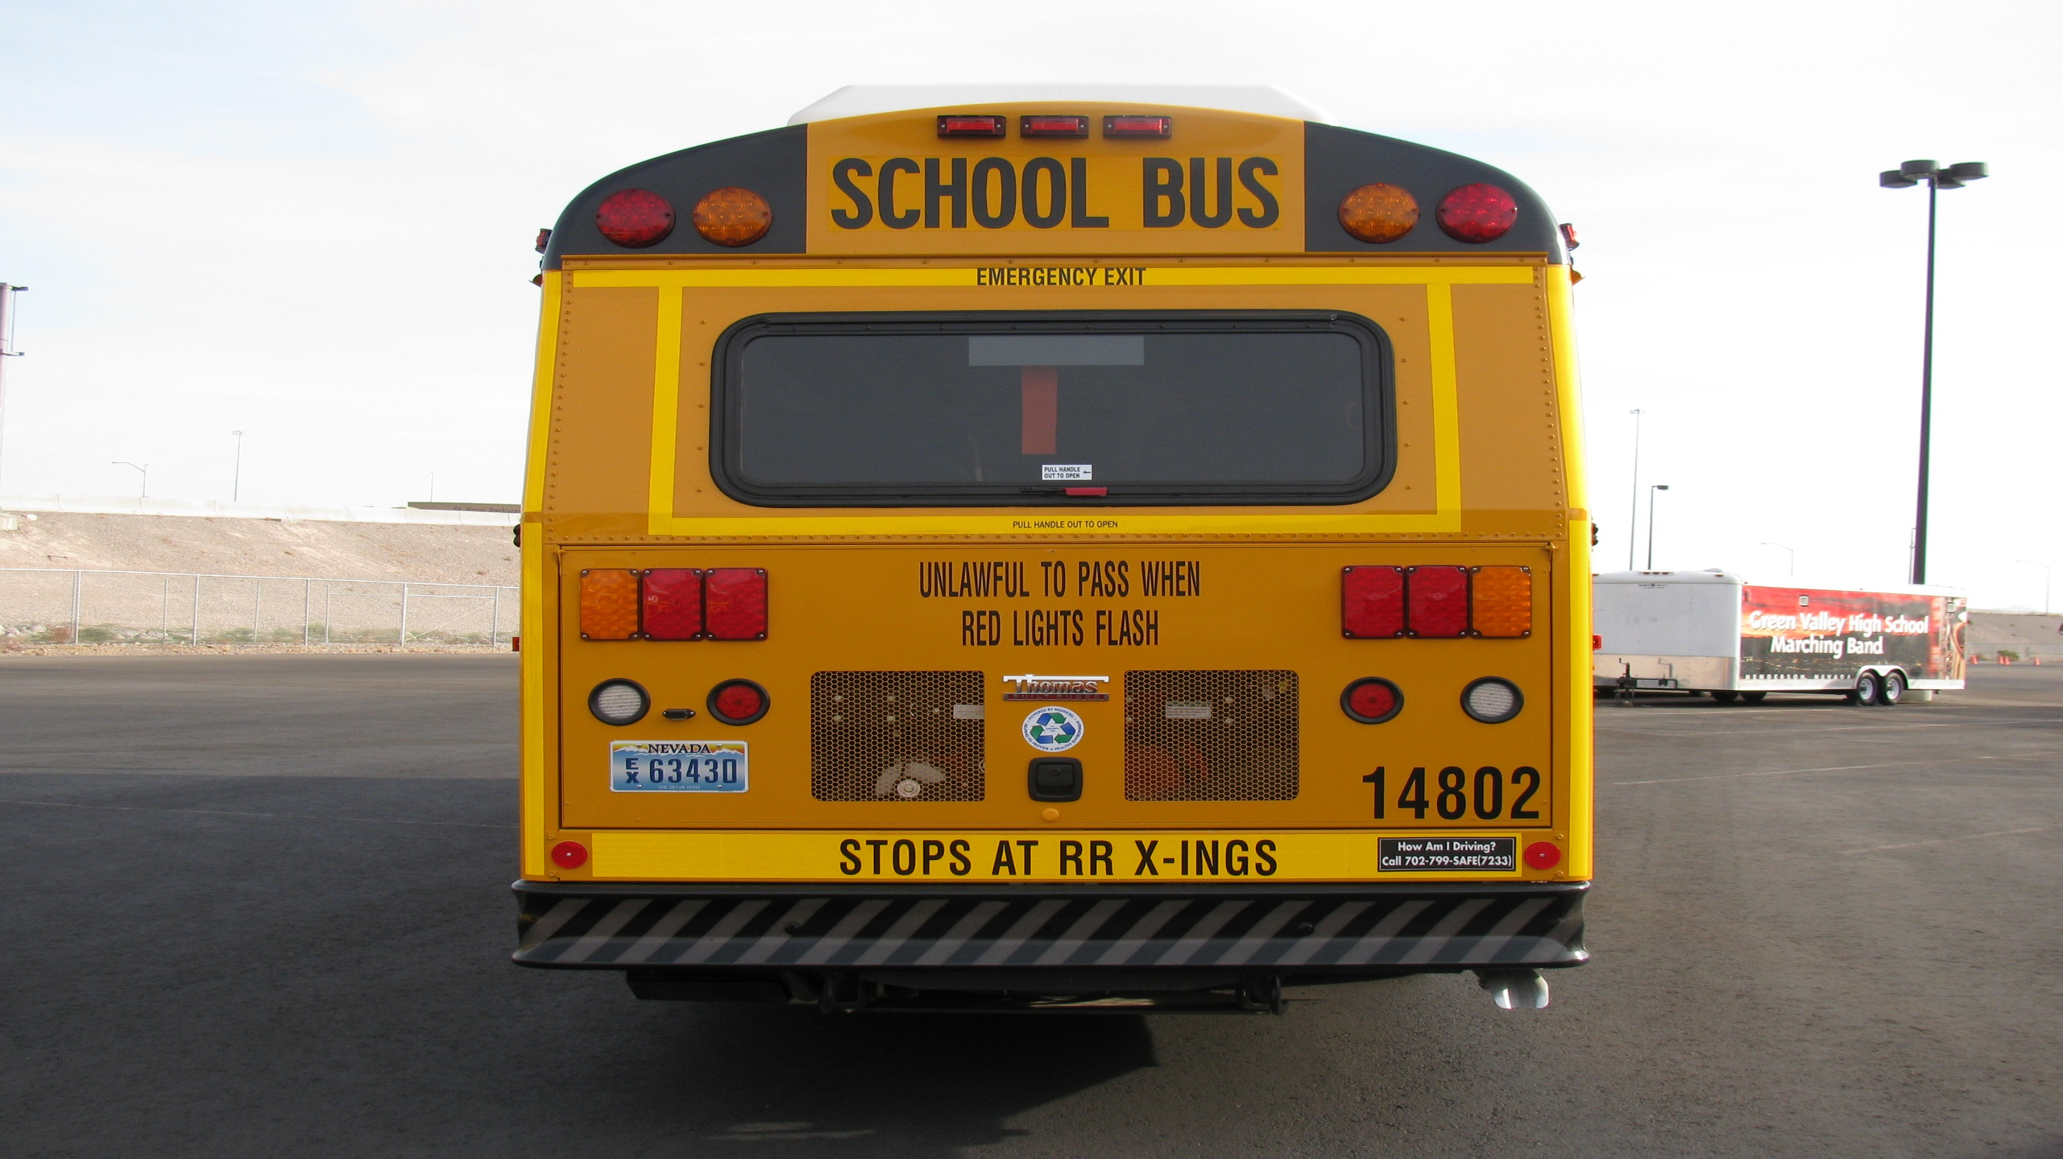
Rear of Bus
Check that all external lights, and reflective equipment are clean and functional.
Light and reflector checks include:
Clearance lights
Student lights (Yellows and Reds)
Turn signal / 4 way Flasher
Brake lights
Tail lights
Reverse light

Slide 35
Windows: Check seals are in good condition
License Plate: Checks that the rear license plate is mounted securely &legible
Window/Door: Check that the door and hinges are not damaged and that it opens, closes and latches properly from the outside.
Check that the rubber seal is intact and in good condition

Slide 36
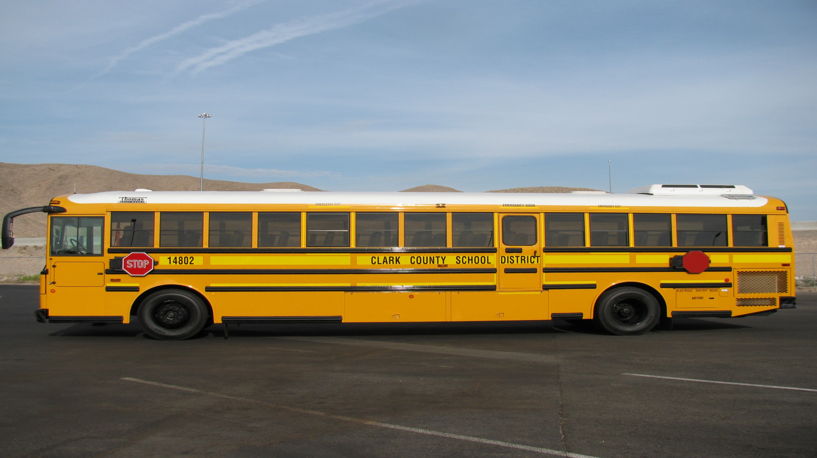
Left side of Bus
At this point, explain to the instructor that they will be checking the things on the left side that are different from the right side
Stop Arms: Check that stop arms are mounted securely to the frame of the vehicle
Check for loose fittings and damage

Slide 37
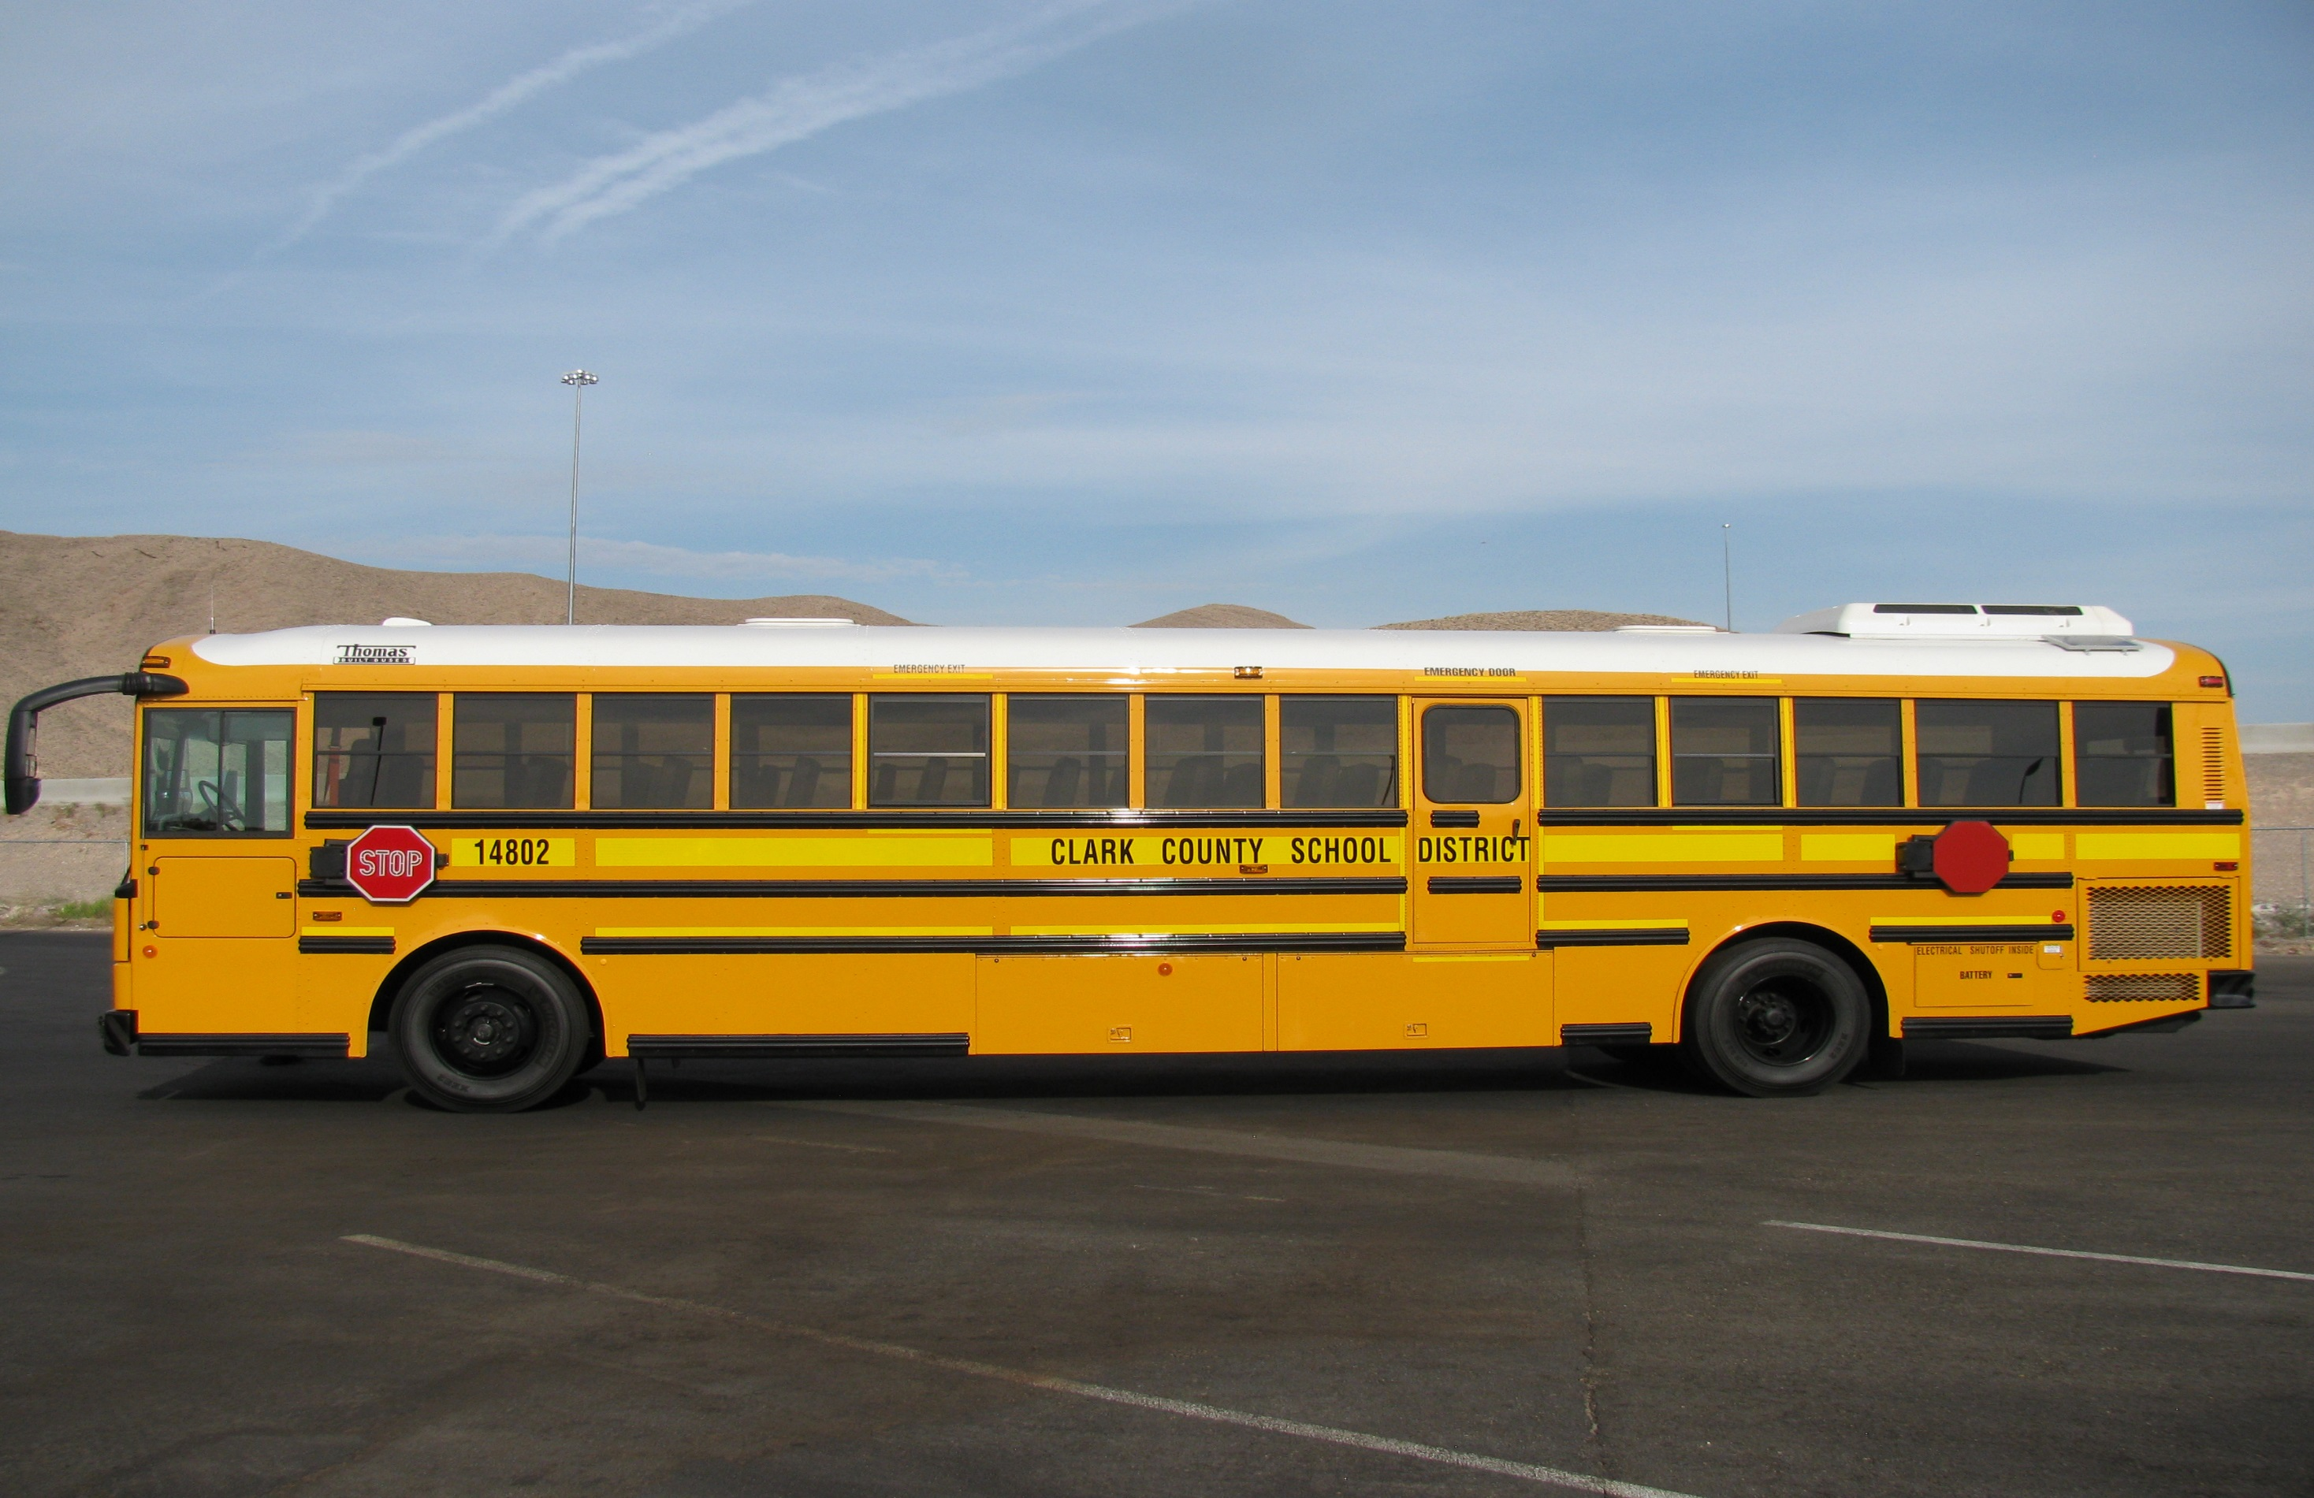
Left side of Bus
Door: Check that the door and hinges are not damaged and that it opens, closes and latches properly from the outside.

Slide 38
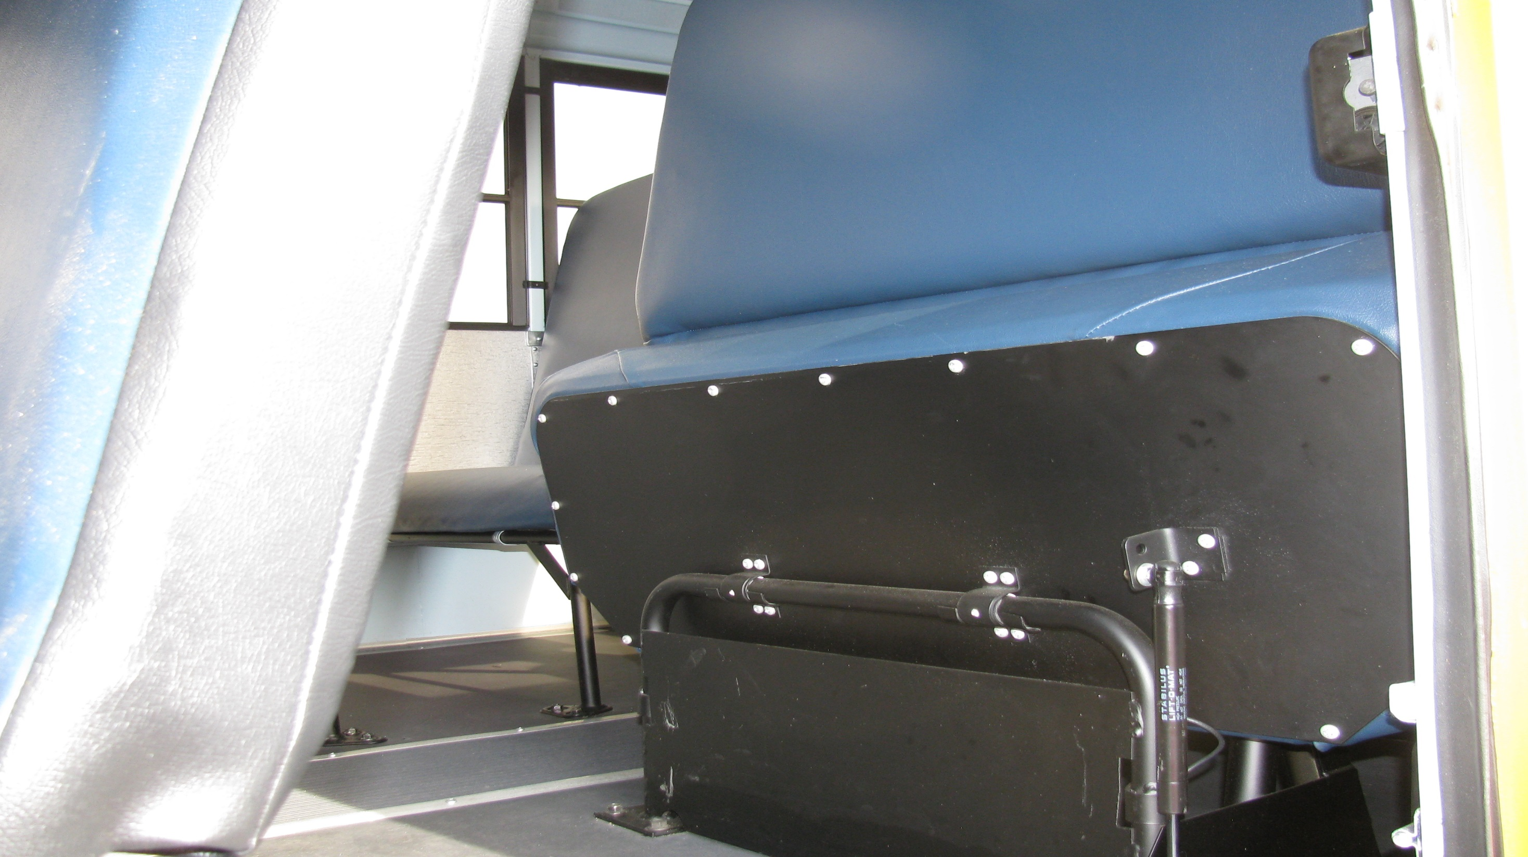
Flip seat: Make sure the fold down seat stays in the up position on its own.

Slide 39
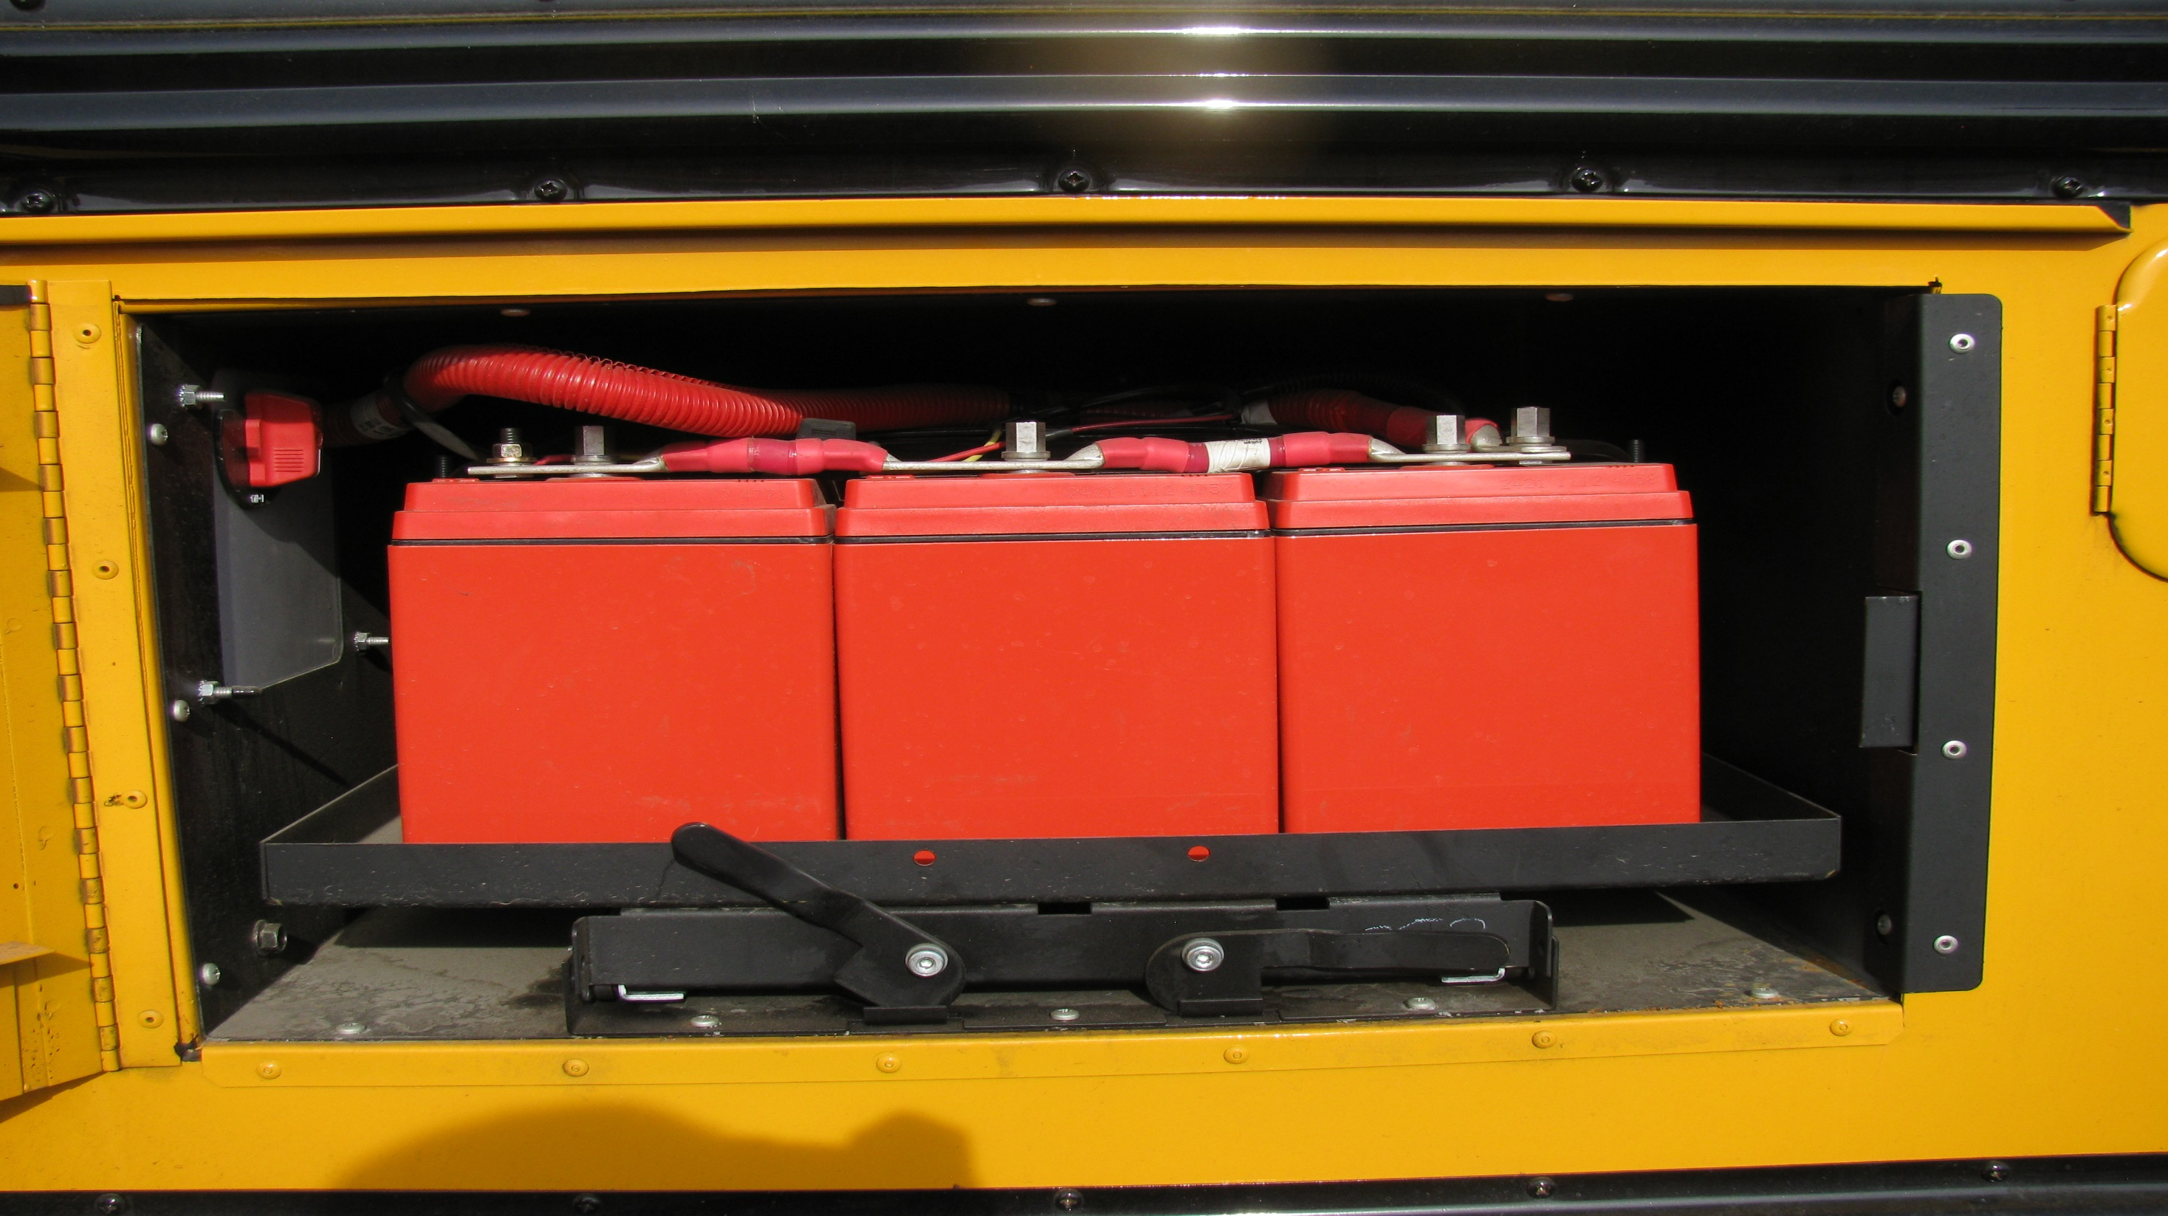
Battery Box: Wherever located, see that the battery(s) are secure, connections are tight, cell caps are present and no signs of excessive corrosion.

Slide 40
Left side of Bus
Fuses: Driver should point to where panel/box is located and mention this is where the spare fuses are located
Mirror(s): Check that mirror(s) and mirror brackets are not damaged and are mounted securely with no loose fittings.
At this point you will check the operation of the outside lights.
Ask your instructor to assist you.

Slide 41
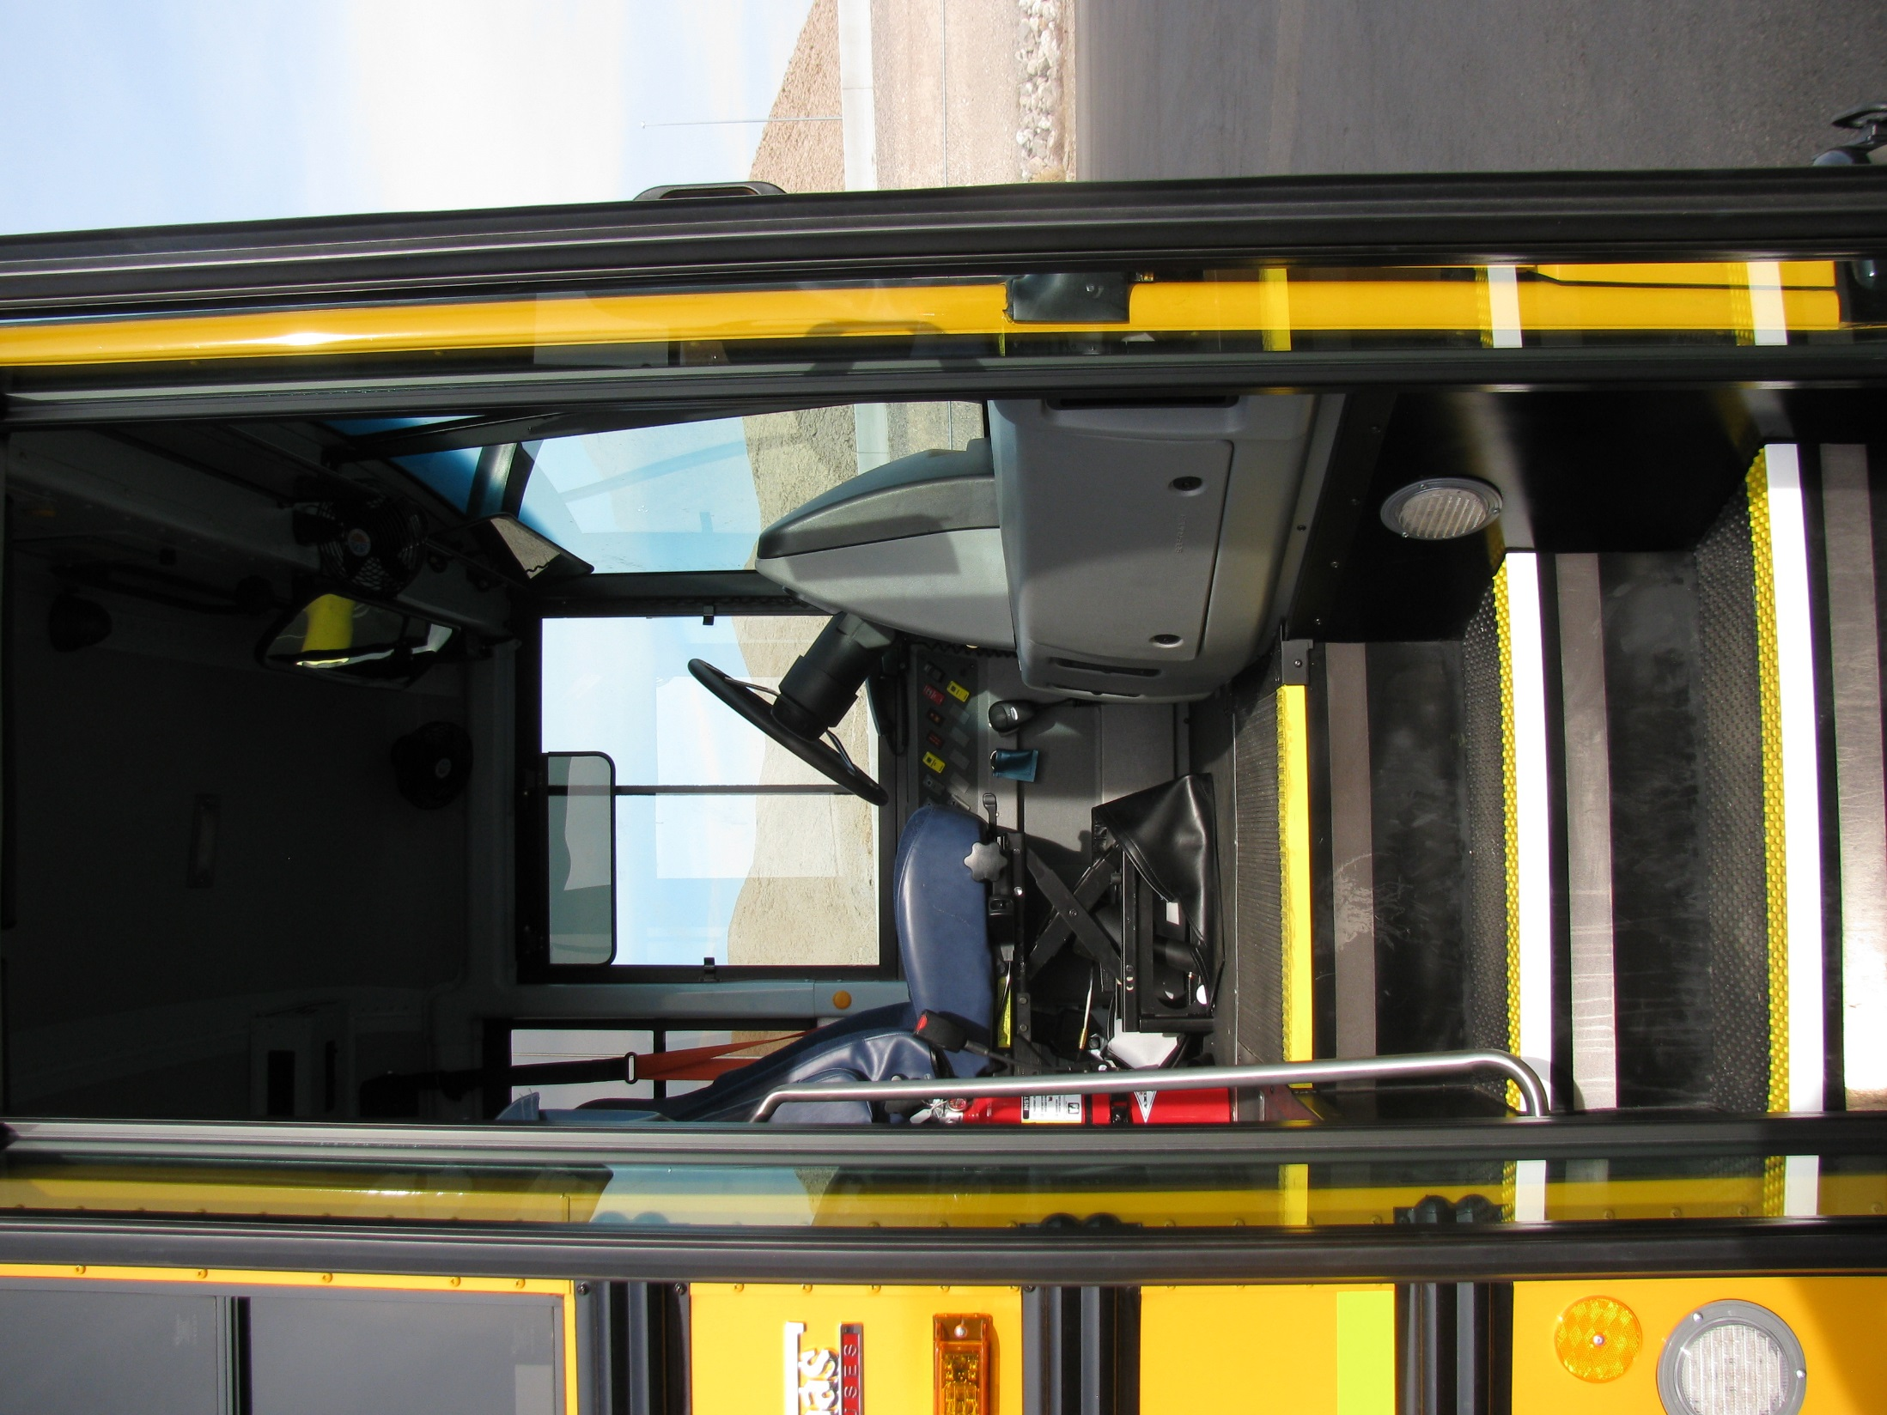
Procedure #4
Entrance & Drivers Area
Check entry door is not damaged, operates smoothly &closes securely from the inside
Checks the stairwell for loose matting or foreign objects or debris.
Checks that hand rail is secure and the step light is not cracked or broken and the lens is secure and proper color.

Slide 42
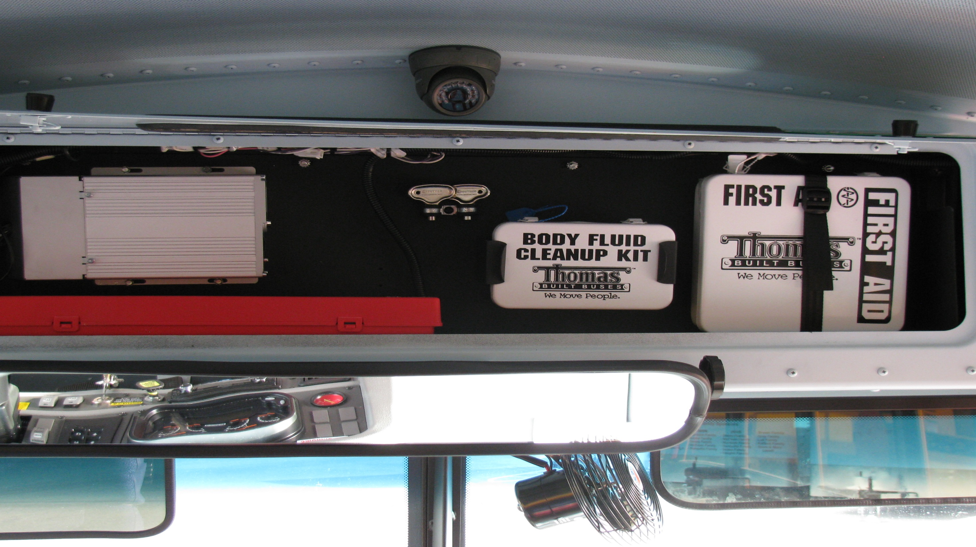
First Aid & Body Fluid Kits: Mounted securely and sealed
Red Triangles: Checks to see that the case holding triangles is mounted securely, The (3) triangles are operational, not cracked, or broken.

Slide 43
Fire extinguisher: Checks that it is fully charged (in the green), and securely mounted.
Rated ABC
Do not block with misc. items.

Slide 44
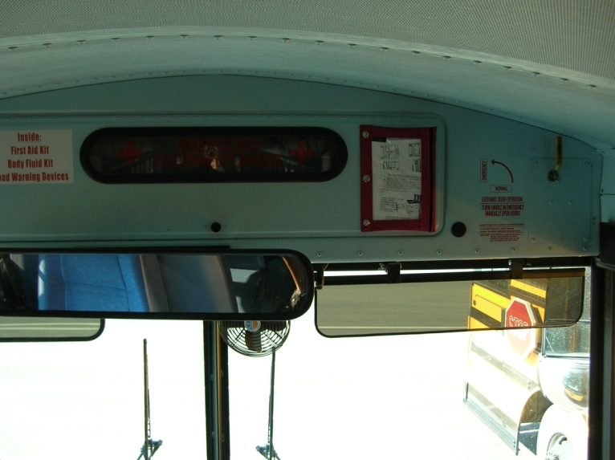
Registration/Insurance and Body Damage card: Checks that a copy of the vehicle registration, insurance waiver and body damage card is present on the bus.

Slide 45
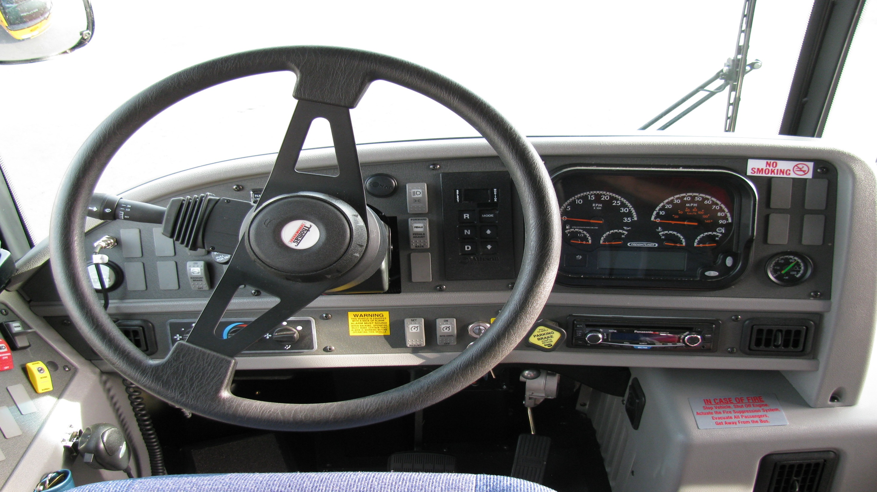
Safe Start
Turn ignition key to the on position:
Watch for a yellow ABS light to flash twice and go out. At the same time you will hear two clicking sounds, start the engine.
Gearshift/parking brake: Checks that gearshift is in neutral and parking brake is set.
Warning light: Checks that all warning lights activate, and or buzzer sounds as engine is started. Lights should come on briefly and then go out.

Slide 46
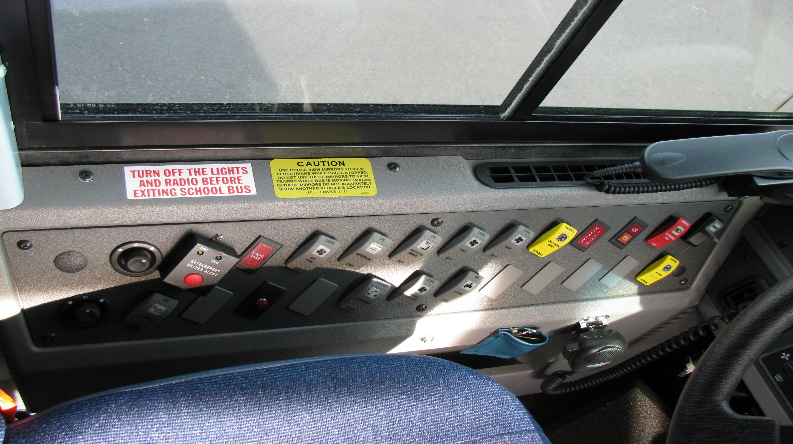
Switches
All heaters/defrosters are working
Dome lights
Student light indicators yellow and red

Slide 47
Air Gauge: Is working and checking to see if it is between 120 and 140 PSI.
Temperature gauge: Is working, climbs to normal operating range or light is off.
Fuel Gauge: No less than ¼ tank.
Oil Gauge: Is working, increasing or normal pressure or light is off.
Speedometer/Odometer: Check for serviceability when it is feasible

Slide 48
Steering Play: No more than 10 degrees
Lighting Indicators: Turn signals (L/R), 4 way, high beam
Horn: Make sure is working
Wiper/washer operation: wipers must operate correctly. Checks that washer works.
Radio (2way/P.A. Mic): Checks that 2-way radio is on and audible over engine noise, and on the proper channel. Checks that the P.A. system is audible, both inside/outside bus.
Dashboard area: Must be clean and clear of all items before operating vehicle.
Mirrors: Checks for proper adjustment from the drivers seat. Check that view is not obstructed due to dirty mirrors.

Slide 49
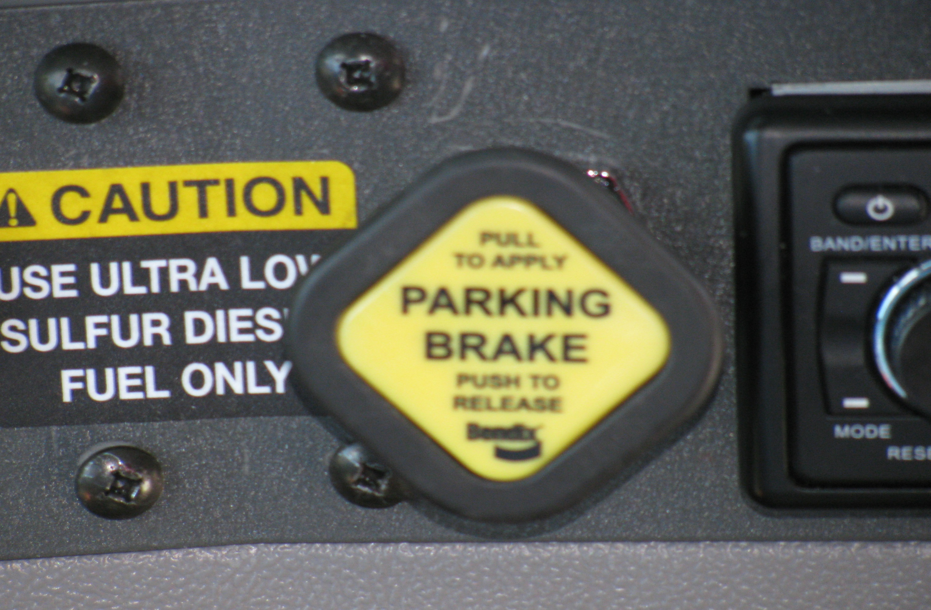
T A P
TUG
With air pressure gauges fully charged, engine running, and parking brake set, put bus in drive. Gently tap the accelerator to see that the parking brake will hold.. Place gear back into neutral, turn the engine off and place key into on position.

Slide 50
Applied
With air brake system fully charged (between 120-140 PSI) firmly apply the foot brake peddle while releasing the parking brake. Hold the brake peddle down for one minute. Check the air pressure gauge to see that the air pressure drops no more than three PSI

Slide 51
Pump Down
Without restarting the engine, begin pumping off the air pressure by rapidly applying and releasing the foot brake. The low air warning device (light and /or buzzer), should activate before air pressure drops below 60 PSI.

Slide 52
Parking Brake Pop Out
Driver continues to fan off the air pressure. Approx. 40 PSI the parking brake should close (Pop Out).

Slide 53
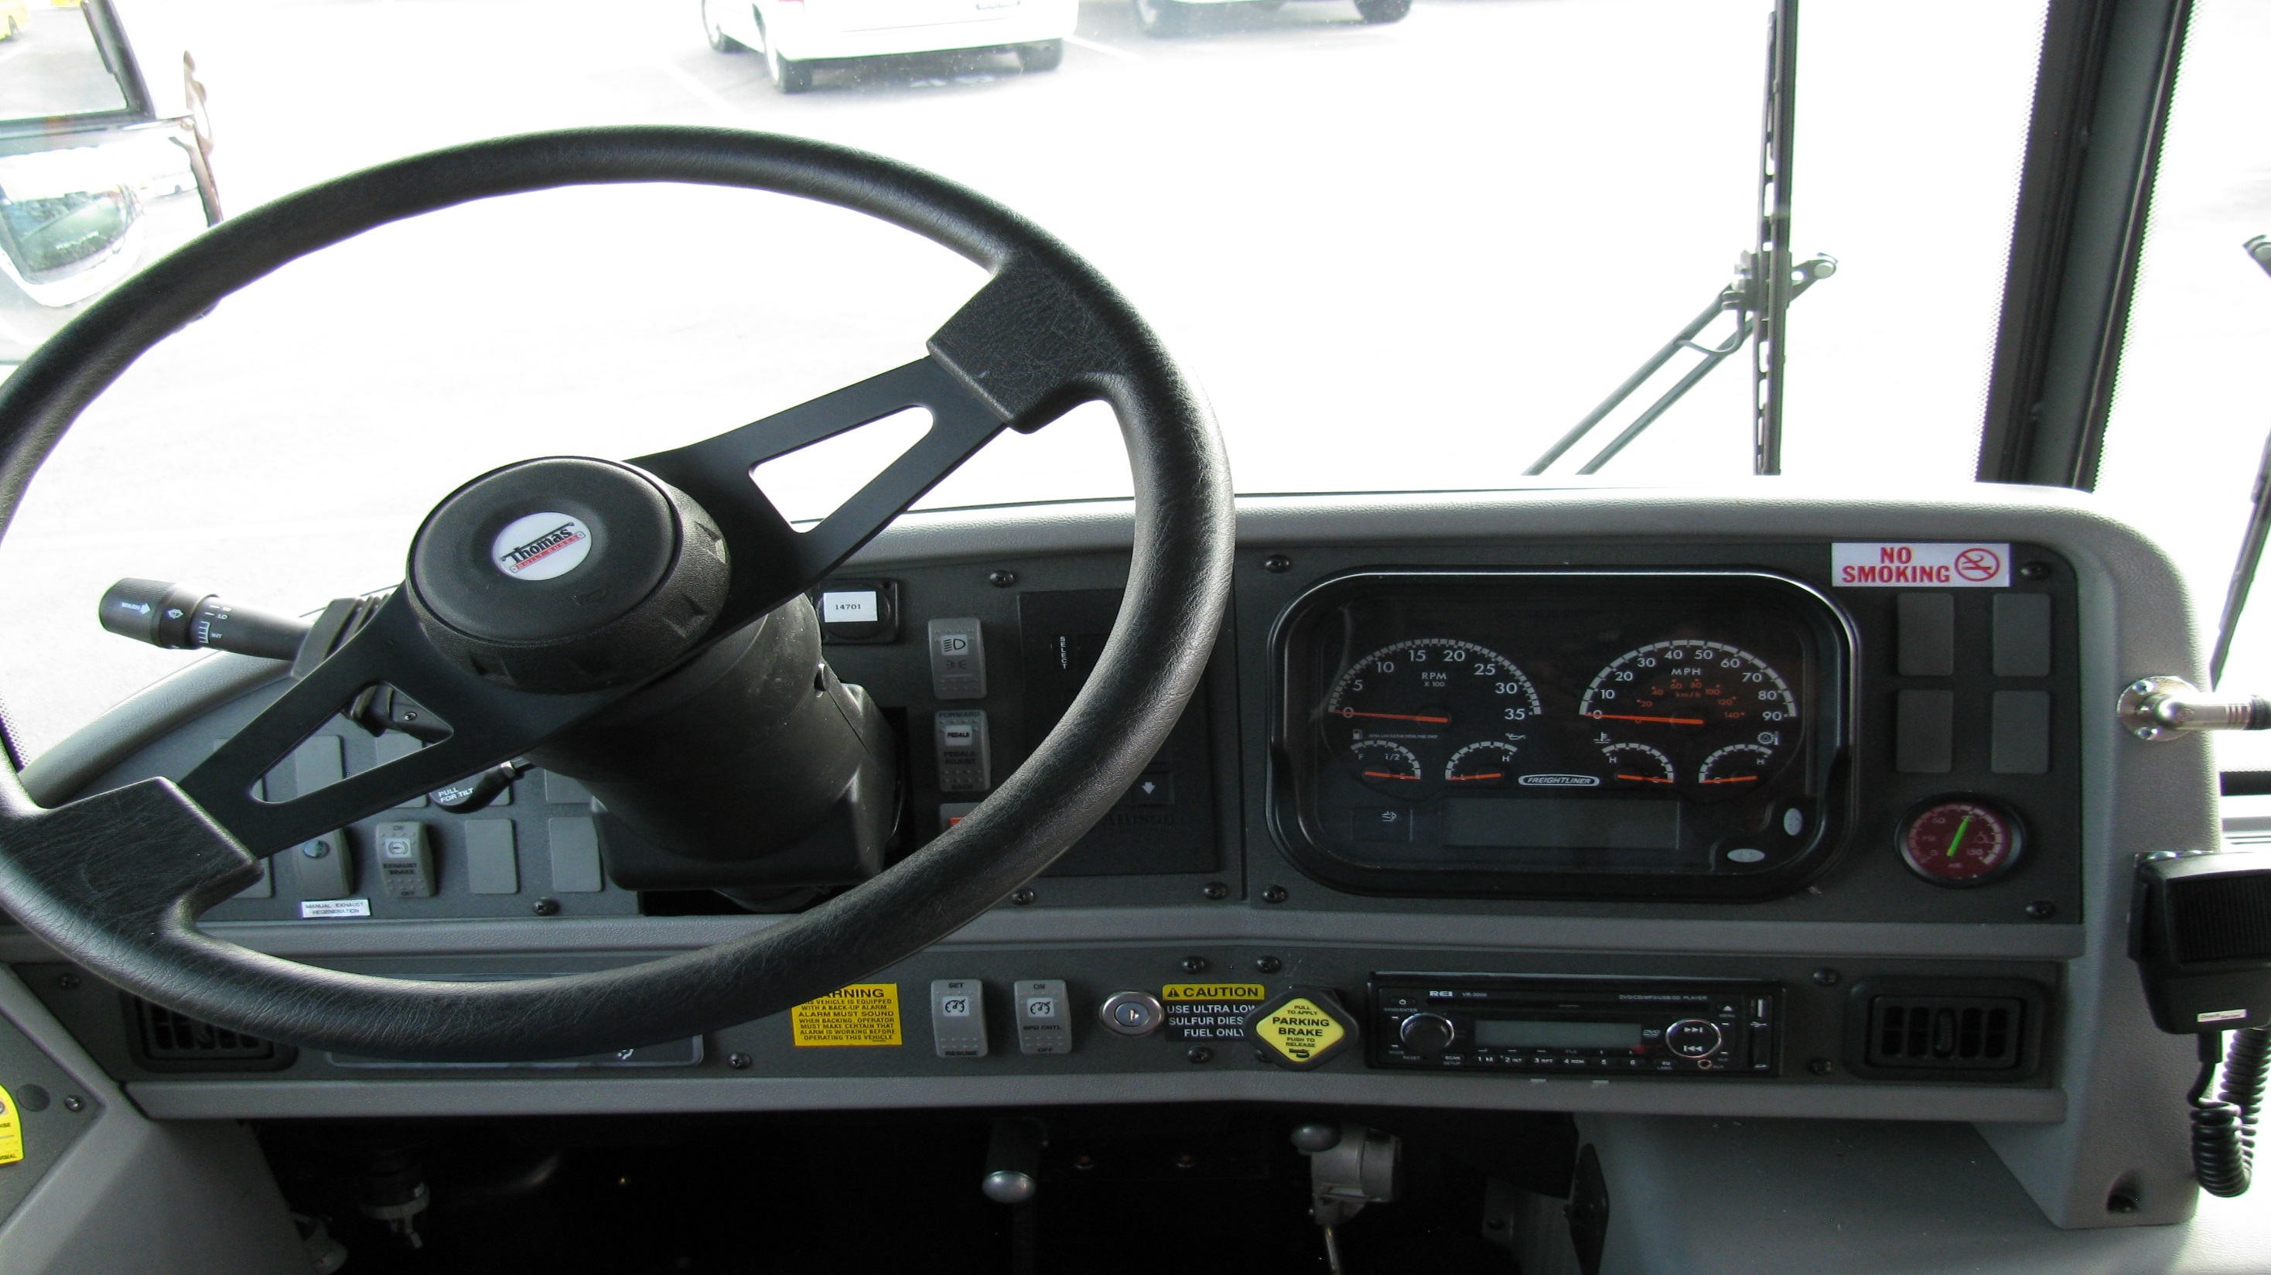
Restart engine—leave running to rebuild the air pressure

Slide 54
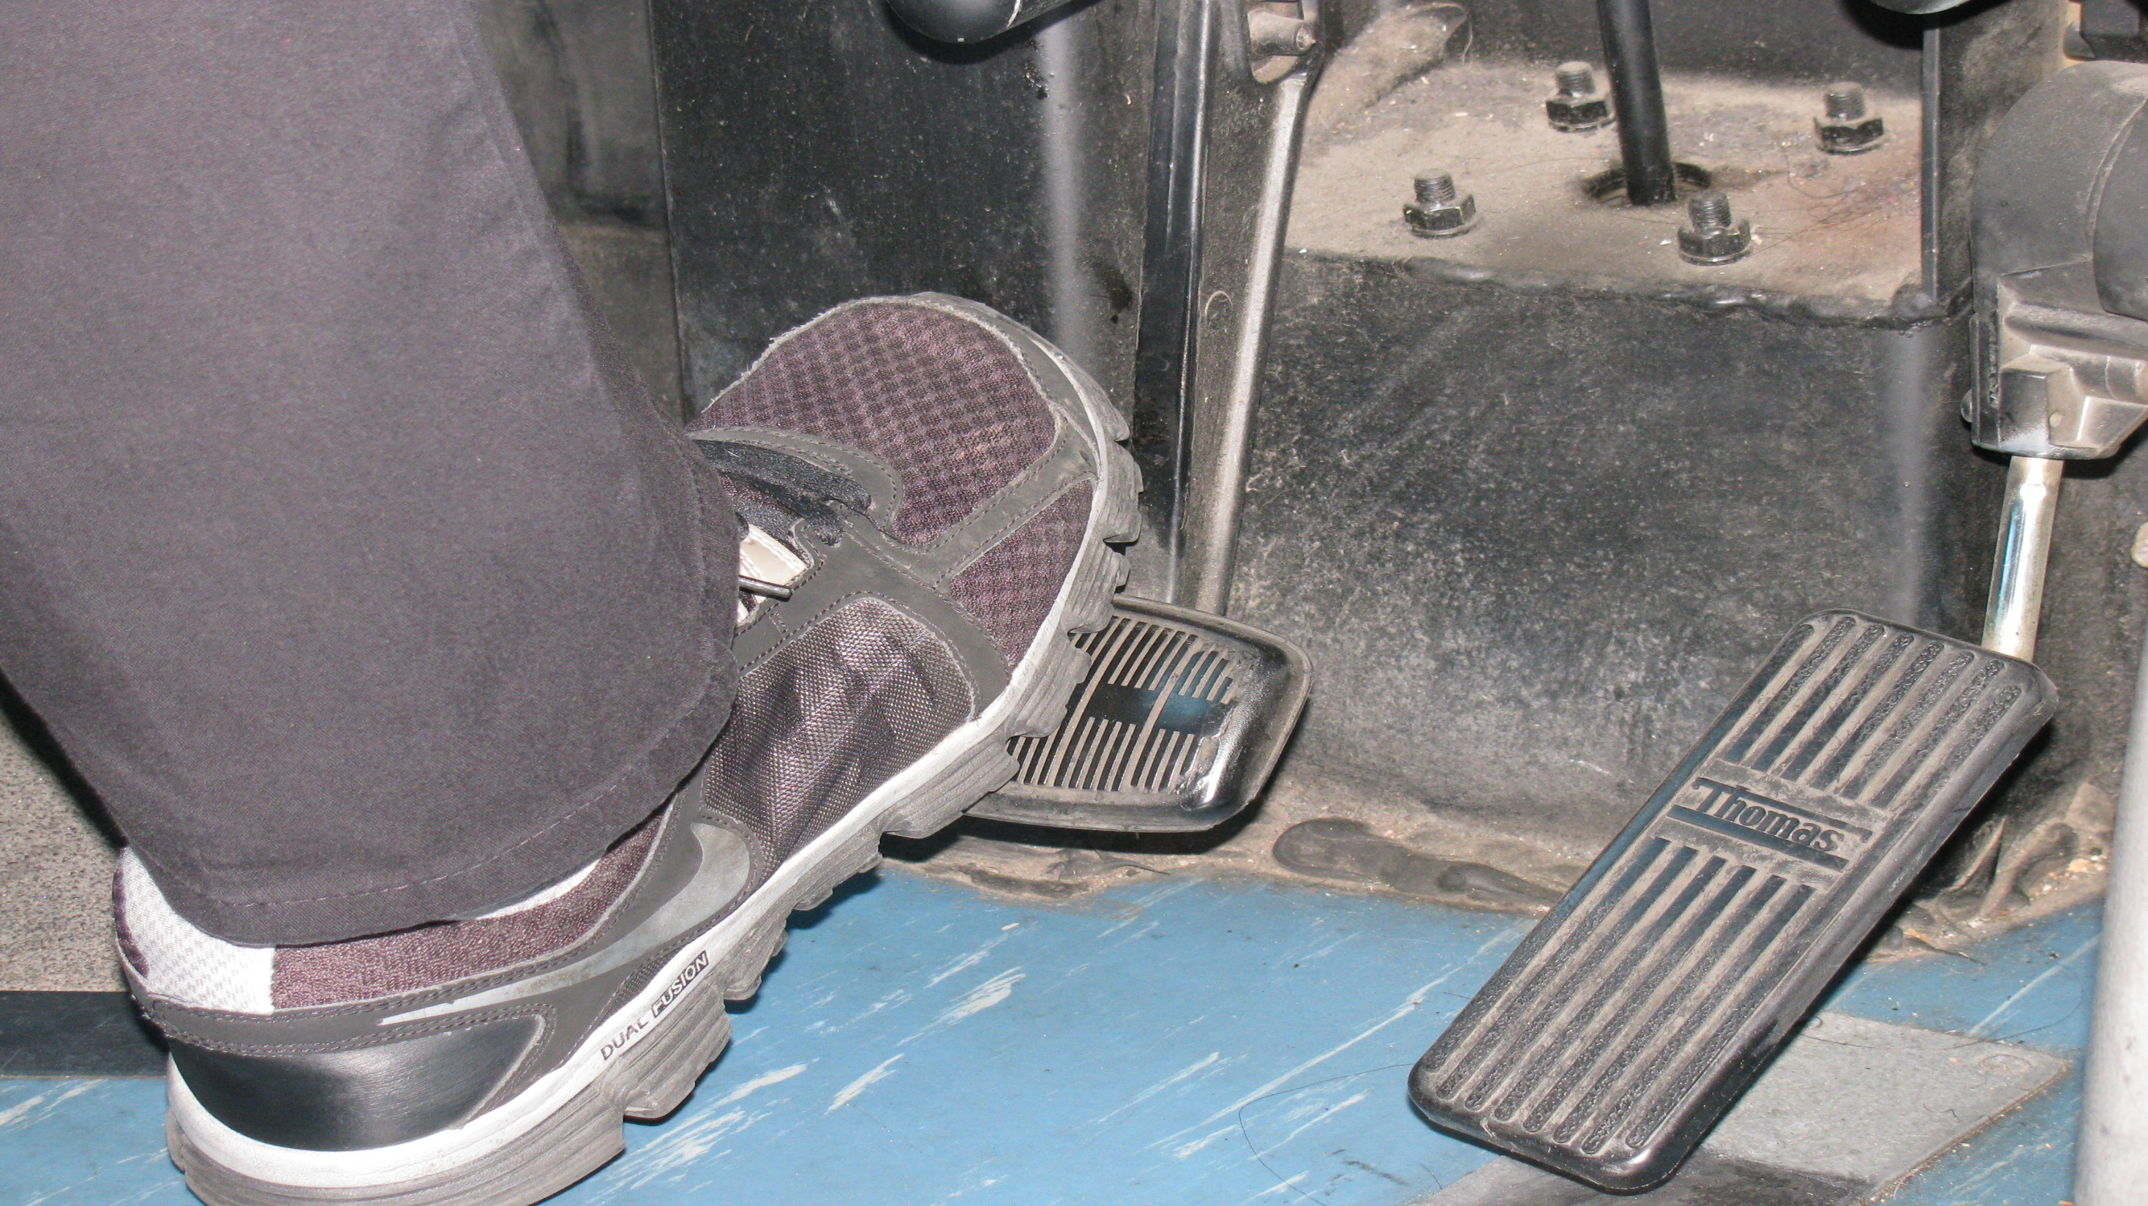
Service Brake Check
Pull forward at 5MPH, apply the service brake and stop.
Check to see that the vehicle does not pull to either side and that it stops when brake is applied.

Slide 55
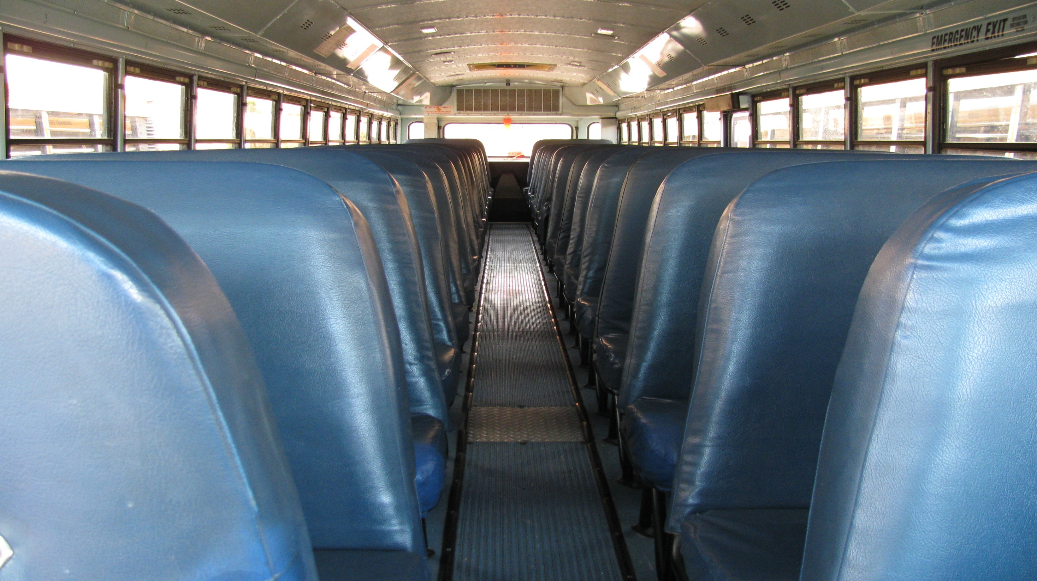
Procedure #6
Walk Thru

Slide 56
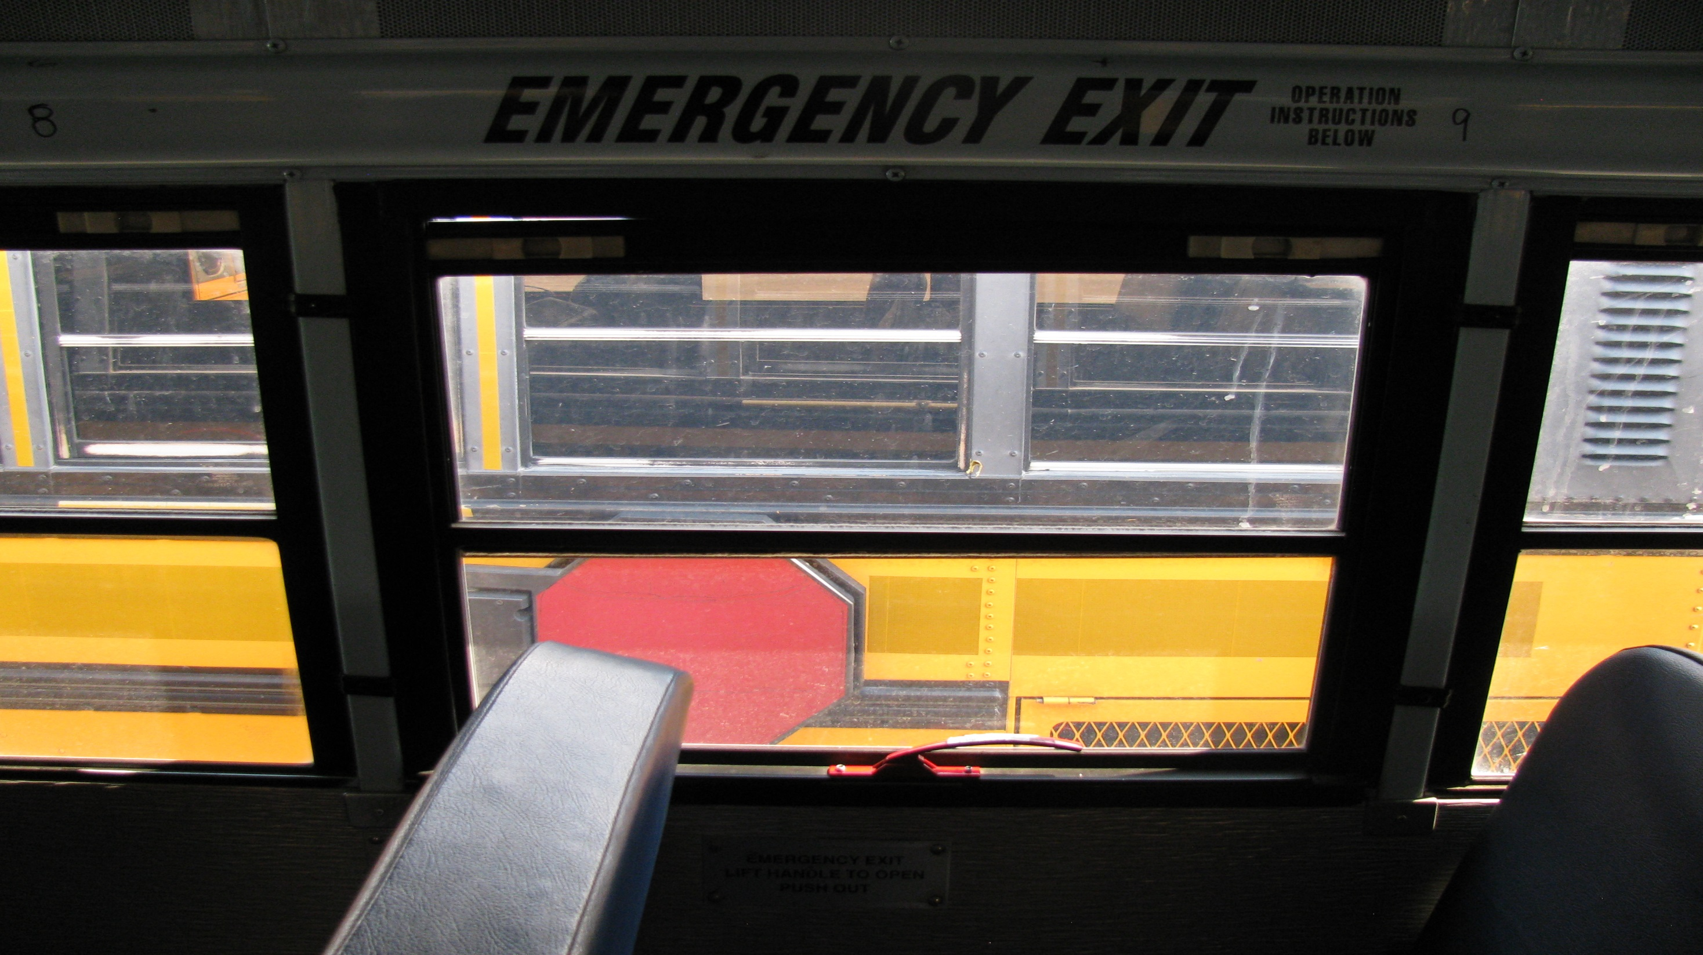
Checks that all emergency exits are clearly labeled.
Checks that the operating instructions are clearly posted.
Checks that all emergency exits open and close freely without binding.
Checks that emergency exit warning devices are working.
Check that all emergency exits are free from any obstructions.

Slide 57
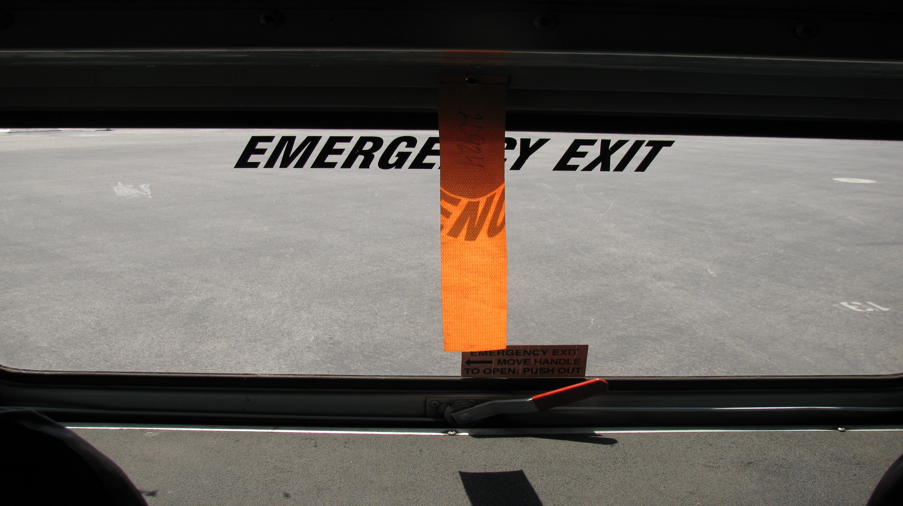
Flag
Remove and bring to the front of the bus before leaving yard.
Note: This indicates that the driver performed a walk thru search for students and their belongings. If you see a bus in the yard with out a flag hung in the rear window, please check that bus out and hang the flag!

Slide 58
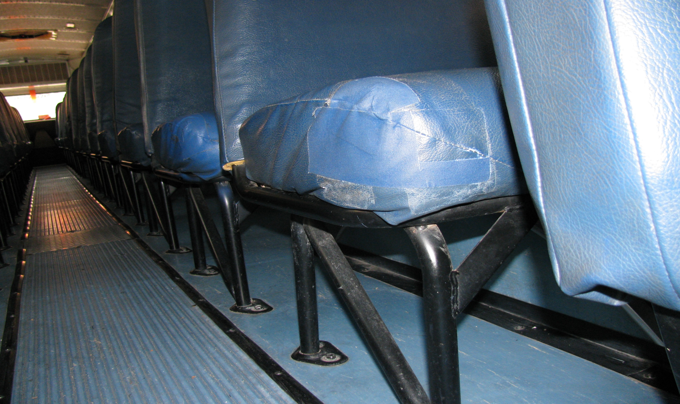
Seats (Top and Bottom)
Checks that there are no broken seat frames and that the frames are firmly attached to the floor.
Checks that the seat cushions are secure to the frames, and not damaged.

Slide 59
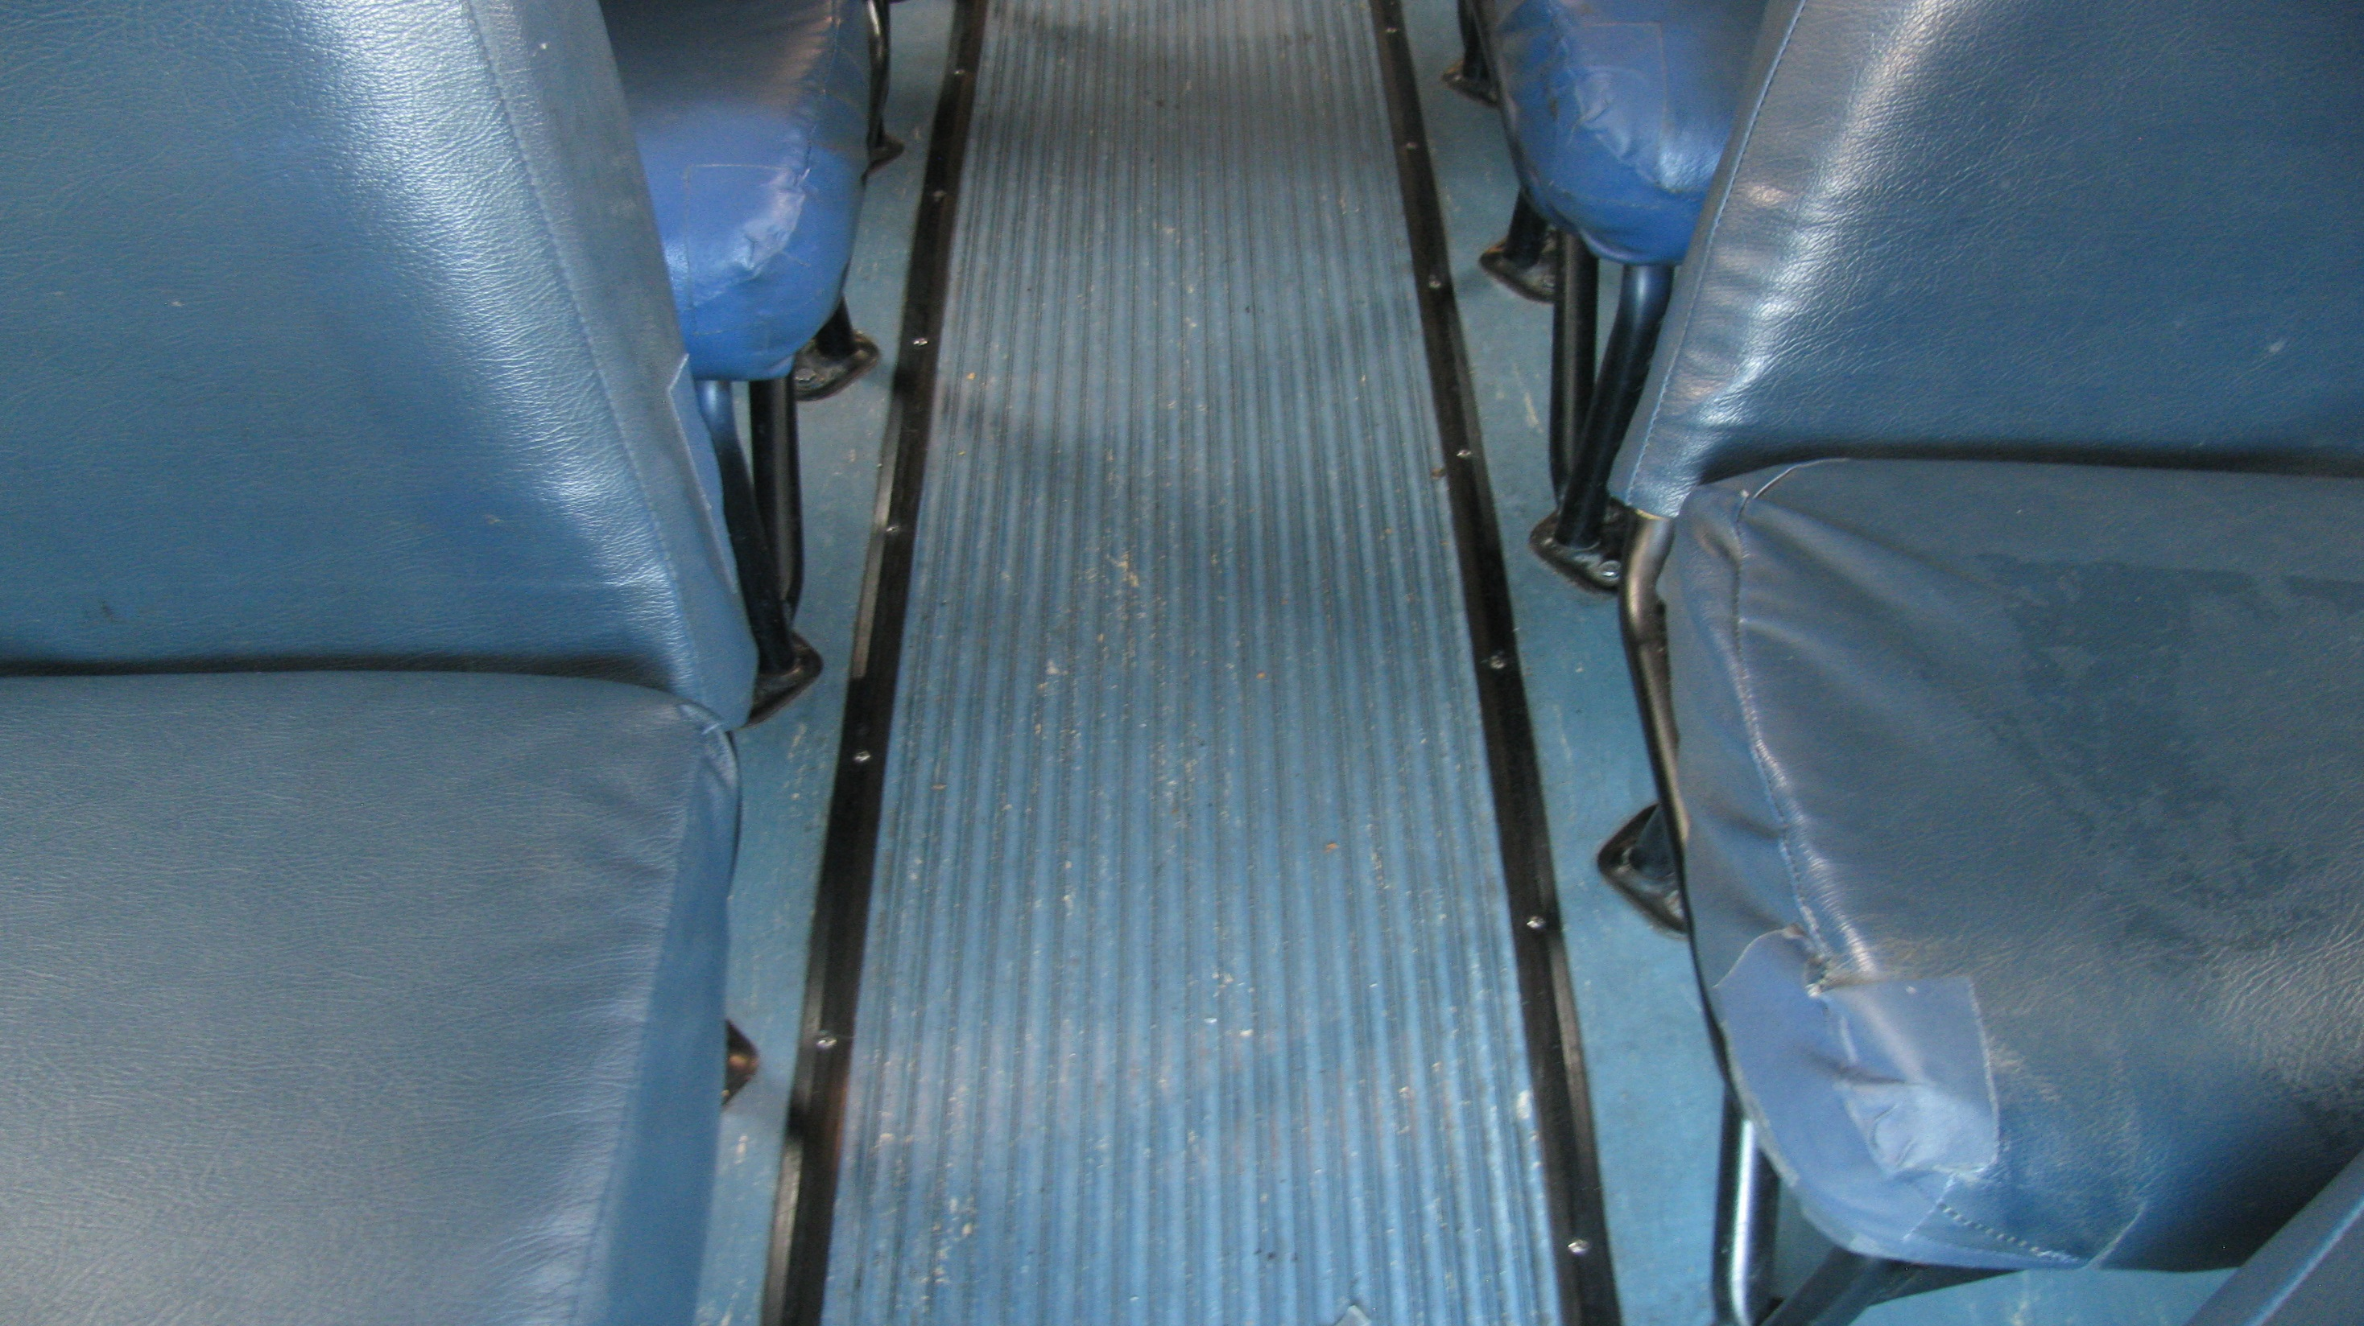
Floor
Checks that all flooring (walk matting, etc.) is secure and in good condition.

Slide 60
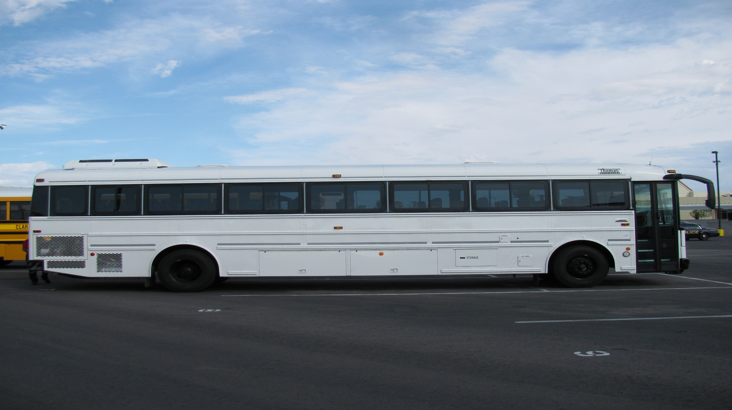
The End

