Slide 1
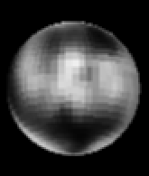
CHARON
Pluto’s Largest Satellite

Slide 2
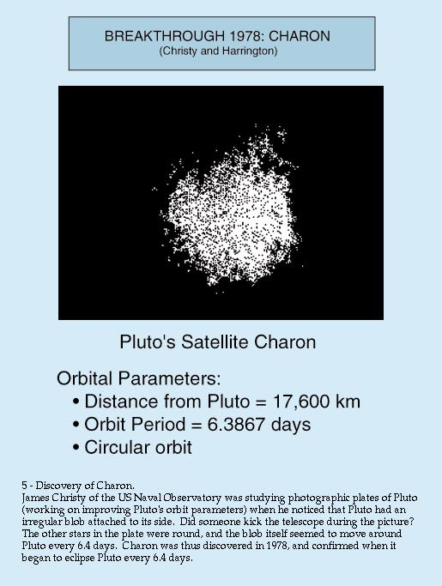
Discovery
James Christy
June 22, 1978
US Naval Observatory, Flagstaff, AZ
Discovered as a “bulge” on Pluto
Eclipse from 1985 to 1990

Slide 3
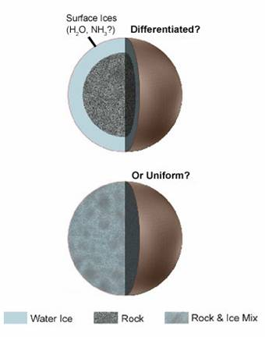
Surface Characteristics
Radius: Roughly one-tenth of Earth’s
Mass: (1.52 ± 0.06) × 10²¹ Kg
Temperature: -220 degrees Celsius (53 K)
Surface material: Ice
“Cryovolcanism”
Frigid geysers

Slide 4
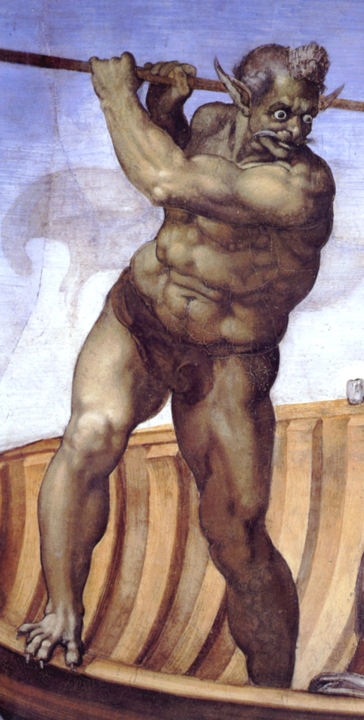
Naming the Satellite
The Ferryman of the Dead
S/1978 P 1
Charlene “Char” Christy
Proposed but rejected: Persephone (Pluto’s wife)
Different pronunciations

Slide 5
Problems with Charon
Pluto and Charon orbit one another
External center of mass
2006 IAU re-definition
“Double Planet”

Slide 6
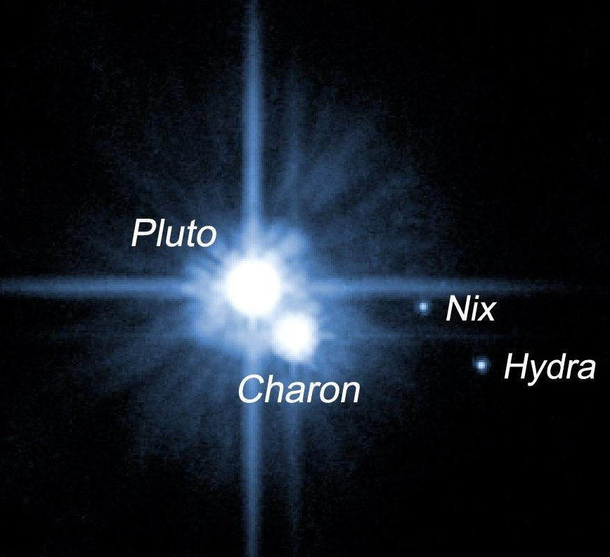
Other Satellites of Pluto
Nix
Hydra
Discovered: June 2005 by Pluto Companion Search Team
Not spherical
Both follow Charon’s orbit

Slide 7
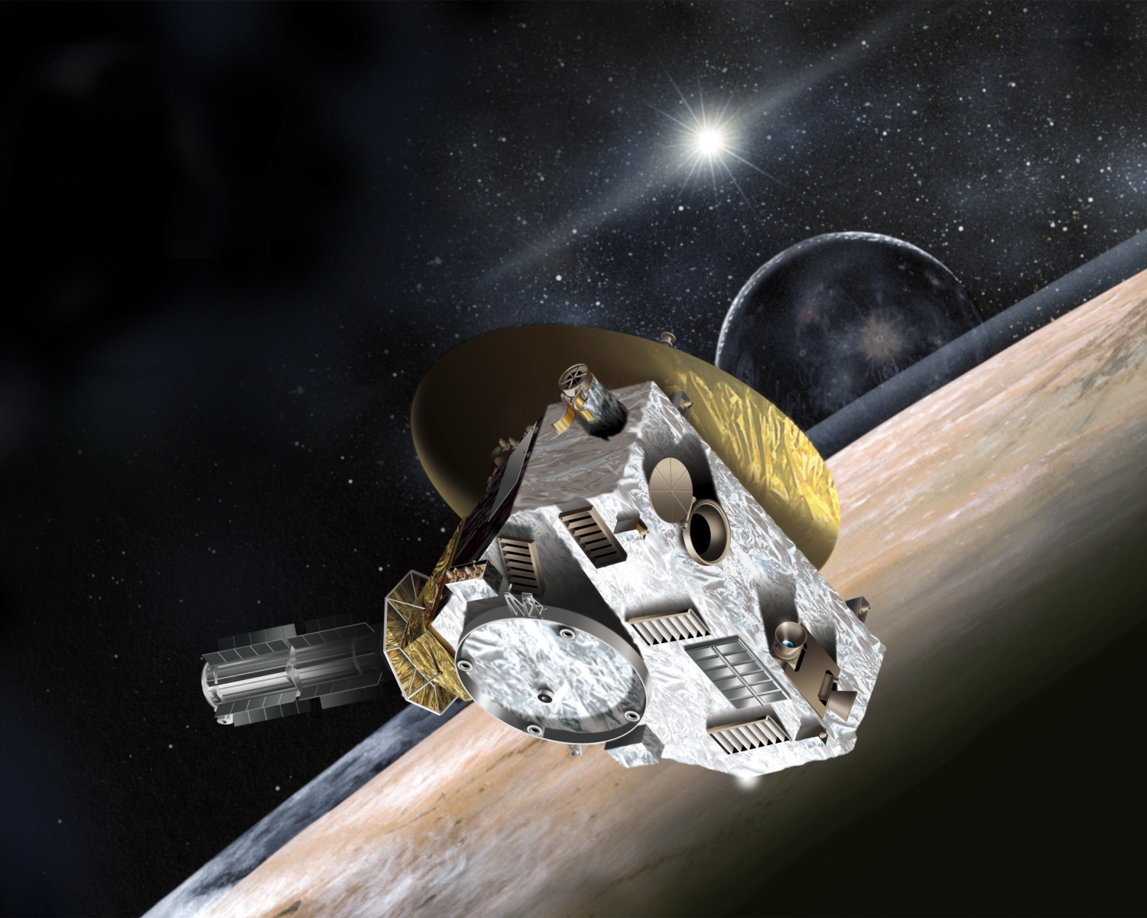
New Horizons
Future mission to Pluto
Launched January 19th 2006, expected to arrive 2015
First mission to study Pluto and its moons
Will also study the Kuiper Asteroid Belt

Slide 8
References
http://adsabs.harvard.edu//full/seri/AJ.../0083//0001005.000.html
http://pluto.jhuapl.edu/
http://www.spaceflightnow.com/news/n0707/17charon/

