Slide 1
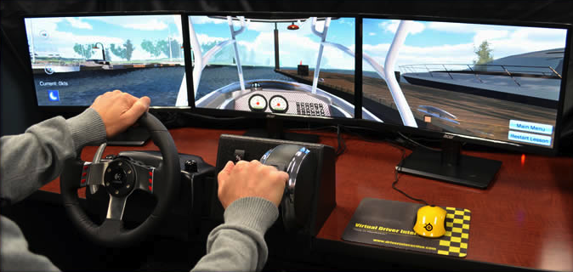
Boating Skills Virtual Trainer
P/R/C Bob Palmer, SN and
P/C Lisa Herndon, AP
USPS Jacksonville Annual Meeting
January 23, 2015

Slide 2
Agenda
Background
Current Status and new functionality
Resources for ordering and usage
Issues and Concerns
Next steps
Incorporating BSVT into USPS education
Troubleshooting and set-up/tear-down

Slide 3
Background
USPS was awarded a $215k grant by the Coast Guard in 2013 to develop a Boating Skills Virtual Trainer
First training simulator of its kind for the recreational boater with educational exercises modeled to complement USPS Practical On The Water training
Grant one funded five units which were delivered mid-year 2014 and an extra unit delivered Sept.
Grant two ($200k) funds an additional seven units for a total of thirteen in the fleet
Nine units now available for reservation
Notes:
USPS team:
R/C Bob Palmer Project Director
P/C Lisa Herndon, Project Manager
Tim Tate,
John Malatak, Partner liaison
Chris Windeler – Scott MacDonald
James Runge – now John Kern
Legal Officer David Allen
USPS HQ staff Tammy Brown, Marketing
SueLee Tang, Outreach liasion to the Coast Guard
Everyone in the Raleigh area who came into help with the testing evaluations:

Slide 4
Features and Functionality
Hardware includes three 20” monitors, steering wheel, horn and Mercury Marine throttle with trim controls
Buttons on the wheel provide “slewing” of vision
Gen 2 now provides full 360 degree view and “locks” for stern backing maneuvers
New Multi-lingual capabilities – now equipped for French and Spanish

Slide 5
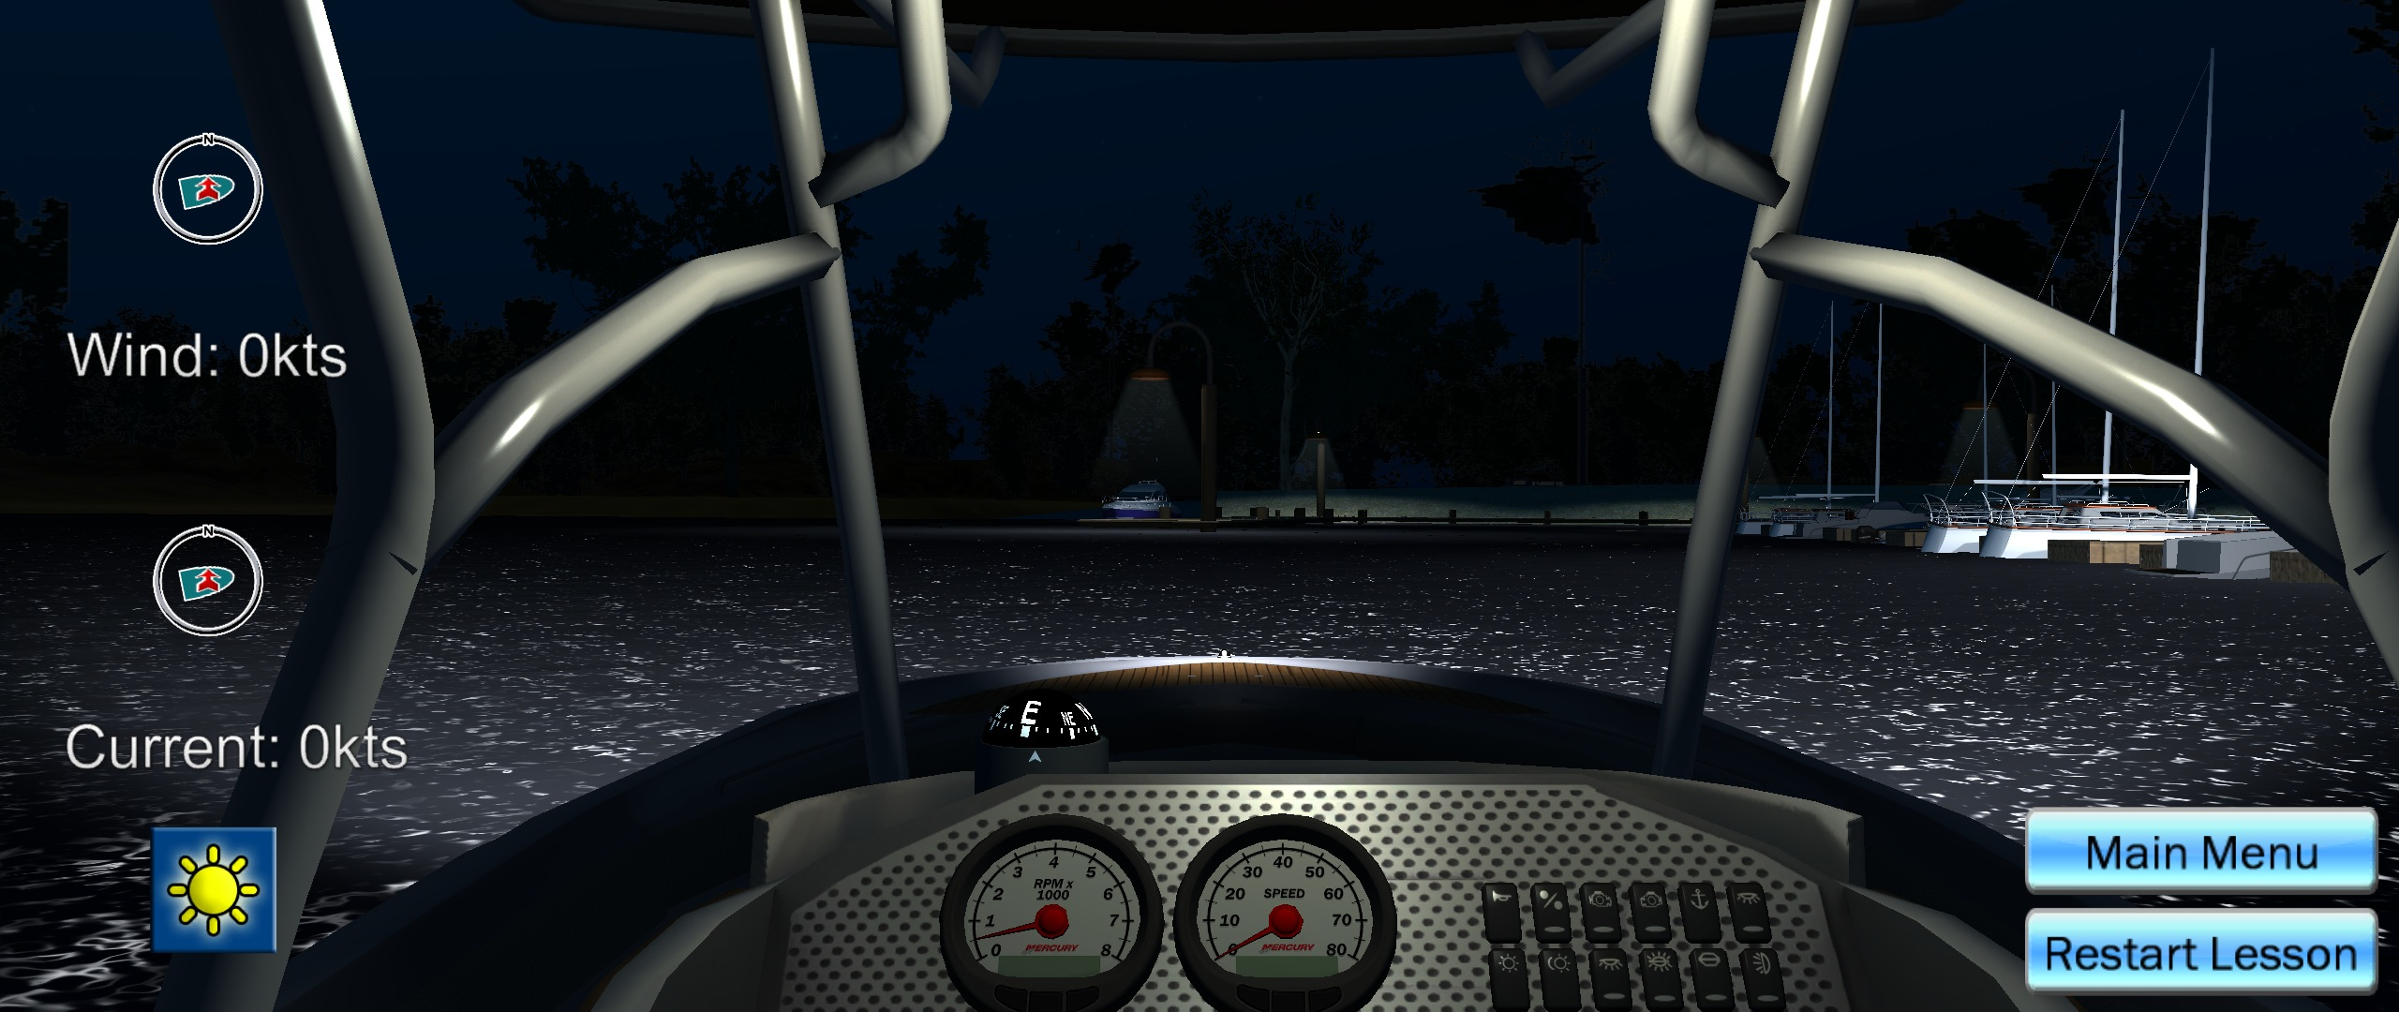
Features and Functionality
Ability to set direction and velocity of current and wind and day/night scenarios

Slide 6
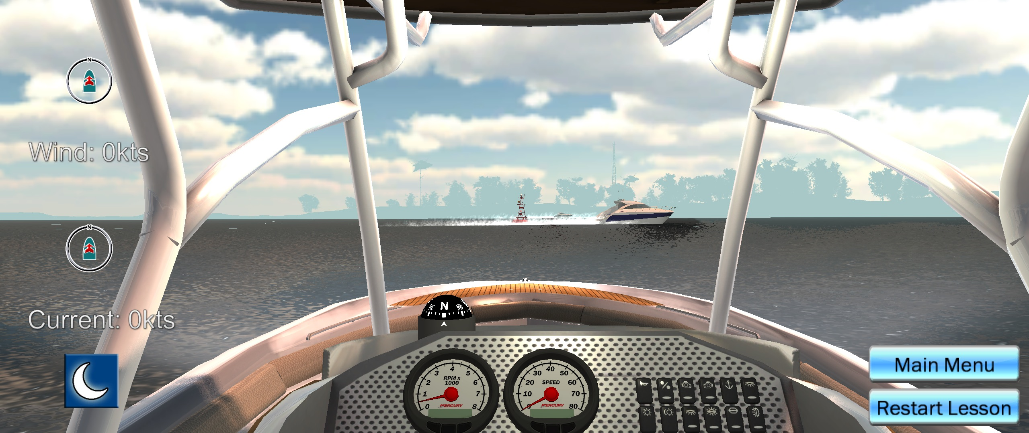
Features and Functionality
Virtual working compass, speedometer and RPM gauge

Slide 7
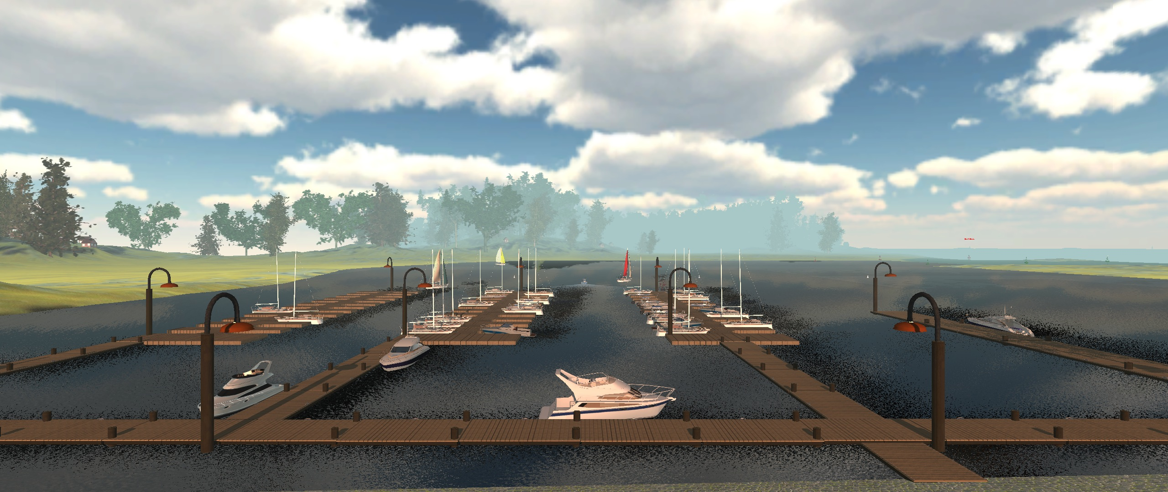
Features and Functionality
Enhanced Environment includes a full marina for docking scenarios

Slide 8
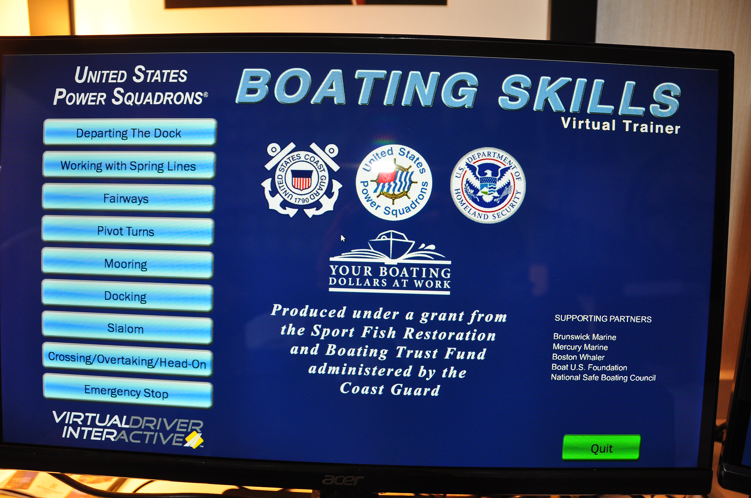
Features and Functionality
Current Exercises are based on POTW and Designed to be Instructor led
Departing dock
Spring lines
Maneuvering in Fairways
Pivot Turn
Mooring
Docking
Slalom Course
Crossing/Overtaking/Head-On
Emergency Stop
All exercises can be done at night with nav lights

Slide 9
NEW Gen 2 Features and Functionality
Range Marker
Mid-Channel
Marker
Day Mark
Additional nav aids including range markers and additional day marks for piloting

Slide 10
NEW Gen 2 Features and Functionality
People in Water
Man Overboard
Beach scene to support new boating standards work
Man overboard

Slide 11
Billboards added for in-product branding and special messaging
NEW Gen 2 Features and Functionality
Billboard w/
USPS message

Slide 12
NEW Gen 2 Features and Functionality
Additional developments underway for debut at International Boating & Water Safety Summit in April 2015
Exercises added to menu for man overboard and beaching
“Mini-map” to show placement on lake
Timer and stop watch
Internal survey – funding dependent

Slide 13
2014 Activities
USPS HQ showed BSVT units at major shows:
International Boating & Water Safety Summit
Tall Ships
NASBLA
Marine Dealers Association
Ft. Lauderdale Boat Show
Annapolis Boat Show
Canadian Power Squadron conference
USPS Governing Board - Crystal City
USPS Annual Meeting – Jacksonville
USPS/CPS receive Canada’s Marine Innovation Award

Slide 14
Current Activities
Districts and Squadrons actively reserving units for their meetings
Currently no usage fee – only actual shipping which averages $115-$175 one way
A late fee may be instituted due to inconvenience for downstream reservations
Reserve up to 14 days for named events
Include estimated number of event participants with reservation for USCG tracking

Slide 15
Current Tools and Support
Internal website for making reservations and accessing support tools and documents:
www.usps.org/php/bsvt
View calendar and unit availability
Make reservations through this site ONLY
Download instructor manual
Download assembly and operations manual
Download promo flyer and template for stickers
Download tally/survey sheet for Coast Guard tracking
View 12 minute assembly tutorial video
Troubleshooting documents added as needed
Banners to accompany units are in development
Use this site days and weeks before delivery!

Slide 16
Technical Support
Virtual Driver Interactive Help Desk is available M-F 8:30-4:00 Pacific time
Outside of work hours leave a message for call back
Do NOT try to manipulate the unit without direction from technical support – could invalidate the warranty
877-746-8332 option 3
Now about those technical issues……

Slide 17
The good, the bad and the ugly…
The good: the units are out and in use and drawing great crowds and interest
The bad: a few technical issues arose and troubleshooting docs were developed
Order of setup and shutdown are very important to keep screen programming correct
Throttle and steering calibration should only be adjusted with VDI support
Cases were all retrofitted with extra foam and units were all sent through for “locktight”
Workarounds/clamps to address varying table widths
The ugly: Not nearly as ugly now!!

Slide 18
Now we can use different tables!
Future units will have expanded “ledge” which can be used to clamp to thicker tables

Slide 19
BSVT Units Available for Sale
Contact USPS HQ Customer Service and they will fill out information for VDI sales referral – some districts applying for grants
Internal USPS/CGA/CPS price: $14,900 for delivery in temporary boxes
Price for external organizations: $18,900. Customization available for additional development costs
Permanent Pelican case available for $1850 (total for 3 cases/unit)

Slide 20
External Tools and Activities
External website for sharing videos with the public at the VDI site:
www.usps.org/boatingskillsvt
View videos
External Organizations who would like to purchase a unit may fill out a form for contact
Canadian Power Squadron has purchased a unit
VA Department of Game and Inland Fisheries has purchased a unit
SC DNR is outfitting a BSVT mobile unit

Slide 21
Your important responsibilities
Your feedback is vital for continued development of the BSVT
Functionality
Maintenance
Clarity and ease of assembly/disassembly
User comments
Your feedback of the actual user experience is critical for Coast Guard tracking and continued support
Currently a very manual process; looking for options through website, apps, BSVT internal

Slide 22
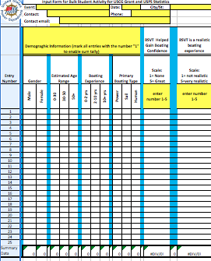
The Coast Guard tally sheet
Five entries to be completed by observer:
By observation:
Gender (M/F)
Age (0-30, 31-50, 50+)
3 questions for the driver:
How many years have you driven a boat? (0-5, 6-10, 10+)
Scale 1-5, How much did BSVT improve your confidence? (1= none; 5= great)
Scale 1-5, How realistic was the BSVT boating experience? (1= not realistic, 5= very realistic)

Slide 23
Post-Show and Return responsibilities
Process for Tally sheet return and upload still in development
Currently please email: lisa@herndon.net with forms, totals and comments
Most important item for tracking is number of BSVT users at each event

Slide 24
Next Steps in 2015
Apply for Grant three!
Roll out final three units
When released and stable, some units may be geographically dispersed
Roll out new software for steamlining HQ tracking, calendar and notifications
Debut remaining Gen 2 functionality at IBWSS
Upgrade all units to latest Gen 2 features (May-June)

Slide 25
Next on Program: Incorporating BSVT into USPS Educational Programs

Slide 26
Making Class Connections
After final 13 rollout, make the connections with advanced grade courses
In addition to the maneuver lesson, begin to create lesson plans to match OTW elements
Begin to coordinate with course manual revision and coordinate with future BOC strategies

Slide 27
ABC3
Basic Rules of the Road
Buoys and bearings
Hull trim
Boat Speeds
Center of Rotation/Pivot Point
Undocking
Horn and whistle signals

Slide 28
Seamanship
BOC IN Level
Steering
Forward and Reverse
Rules of the Road
Man overboard
Moorings
Wakes

Slide 29
Piloting
BOC CN Level
Bearings
60D=ST
Ranges
Fixes
Positioning
Routes

Slide 30
Advanced Piloting
BOC ACN
Impact of current
Impact of wind
Seaman’s Eye
Avoidance Techniques

Slide 31
Create Your Own
Access beach
Crossing/overtaking/meeting

Slide 32
Pre Training for POTW
All POTW Maneuvers are included except Anchoring
Year round opportunities to hone and refine skills in classroom
While waiting for good weather
While waiting for qualified Certifiers
While waiting for a boat

Slide 33
Pre Training for ANSI/ABYC Stds
USCG Grant Developed Standards
BSVT models of most/all proposed 38 standards
For novice boater
For Small Boat Handling Skills
Adaptable as Standards change

Slide 34
Questions? Stay for set-up/tear-down demonstration

